Slide 1
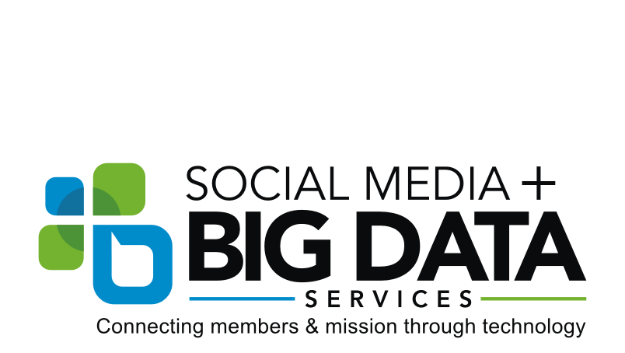
#RSPeace – Chesapeake Conference Digital Strategy Summary Report Jamie Schneider, Digital Strategist

Slide 2
Empowering Our Community
Notes:
Revelation Speaks Peace is a case study in empowering the SDA community to be social media ambassadors for Christ.

Slide 3
Creating Social Media Ambassadors
Notes:
How often do we do host evangelistic series but struggle to make sure the Adventist community is aware? Social media is a powerful tool for creating awareness within our own community to empower them to be social media ambassadors, resulting in something tangible such as increased attendance by non-Adventists.

Slide 4
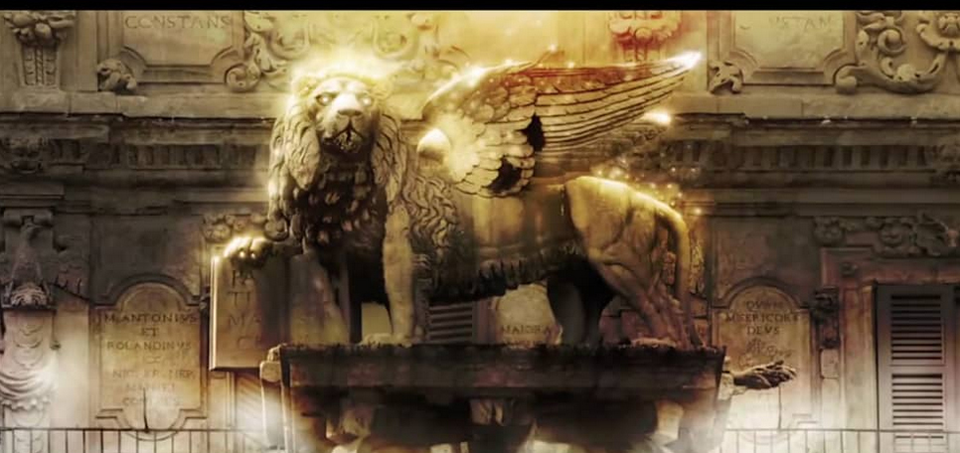
#RSpeace
Highlights:
Facebook Accounts Reached in Maryland: 827,456
Paid Ad Engagements (shares, likes, comments, reactions): 31,605
Total Video Views over 3 seconds on Facebook: 12,389
Overall website visits (sessions): 18,078 - 52.79% as a result of social media
Total Spent: $4,826.25

Slide 5
#RSpeace
The church knows from experience that evangelism works best when there is a foundation built on relationships.
Event Summary:
Free, multi-week prophecy series
Hosted in 33 churches
Registered online or in person
Started a dedicated Facebook page - 2,127 followers as of 01.19.17
- 70% women; predominately mobile devices
Placed paid ads promoting the event
Select sessions live-streamed
Follow-up strategy via the local church
Notes:
The church knows from experience that evangelism works best when there is a foundation built on relationships. The Chesapeake conference recently piloted the voice of prophecy series ‘Revelation Speaks Peace’ in 30 churches.

Slide 6
#RSpeace
Campaign Strategy
Launched a 4 week awareness campaign
After the start of the event, continued with an engagement campaign
Promoted mostly through Facebook
Churches also promoted via email, bulletins, flyers, and signs
Posted one video
Live-streamed three sessions from page, and shared live-stream links from host church pages
Boosted select posts and ran targeted ads
Campaign was shaped by conclusions drawn from data science analysis of the Facebook data output for reach and engagement

Slide 7
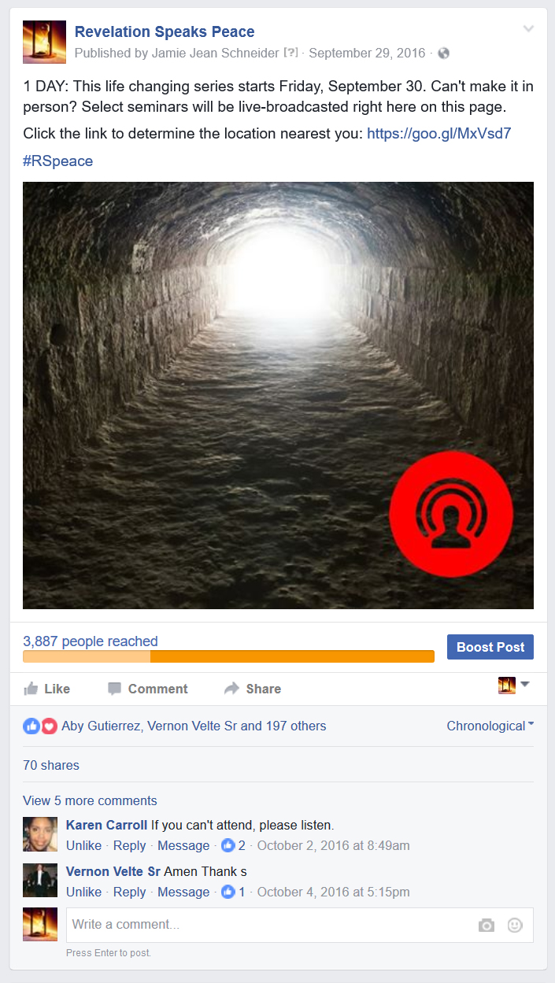
#RSpeace
Video Performance
Total video views: 12,389
Minutes viewed: 4,591 (76.5 hours/3.2 days)
The live video performance was improving with time, it would have been great to live-stream more of the programs.
Whoever takes over the Facebook page next could live stream more sessions and build off of the current following for this series.

Slide 8
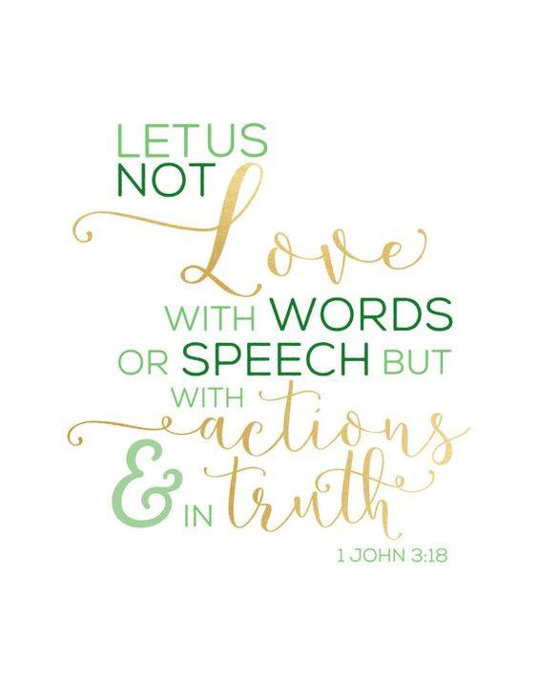
#RSpeace
Partnership
The NAD digital strategist trained a staff member at the Chesapeake conference to implement the content, engagement, and live-stream strategy
Weekly check-ins and data evaluations
Goal was to empower the staff member to implement similar strategies in the future
Paid ads were predominately ran by the NAD digital strategist.

Slide 9
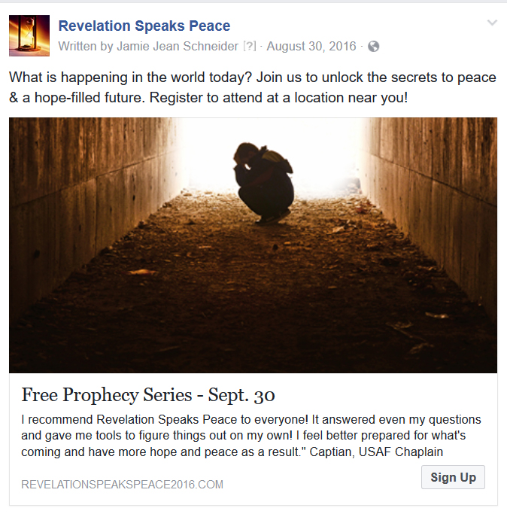
#RSpeace
Two Target Groups for Paid Ads:
Group 1: Local Adventists in the community, with
the hopes that they would spread the word.
Group 2: Locals interested in: Bible, Bible prophecy, Christianity, Prophecy, Spirituality, and religion. We excluded SDAs from this target group.
We did not target atheists or other groups that may require special messaging due to limited budget. We targeted the ‘low hanging fruit,’ and our own people with the goal of empowering them to act as social media ambassadors for the series.

Slide 10
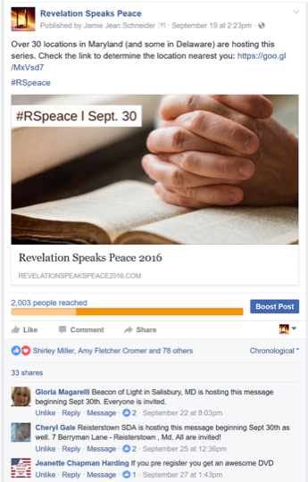
#RSpeace
827K +
7.8% CTR
Notes:
It worked. No prep, no coaching. The SDA community was ready and willing to share about this series to their networks, and based on the relationships they have been cultivating, they most likely know where the ‘rip fruit’ are and who to invite. They actively shared our ads and tagged community members promoting the event to their friends. We did also targeted ads to people who were Christian and/or interested in prophecy. So we had two different advertising target groups that both performed well for different reasons. Overall, we reached a over 827K ad impressions served to people in Maryland with an 7.8% click-through rate. Which means that 7.8% of people who saw the ads took action. A typical direct mail response rate is about 1%.

Slide 11
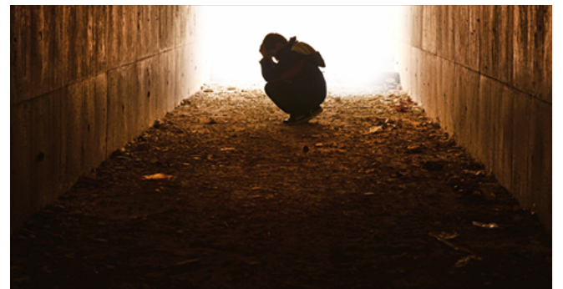
#RSpeace
We also tested the provided imagery against stock images that evoked emotion. Copy was the same for each ad.

Slide 12
#RSpeace
Stock images from Facebook
2.15%
2.61%
2.83%
For the Non-Adventist group, the above images had the strongest click-through rates, and/or highest relevance rating. Each image evokes a sense of conflict, journey, and/or loss of hope.
This ties directly into the message: What is happening in the world today? Join us to unlock the secrets to peace & a hope-filled future. Register to attend at a location near you!

Slide 13
#RSpeace
Stock images from Facebook
Provided images
3.77%
3.53%
3.42%
3.28%
For the Adventist group, the above images had the strongest click-through rates, and/or highest relevance rating. Here we see more of a mix between the stock images and the classic Adventist imagery. The strong performance of more traditional Adventist imagery may be due to ‘brand awareness’ among our members. Having said that, the stock imagery did outperform the Adventist branded images even among Adventists.

Slide 14
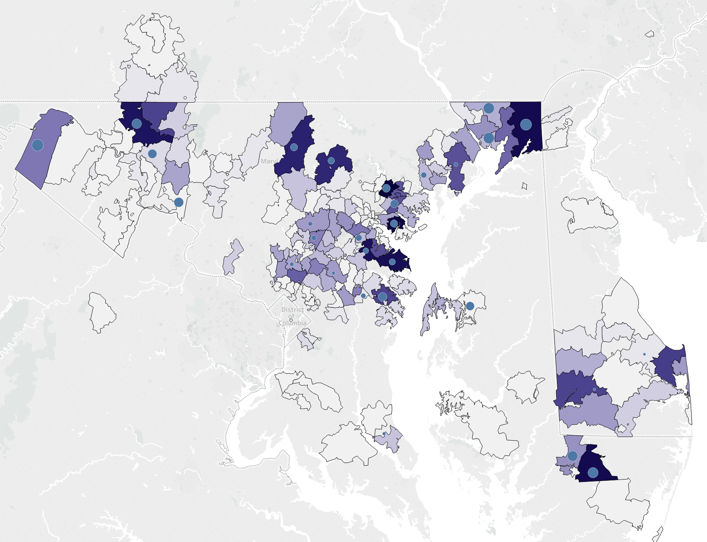
#RSpeace
All of our ads were targeted to Maryland. However when we compared registration zip codes to the location of each host church, we found that people generally did not travel more than 15 miles.
Conclusion: For similar campaigns in the future, geo-target within 20 miles of each church city instead of the entire state to maximize impact/conversion.
Blue dot = host church; Purple = registration by zip code

Slide 15
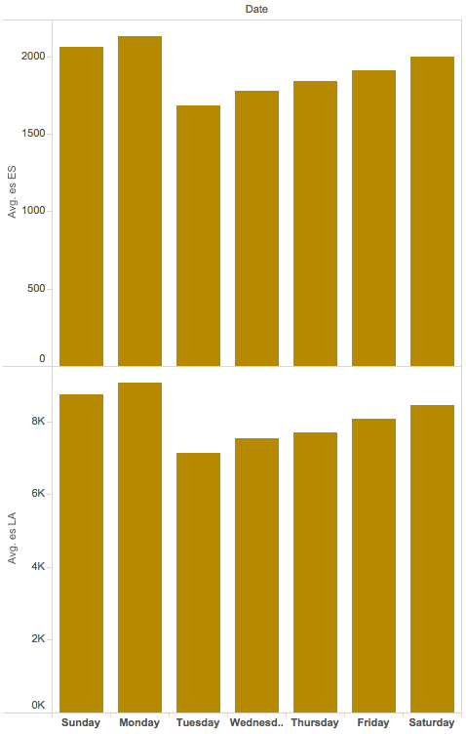
#RSpeace
The following figure shows the total page reach for Spanish-speaking users on Facebook. As you can see, the numbers are high, but none of the locations offered the series in Spanish.
Future evangelistic campaigns in Maryland should also be offered in Spanish.
Harvey Alférez, data scientist

Slide 16
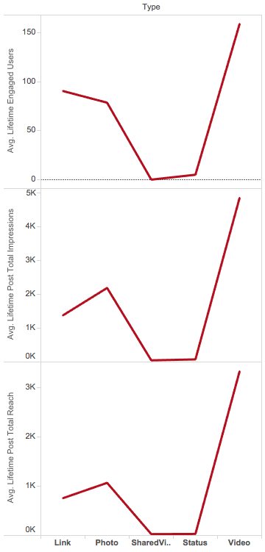
#RSpeace
Videos are still the top type of posts to engage users. Future social media campaigns should use more video.
Harvey Alférez, data scientist

Slide 17
#RSpeace
People tended to like the page on Tuesday, so we began publishing additional posts and ads on Tuesday to try and get more likes.
However, the result in the above figure is not correlated with the day with most of page posts views, which is Wednesday (see below figure). This means that although a lot of people see page posts on Wednesday, they don’t tend to push the “like” button on that day. Therefore we encourage people to like our page more on Wednesday.
Harvey Alférez, data scientist

Slide 18
#RSpeace
The average daily reach of page posts tends to correlate well with the average daily total impressions and the number of times people have given positive feedback to the page (see below figures.) In other words, a higher daily reach is connected to a higher number of impressions and a higher number of positive feedbacks. Harvey Alférez, data scientist

Slide 19
#RSpeace
The Facebook page and reach was much more popular among women (70%). The average number of women of all ages talking about the page tended to decrease as the week passed (see below figure). In fact, the lowest result of women talking about the page is during mid-week. Strategies could be tried to increase women’s activity on Tuesday, Wednesday and Thursday (maybe with posts specifically focused on them).
It’s interesting to see that male are more variant than women when talking about the page (see below figure). Therefore, no conclusion can be given about the tendency of men talking about the page with this data. In general we do need to appeal more to men with this series.
Harvey Alférez, data scientist

Slide 20
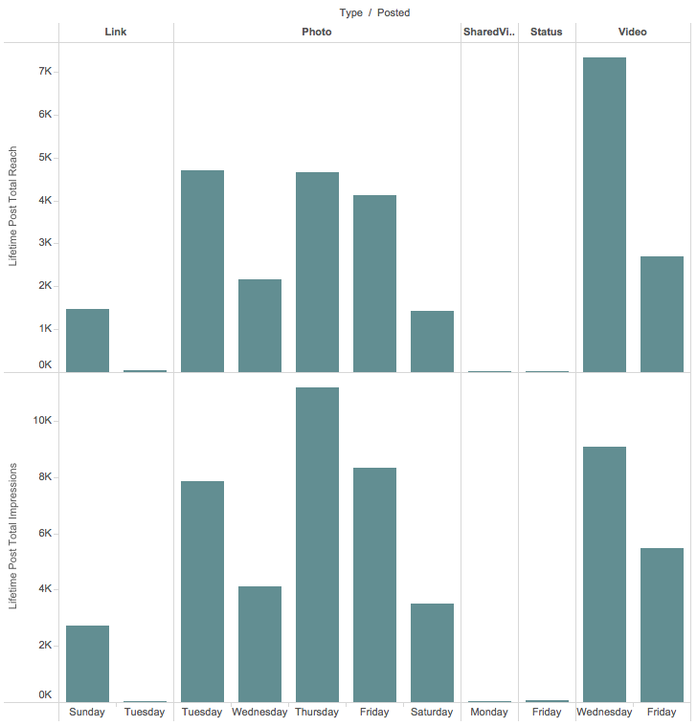
#RSpeace
There is a high correlation between total reach and total impressions on Facebook.
Harvey Alférez, data scientist

Slide 21
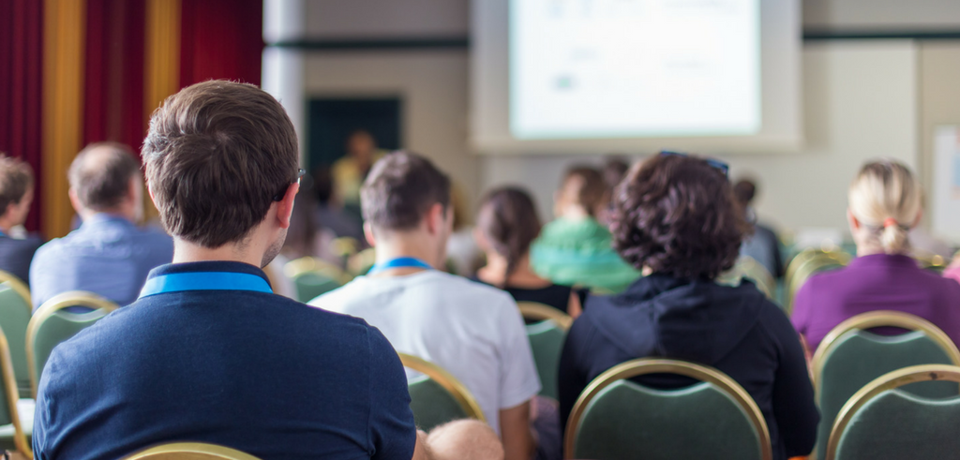
#RSpeace
78.5% over 44
Notes:
These types of series do appeal to an older audience which is confirmed by the survey where 79% of participants identified as being over 44 y.o. This may cause you to question our decision to use social media ads.

Slide 22
#RSpeace
Notes:
Even though we used Facebooks ad manager, our ads appeared mostly on third party websites that appealed to this particular demographic. So with a small budget, we were able to promote this series to an older audience (in Maryland) on websites like Washington Post and Huffington Post while still being cost-effective. I point this out because many are not aware of this feature in Facebook ads manager.

Slide 23
#RSpeace
Website Summary:
Time Frame: August 21-November 30
Traffic from Social Media: 52.79%
- This is huge and most likely directly impacted attendance
Users: 9,671
- Would live-streaming more seminars engage more of these people? Who are we excluded from this series by not live -streaming? What about people who live too far away or are confined to their homes?
Sessions: 18,078
Pageviews: 36,339
Pages/Session: 2.01
Average Session Duration: 1:36
Bounce Rate: 73.62%
- Industry standard good is 60%, so this is a bit high
Sessions on Mobile/Tablet: 62.20% - It’s important to make sure the website and registration is mobile friendly

Slide 24
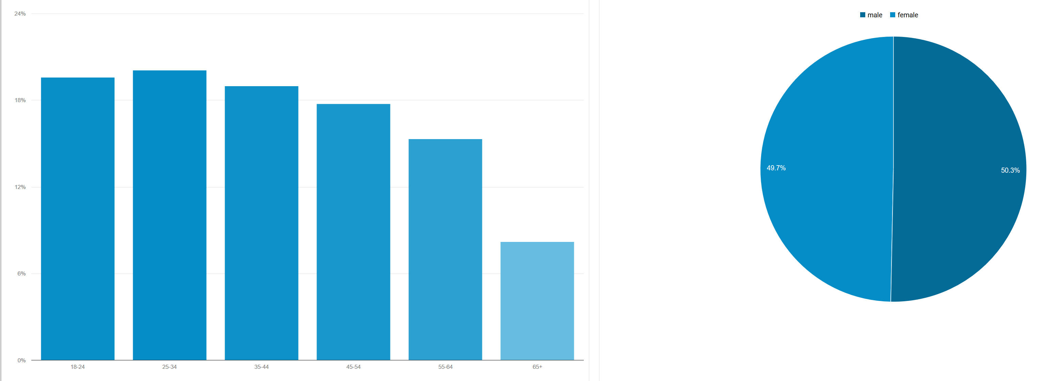
#RSpeace
58.69% of visitors to the website were under 44 but 79% of those who attended were over 44. So why are we losing the younger audience? Can different, more modern imagery bring them in? Or a shorter format that speaks to this target audience. Both? What is for certain is that these two audiences (under and over 44) prefer different imagery, topics, and messaging.

Slide 25
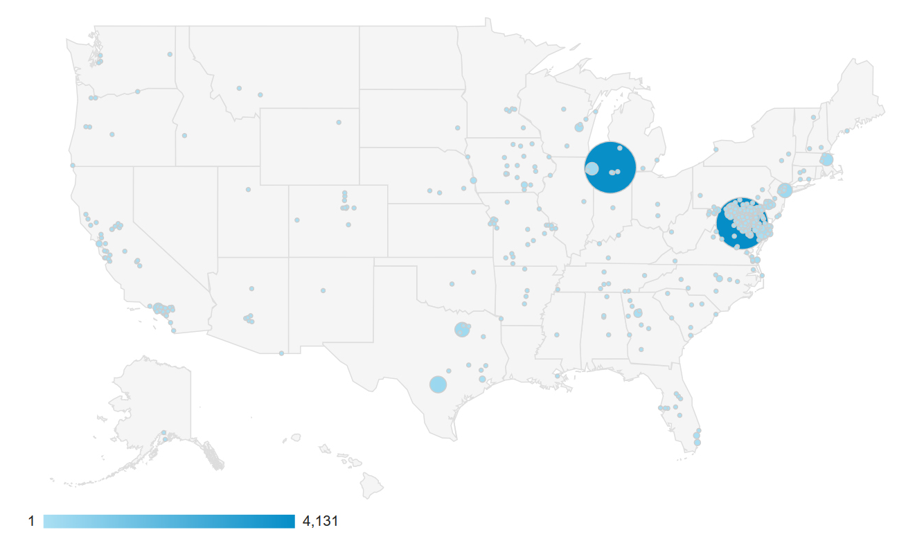
#RSpeace
Website influence: This map represents the location of visitors to the website, concentrated in two hot spots: Maryland and Andrews (location of the call center.) The rest of the reach is most likely organic.

Slide 26
#RSpeace
1,500 Participants*
How many were not Adventist?
50%
*Participant number is not final, still missing data from select churches
Notes:
Now for the results….Of the approximately 1,500 registered participants, 50% self-identified as non-Adventist. This is confirmed by the survey results. Normally we would not expect more than a 1/3 of the participants to be non-Adventist (based on conversations I’ve had with experienced pastors and evangelists).

Slide 27
#RSpeace
A Survey was sent to the available email addresses of registrants:
903 total invitations; 211 responses; 23.4% response-rate
Non-Adventist: over 70%
28.9% male; 71.1% Female
78.5% over age 44
Sessions Attended:
1-3: 14.8%
3-7: 21.5%
7-12: 21.5%
13+ (but not all): 21.5%
Entire Series: 20.7%
69% would recommend the series to a friend or family member
61.5% rated the series as ‘excellent’; 28.2% rated the series as ‘very good’
76.3% said the series was the right length (verses too long or too short)
52.6% said the series was ‘extremely organized’; 43.7% said ‘very organized’
73.3% said the series was ‘better or a lot better than expected’
92.6% said that the information was presented in a clear and understandable way
Overall the series received VERY positive feedback!

Slide 28
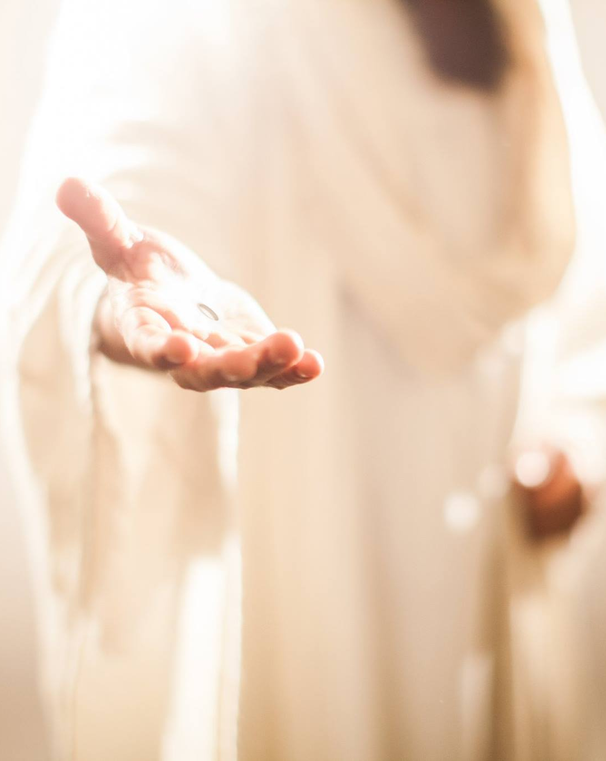
Evaluating Impact Part 1
#RSpeace
71.9% of survey respondents that said that they were likely to visit an Adventist church or Bible study again?
71.1% said their questions were answered; 23.7% said some questions were answered
82.2% said at least some of the information was new to them
79.3% said they were ‘very satisfied’ with the information presented
Notes:
In this case study, we had a strong product and an integrated strategy that utilized targeted online ads. But impact is more than getting people in the door. How did this series affect those who came? Of our survey respondents…

Slide 29
Evaluating Impact Part 2 – Positive Response
#RSpeace
Did this presentation cause you to think more about the significance of the Bible and prophecy?
Did this presentation inspire conversations with your friends or family about Bible prophecy?
93%
91%
Did this presentation increase your faith in the truth of the Bible?
86%
Notes:
Given that over 70% of those who took the survey, indicated that they were not Adventist, these results are great!

Slide 30
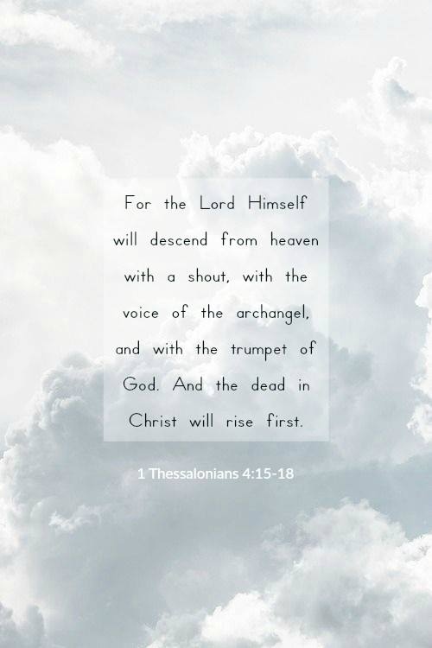
#RSpeace
Recommendations for Future Campaigns:
Geo-target paid Facebook ads to within 20 miles of each location
Use fresher more modern images that evoke an emotional response
Offer the series in Spanish if there is a large Hispanic community or in another popular language for the region
Continue using Facebook Ads manager to promote via audience network ads
Live-stream more sessions, use more video overall
Plan to host live Q&A via Facebook and promote in advance
Determine the best route to help churches submit the data to enable us to better evaluate performance
It would be great if the individual churches promoted more via their social media channels as well as the conferences social media channels
Use this data as comparative data to evaluate the performance of the next Revelation Speaks Peace or similar series

Slide 31
Questions?
Follow @DigiEvangelism on Facebook, Twitter, and Instagram for tips, courses, resources, and videos. Or visit SDAdata.org and subscribe.
Alvin Kibble, Vice President
alvinkibble@nadadventist.org
Paul Hopkins, Director
paulhopkins@nadadventist.org
Jamie Schneider, Digital Strategist
jamieschneider@nadadventist.org
Notes:
Feel free to contact us for any questions you may have.

