Slide 2
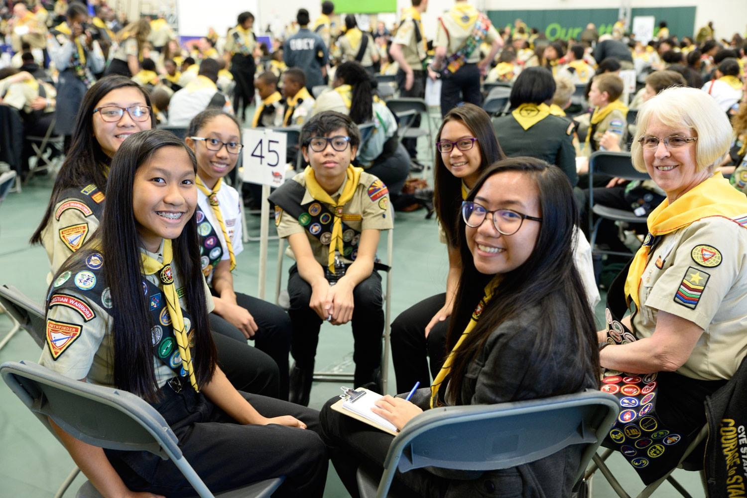
NAD Pathfinder Bible Experience 2017
Notes:
Our Pathfinder ministry is the biggest, most structured and effective youth ministry in our church! It ministers to young people ages 10-16 years old, thus it’s a ministry targeting young people in the transitional years of their lives. For over 50 years, Pathfinder ministry has evolved and morphed to better serve and equip our young people. Programs like the Teen Leadership Training program have emerged to help young people follow and lead in our church better. Another program that has grown in the last few years is the Pathfinder Bible Experience program, which is a Bible testing event.
Pathfinder Bible Experience is a program that involves a team of up to 6 Pathfinders memorizing and learning about certain books of the Bible. These teams are tested at the area level. If they achieve over 90% correct answers, they move onto the Conference level. There is also a Union level and finally the Division level. This year the Division leader was held on April 21, 22 in the Chicago area.

Slide 3
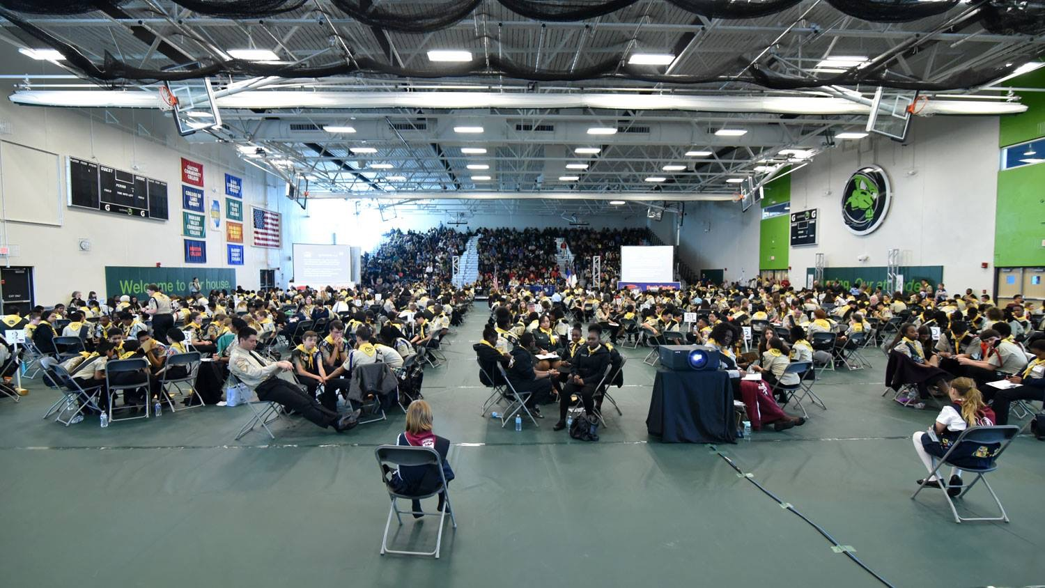
Over 2,000 in Attendance
Great Event
Notes:
Over 15,000 Pathfinders start the path to Division level at the area level. At the Division level event, we had around 600 Pathfinders. Also, this event brings families and clubs together in support of their PBE teams. There was an estimate of 2,000 people overall at the venue in Moraine Valley Community College, meaning that there were over 1,400 supporters and families!

Slide 4
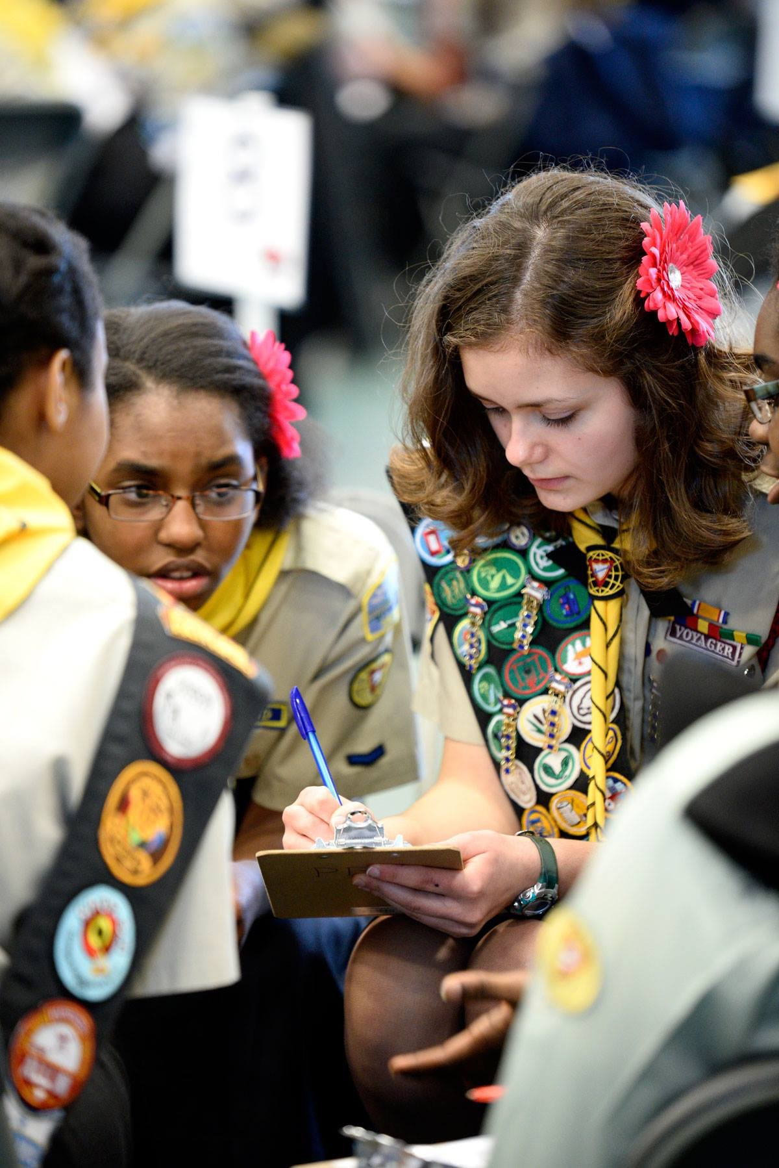
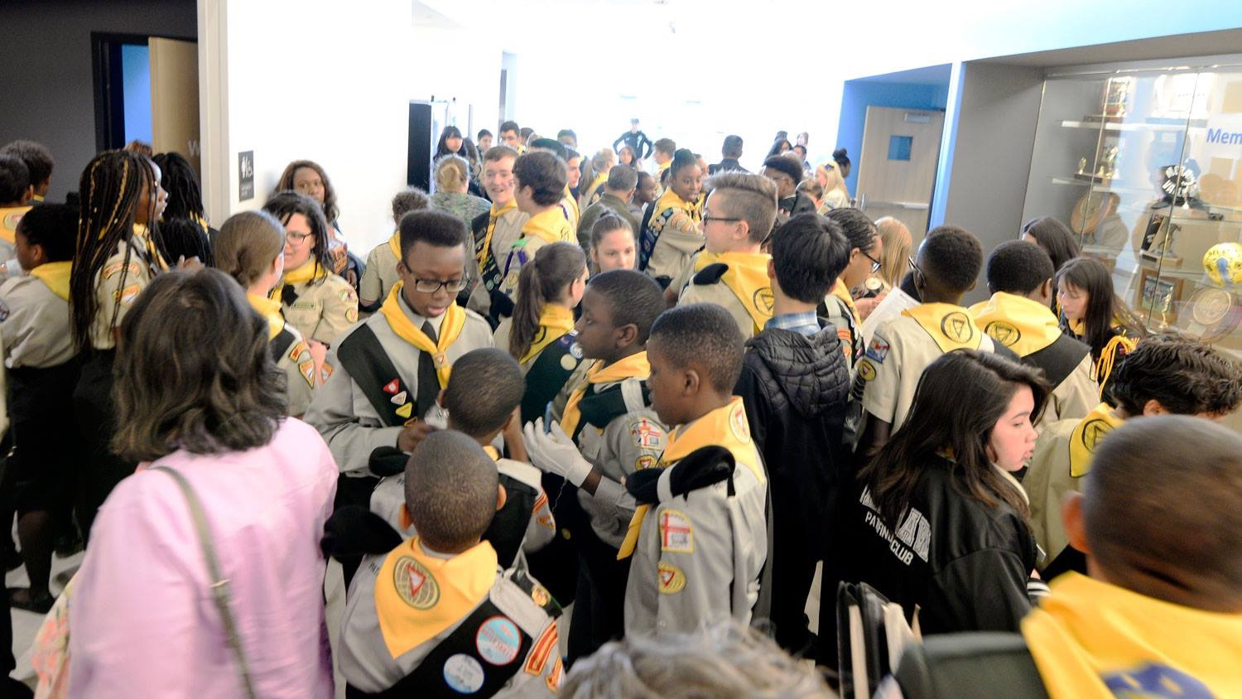
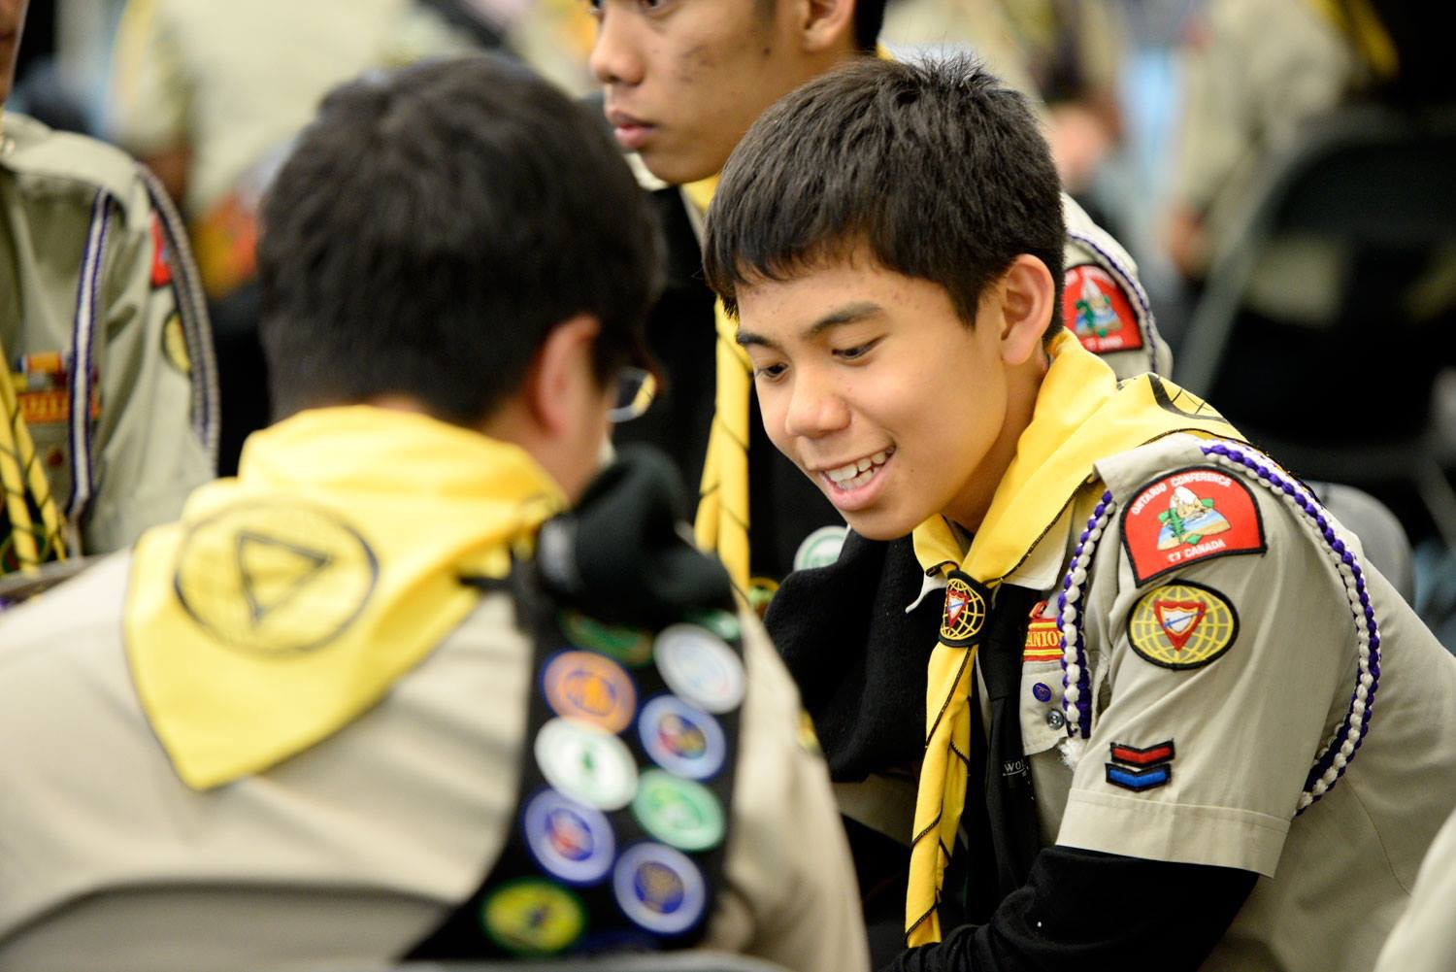
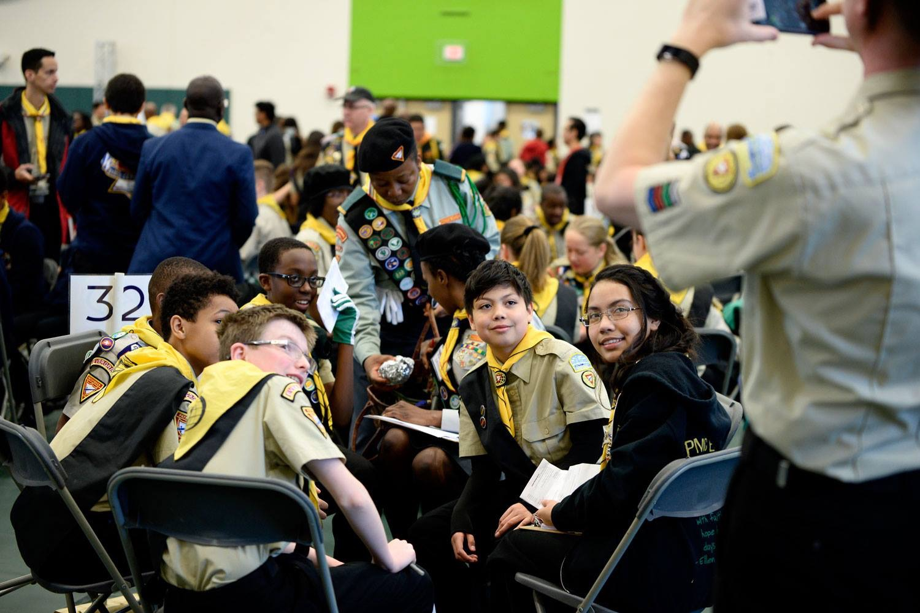
Pathfinders from all over NAD and England
Pathfinders
Notes:
The South England Conference has united and joined the North American Division Pathfinders by participating on Pathfinder Bible Experience. This year, 8 teams from England came to the Division level competition.

Slide 5
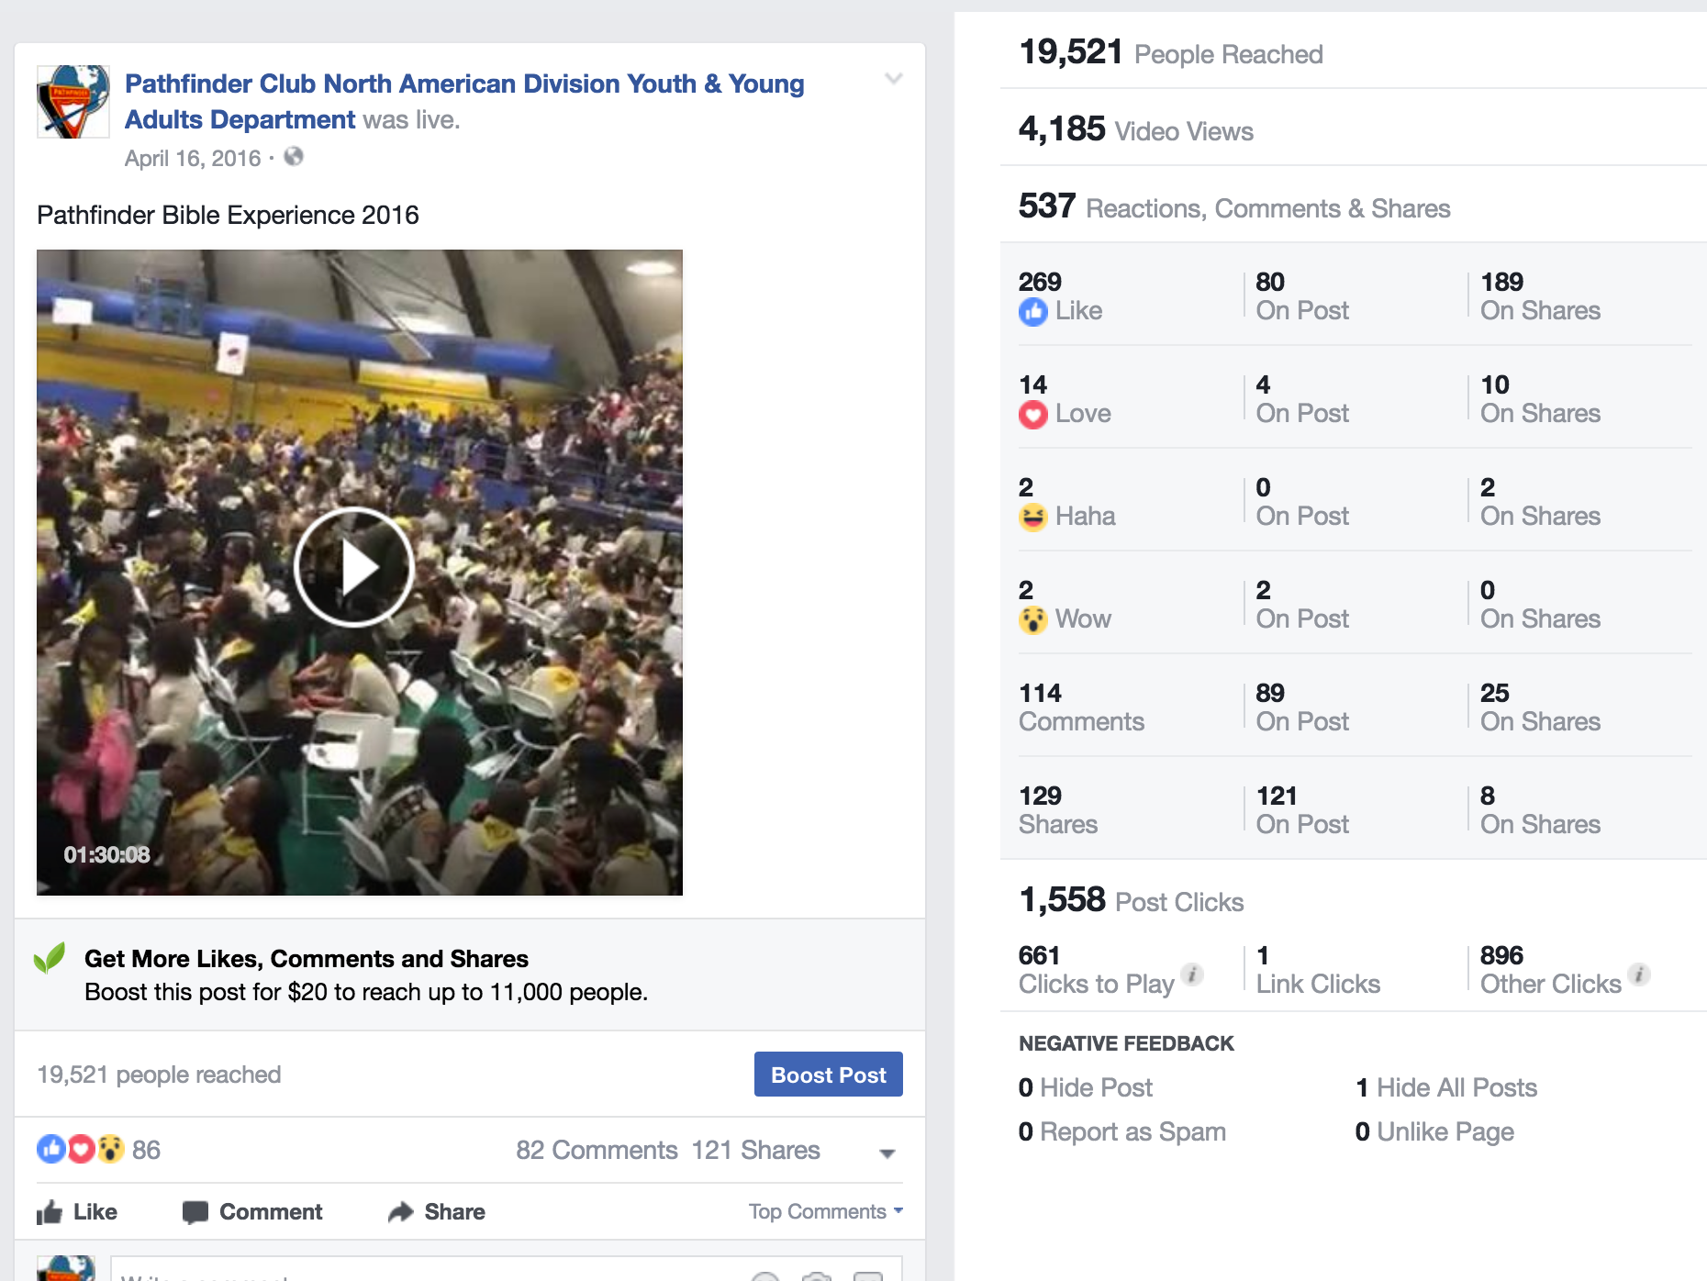
Engagement and Conversations
Where we were in 2016
Notes:
With all the technology going around, it is imperative that we explore ways of streaming and connecting with Pathfinder parents and people around the Division. Last year was our first attempt to use social media to connect and as you can see in this slide, it went pretty well for being the first time.
We used Facebook Live and were successful in reaching a good number of people. We received comments from Philippines, England, Brazil and some from Africa asking us what this event was all about. It was a moment of testimony to a bigger audience that we had at the gym!!

Slide 6
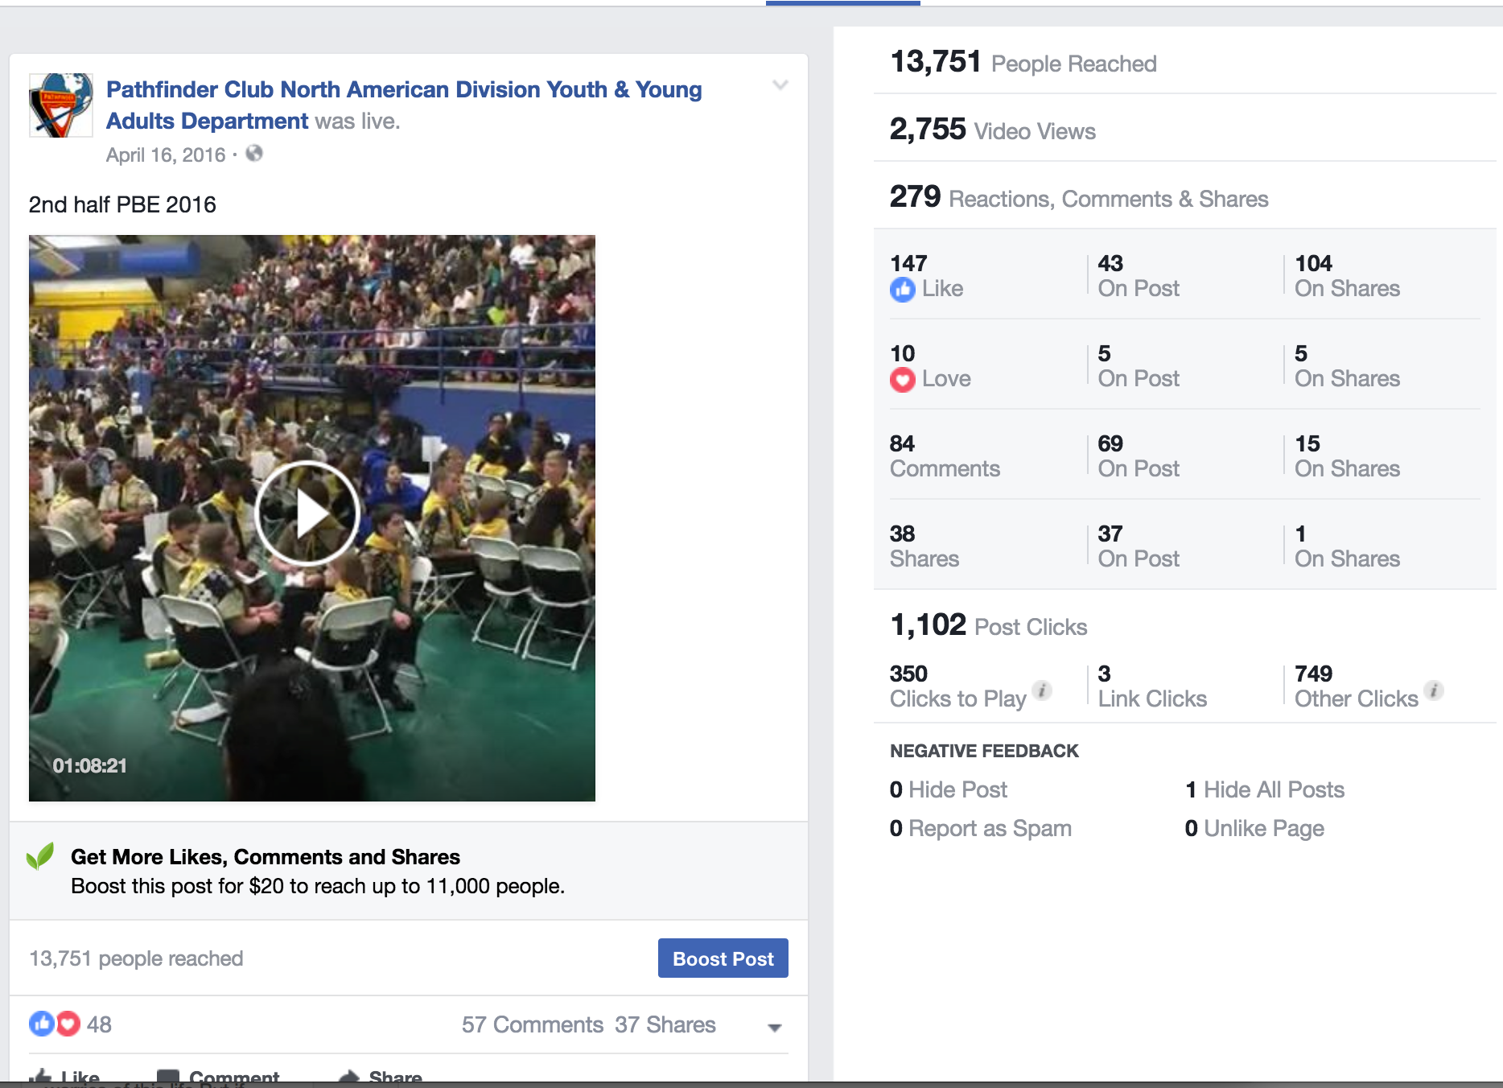
Engagement and Conversations
Where we were in 2016
Notes:
In two segments, you can see that we reached over 32,000 people! But it was not all, we have more videos and interactions with people because of this. Our Pathfinder Facebook page got a boost in likes and follows from this event. And we did this free!!!
We definitely see this as a tool for the present and future outreach!

Slide 7
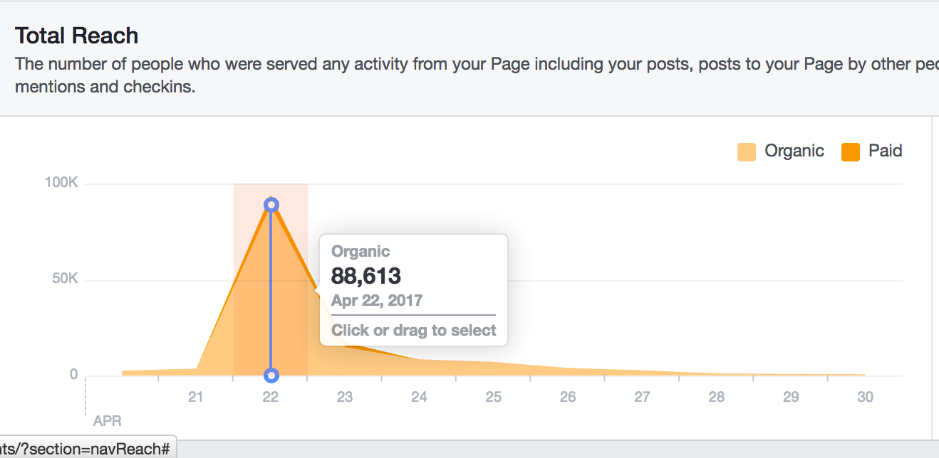
Engagement and Conversations
Pathfinder Bible Experience Live 2017
Notes:
Now, as you can see from this slide, a year later and we reached 3 times the amount of people than in 2016!! We were more intentional and engaging in conversations with people around the world. Also, we had a team of social media managers that handled streaming and all that comes with it. They were young people who were former Pathfinders!!! As young adults that they were, they used not only Facebook, but started using Instagram and Snapchat!

Slide 8
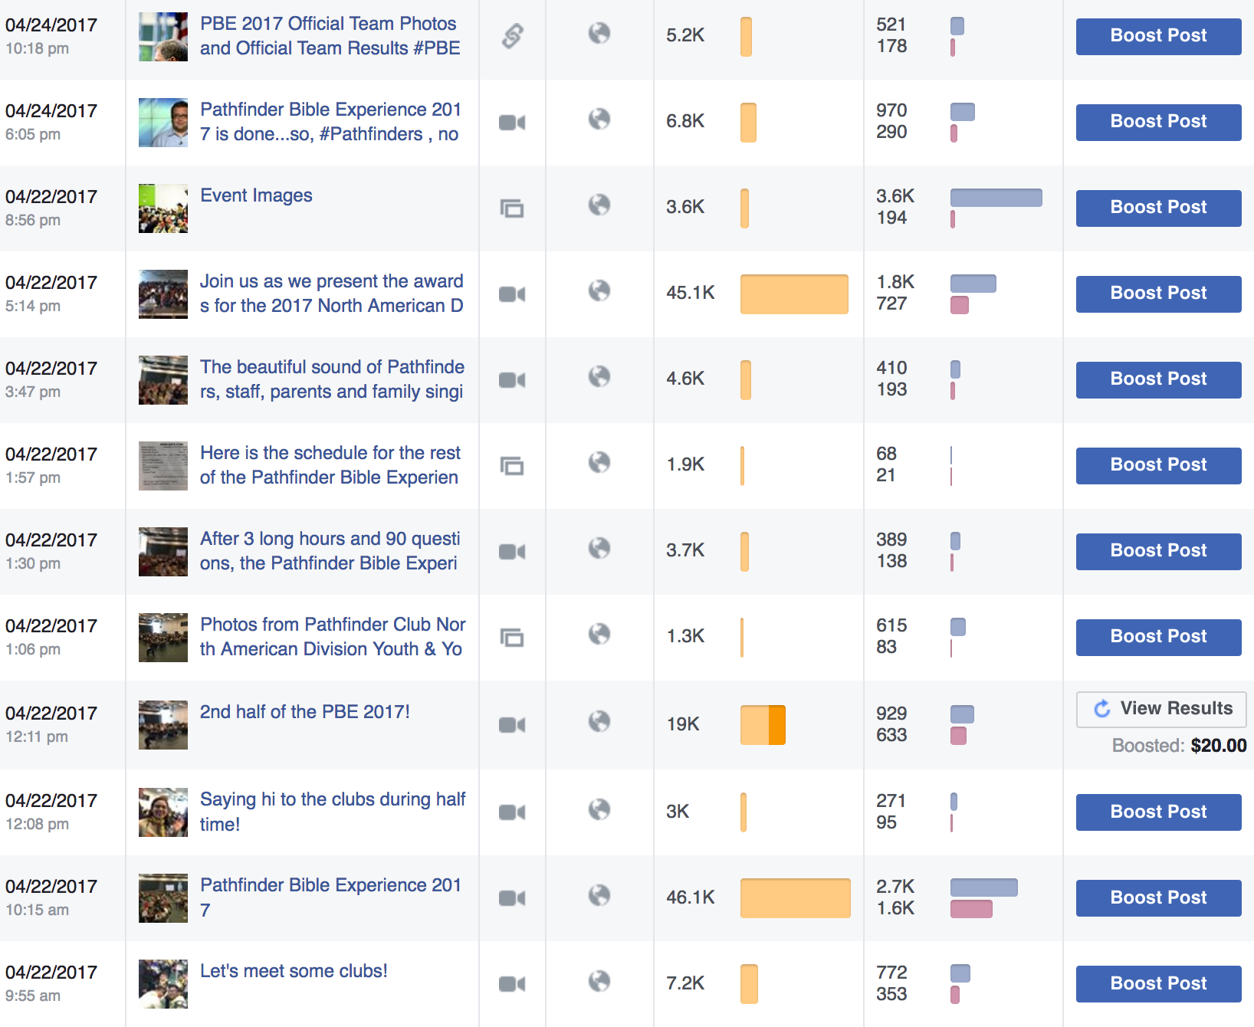
Engagement and Conversations
Pathfinder Bible Experience Live
Notes:
This screen picture shows you the amount of activity we had on one day!! From images, to videos, you can see our reach was huge compared to the year before! This screen picture was taken about a week after the event!
We also paid to test out the ad reach on a video and as you can see, the free videos did better than the paid one in itself. We do not know the reason, but we are looking to learn from this so that we can be more effective in using our marketing funds.

Slide 9
Testing New tool
SNAPCHAT
Notes:
We also endeavored in using Snapchat for the first time. We do not officially have a Snapchat account at the Division level, but know that most of our Teenagers have this application in their smartphones. Now, one of the young adults (18 years old) created this geo filter for Snapchat. Using our brand logo and the city skyline from Chicago, he made sure that it was relevant and fun to use

Slide 10
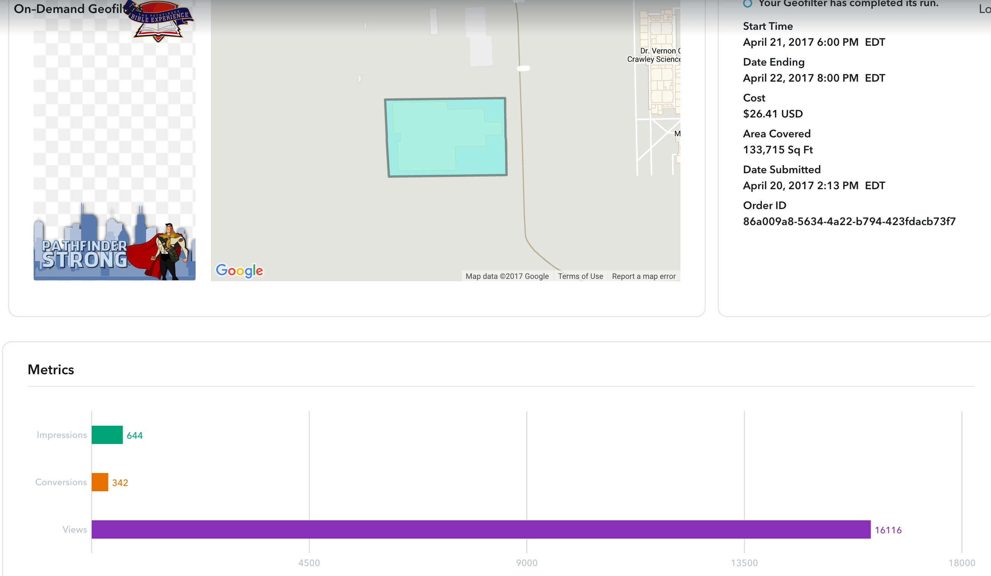
Testing New tool
SNAPCHAT
Notes:
The amazing thing about Snap chat geo filters is that you can target this so specific that you can be very pointed in your approach. We learned that we could pay for a very specific area and spend very little, yet be very effective as you an see in the picture!
The amazing thing was that we spent $26 dollars for just over a day and we had great impressions with that geo filter! To give you a perspective, most Pathfinders were occupied for the whole morning with the testing, so they did not have their cell phones to snap chat, but it took an afternoon to make use of the filter and use it in their snaps and the people that saw their snaps is comparable to one of the videos for Facebook live!!!

Slide 11
There are more ways to reach young people
What did we Learn?
Notes:
After seeing this, we are certain that our influence and reach has increased. We not only reached parents of Pathfinders who wanted to see their children live when they themselves were not present, but we also reached teens in the Snapchat platform that were impacted by a simple geo filter that cost us just over $26 dollars!
There are still ways to reach more people and social media is one tool to do so. We will keep doing it!!!

