Slide 1
Writing for Social Media
JAMIE DOMM, DIGITAL STRATEGIST
Social Media + Big Data, North American Division
Notes:
Just because you know how to use social media platforms for personal sharing, this does not mean you know how to write for social media to achieve a goal. This session is designed to give you a framework and pointers for successfully sharing content that results in engagements and people taking action.

Slide 2
SDAdata.org
Good communication is when you communicate in such a way that your audience understands.
Notes:
Learning to write for social media platforms and your audiences is the key to effective communication. It’s doesn’t matter if you know what you mean, put yourself in your audience’s shoes, and speak to them accordingly. Speak to your audience, in a way and with the words that enable them to understand and connect with your message. REMEMBER EMPATHY FIRST. After all…
This means when you communicate in the digital space, we must speak the language of the platform and understand the “cultural expectations” and “norms” prevalent in the space….whether that’s Snapchat, Facebook, or Reddit. This is why it’s vital that you learn to write for social media. But as you’ll see it’s not as easy as you might have assumed. There is so much more to consider. Language “our words” are just the tip of the iceberg.

Slide 3
SDAdata.org
If you try to reach everyone all the time, you’ll end up
REACHING NO ONE.
Notes:
Understand who your audience is before you write a single post

Slide 4
Determine Your Target Audience:
SDAdata.org
Surface level:
Location
Age
Gender
Race/language
Interests
Deep level:
Needs
Core Values
Notes:
Once you determine the high level characteristics of your target audience, then investigate your audience to determine their needs, interests, and perceptions. Conduct surveys and interviews when possible. To really make impact, go deeper when possible. Especially for developing future evangelist campaigns, understand their experiences and core values. Ask yourself: What motivates their actions?
An example: Teen boys of single mothers, living within 5 miles of a city church, looking for male leadership, POC
Other examples?
Examples of Core Values: Healthy eating, good parenting etc.
Example of Needs: Comfort in Crisis, What happens when we die? Food insecurity

Slide 5
“CULTURAL EMPATHY”
in the digital mission field
Notes:
The concept of cultural empathy is well known in the physical mission field. Evangelism experts know that the best way to reach a community or people group, is to empower a member of that community. Or at the very least, speak the language of the people and show sensitivity and respect to their cultural paradigms. In other words, sincerely seek to understand them and reach them where they are in a way that is relevant.

Slide 6
SDAdata.org
“…become all things to all men, that I may by all means save some.”
(1 Corinthians 9:19-23)
Example: midwestern transplant to Washington D.C., Xennial, first generation college-educated, Adventist convert, vegetarian, professional woman, multi-cultural friend group with strong ties to the Italian and Jewish cultures through immigrant families
Versus: my grandparents who were part of a homogenous community of Italian immigrants, living in the Midwest, coal miners, Catholic etc. Everyone ate the same, worshiped the same, spoke the same language, the entire community functioned around the same industry, isolated, same education etc.
Notes:
But we have forgotten this principle when it comes to Digital Evangelism. Now Digital Evangelism or Discipleship is a new concept for much of the church, but we must remember and translate these tried and true bits of wisdom gained in the field. Digital tools are a way to magnify the reach and impact of traditional and friendship evangelism, not necessarily replacing it. Digital allows us to scale up our efforts in a low-cost way.
The apostle Paul admonishes us to “become all things to all men, that I may by all means save some” (1 Corinthians 9:19-23). To accomplish this in modern society, our definition of culture needs to be expanded. Many now find themselves between cultures and functioning in multiple different communities simultaneously.
What other cultures might we want to consider?

Slide 7
SDAdata.org
A World of Intersecting Cultures to Consider:
Platform
Age
Gender
Language(s)
People groups: race, ethnic, immigrant v. first generation, etc.
Current location: city/suburbs/country
In school v. out of school
Lived in a specific geolocation their whole life v. transplants
Faith groups, life-long Adventists v. converts
Professional groups
College educated v. blue-collar workers
Social groups
Notes:
Your average person is as likely to have moved several times, as to have lived and died in the community they were born, surrounded by a homogeneous collective of people who share the same culture and life experiences. The "simple life" has given way to something more complicated, perhaps messy. Even for those who never change their geographical location, they are globally connected to people through social media in ways that were unheard of just twenty years ago. What this means is that we now live in a world of intersecting cultures or communities. These cultures are potentially endless. They can include:

Slide 8
SDAdata.org
Internal v. External
Are you speaking to Adventists or non-Adventists?
Internal:
Church members
Church leaders
North American Division
Faith communities: city/neighborhoods/ministries
External:
Broader community: neighborhoods/city/state/metro areas
Businesses
Related causes
Local news
Notes:
Are you speaking to Adventists or non-Adventists? Your language should change based on the answer to this question. Be careful to not use Adventist speak when addressing external audiences.

Slide 9
Put your assumptions & judgements in the
TRASH.
Notes:
Make data informed decisions about your audience.
[Pathway to Health Beckley Example]
What other assumptions might we make about our audiences?

Slide 10
Create deep connections by identifying with
CORE VALUES & COMMON EXPERIENCES.
Notes:
People no longer fit into neat categories, so we must connect with them on a deeper level. If you can, your audience will be loyal to your brand because you resonate with them at their core.

Slide 11
SDAdata.org
DEVELOPING AUDIENCE PERSONAS
“A persona is a fictional character that communicates the primary characteristics of a group or segment of your audience and takes into consideration needs, demographics, motivations, and environments.” Source: The Guardian
Determining your audience personas can help you develop and write content that will be the most relevant and useful to your audience.
Notes:
The best personas are often created by getting out there and talking to your audience, but social media insights can also prove very useful. Personas give a human face to a collection of information and data and they allow you to classify groups for different social media campaigns.
Armed with this knowledge, you may end up writing two posts on the same subject with a different angle for each target group if your campaign is geared towards multiple audiences.

Slide 12
ANATOMY OF A PERSONA
About Business Major Bryce
Age | 22
Education | College Senior
Salary | $7,000 a year
Location | Berkeley, Calif.
Family | Adopted, married parents, no siblings, Hispanic
Goals: Finding a good paying job, mentoring younger peers, finding a girlfriend, finding a Christian friend group
Challenges: Finding friends with same morals, avoiding drugs/alcohol, food insecure, feels rejected by his biological parents and struggles to connect
Values: Fair justice system, good reputation, strong character, fairness, good citizenship, leadership training and experience
Fears: The unknown, poor work-life balance, not graduating, student loan debt, rejection
Messages: We are all adopted into God’s family. A place to belong and a place to grow. Connection to others, connection to God.
Notes:
Persona Credit: Faith Hoyt, developed for targeting young adults in the Pacific Union

Slide 13
WHO IS VERN?
About Vern
Age |
Education |
Salary |
Location |
Family |
Goals:
Challenges:
Values:
Fears:
Messages:
Notes:
Now in order for this exercise to work, we do have to make some assumptions about our imaginary representative of our target audience. So does someone have an upcoming event or campaign that they think Vern would be interested in?

Slide 14
SDAdata.org
No one should know more about your audience than you do. BECOME AN EXPERT ON THE PEOPLE YOU ARE TRYING TO REACH.

Slide 15
Now the “easy” part.
Notes:
As you can see, understanding your audience takes a lot of effort. Constructing your posts is actually pretty straightforward and kind of formulaic. If you are familiar with the content, there are some basic principals to follow to maximize effectiveness across any channel. Even as the technology changes, these principles will largely stay the same.

Slide 16
SDAdata.org
PRINCIPLES FOR CREATING A POST
Get to the point & focus your message.
Less IS MORE (think snackable content).
Include a call-to-action (should reflect goals/objectives).
Include a link.
Limit text in images & use high quality images.
Use the lingo of the platform.
Be honest; no bait-and-switch.
Include captioning on videos and always provide context.
Tag relevant accounts.
Use relevant hashtags.
Visit SDAdata.org/social-media-resources for a complete cheat sheet to writing for specific social media platforms.

Slide 17
SDAdata.org
GUIDELINES FOR CHOOSING GOOD PHOTOS
Keep it visual; less text is more.
High quality (take your own or use stock images).
Invoke an emotional response/tell a story.
People are attracted to bright colors and group shots.
Keep a consistent look, brand, and color/font palette.
Be creative.
Use contrast to help your image stand out.
Keep it simple.
Visit SDAdata.org/branding-image-design-resources for a guide to free and low-cost stock images, design tips, and branding guides.
Notes:
Keep these guidelines in mind when choosing images for ads as well.

Slide 18
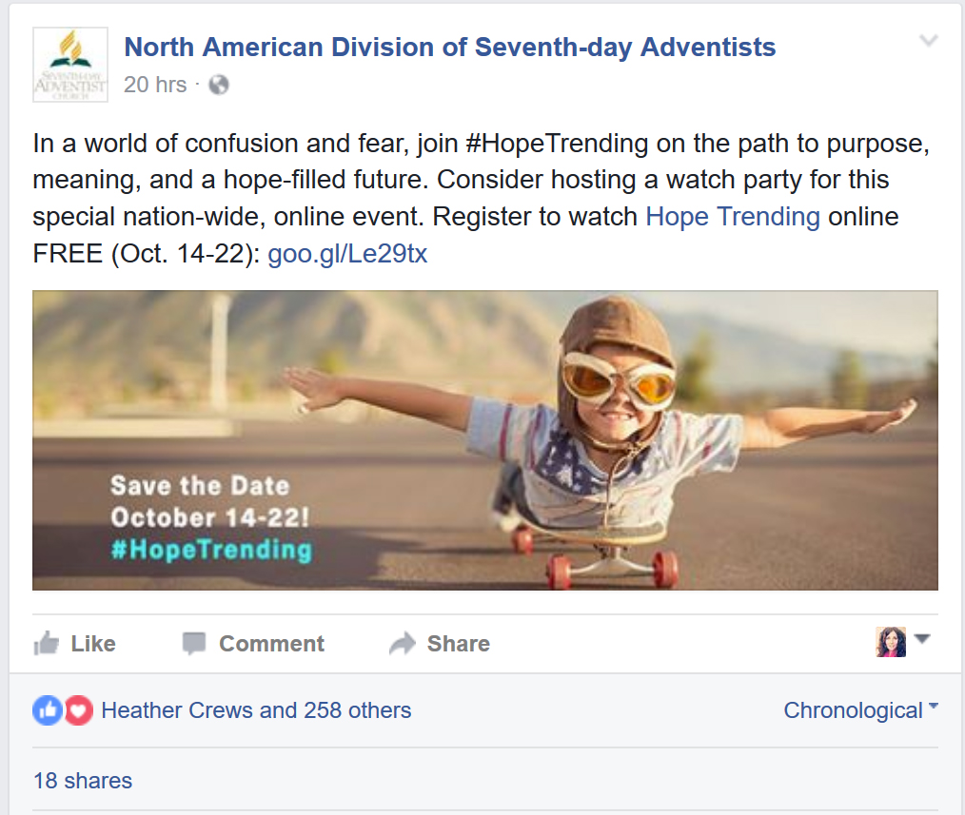
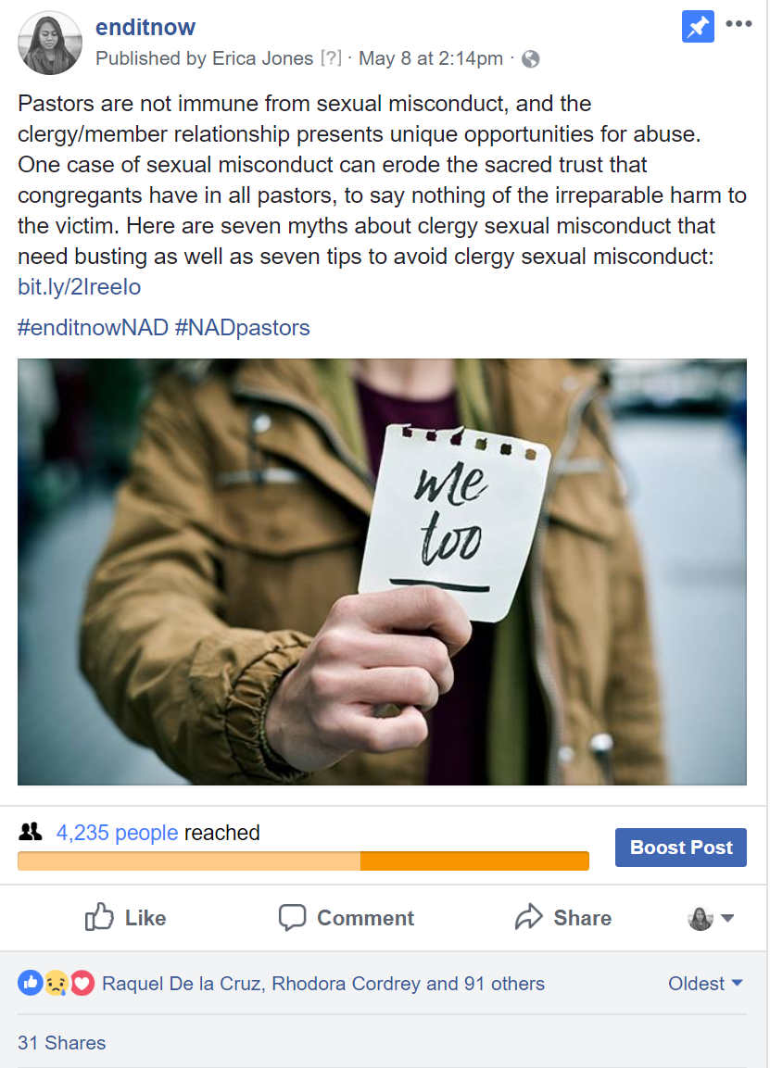
ANATOMY OF A POST

Slide 19
SDAdata.org
80/20 RULE FOR CONTENT
Social media is not only a conversation. View the platforms like a social gathering place.
20% “sales” messages 80% engagement (or content marketing)
Don’t keep telling the same story the same way. Utilize diversity of content and keep it relevant.
Notes:
You wouldn’t hard sell your friends at a get together on your business, but you might talk about your goals, ambitions, and share your general excitement about what you have planned or why it’s important. The same is true for social media. Be authentic, transparent, and human.

Slide 20
Tell stories.
Stories never tell us what to think, they give us something to think about.
Stories don’t tell us what to feel, they cause us to feel.
SDAdata.org
Notes:
Storytelling is a powerful means of communication online because stories never tell us what to think, they give us something to think about. Stories don’t tell us what to feel, they cause us to feel.
This is why they are effective in reaching people, and connecting with them. To share stories is human and approachable.

Slide 21
SDAdata.org
BE STRATEGIC
Notes:
Storytelling connects people, and gets people engaged and interested. The reason why people love going to the movies and reading books is because we love to be engaged by stories. Social Media is people connecting with people to create a collective human story. Our job is to frame that story within the context of our faith.
We know that the two main areas of content people search for alone are religion & pornography. We can provide people with the answers and connection they are looking for, if we’re strategic and intentional with what we write.

Slide 22
SDAdata.org
​People are Googling for God.
Each year there are millions of Google searches for answers to questions like:
Is God real?
What happens when we die?
How do I know I’m saved?
Why is there so much suffering in the world?
Notes:
There is a great need for our message. Additionally, many people are hurting, entertaining suicidal thoughts, or feel there is no hope for their situation. They turn to the internet for companionship, understanding, information, anonymity, and more. It’s easier for them to pour their hearts out on Google than it is to come to a friend, neighbor, co-worker or family member. So this is where we as disciples need to cast our net. To do that, we need to use the kind of spiritual bait the fish are looking to feed on.

Slide 23
GO FISH!
Notes:
.
Find content, write content, curate content related to top google searches. Frame your posts accordingly to pique curiosity, and answer people’s questions that meet their deepest longings.
You can get these predictions from any search engine, YouTube, and other social media trends.

Slide 24
SDAdata.org
"My task, which I am trying to achieve is, by the power of the written word, to make you hear, to make you feel—it is, before all, to make you see."
— Joseph Conrad, author
Notes:
.
There is a reason God chose to speak to us through the written word. Words have power, and the Words you choose matter.

Slide 25
SDAdata.org
“How will your audience change as a result of your [article/letter/post/video]?
—Seth Godin, Marketing guru
In other words:
Why should they read or watch your content instead of someone else’s?
Notes:
We have to expect that our audiences experience a daily overload of content consumption just like us. Why should they prioritize your content?
Your content has to be clicked on before it can have any kind of life-changing effect. To stand out, your headline has to communicate directly to the reader in a way that is relevant to their life, situation, or needs, “This will make your life easier” or “Here’s a way to do the thing you always do, better” or “Here’s some insight on that nagging question you have.”

Slide 26
Tips for Getting Your Content Noticed
List posts perform well.
Use “you” and “your” frequently.
Enable your readers to envision a better life.
Slightly alter headlines for different channels.
Tug at emotions.
Stay real and conversational.
Notes:
List posts perform well This is a highly shareable form of headline for an article or video. This doesn’t seem to get old—people love that list posts are highly skimmable and offer clear takeaways. Again snackable content. Use “you” and “your” frequently These words already tell readers’ brains that this is about them—which is who they’re consuming content for in the first place. Enable your readers to envision a better life If readers believe they will learn how to do something amazing or have their mind blown, they will be more likely to stop and pay attention, as well as share. Slightly alter headlines for different channels Tug at emotions Descriptively acknowledge what your audience is going through and how this piece of content addresses it. Ask questions, even venture assumptions, such as “Feeling stuck?” or “Life is tough.”
Stay real and conversational
When in doubt, write as though you are writing to a friend.

Slide 27
Why People Share Online
To improve the lives of others.
To define themselves.
To grow and nourish relationships.
Self-fulfillment.
To get the word out about causes they believe in.
“These five key motivations clearly show that your audience’s main reasons for sharing are their relationships with other people—not your brand. Keep this in mind as you continue creating and sharing audience-focused content.” — Dara Fontein, Hootsuite
New York Times: blog.hootsuite.com/social-media-psychology-marketers
Notes:
To improve the lives of others. Almost all participants (94 percent) said they share because they feel the content will improve the lives of their audience. As a marketer, it’s important to create helpful content that will do something to make your audience (and their audience’s) lives better.
To define themselves. Two in three participants (68 percent) reported sharing content in order to create an “idealized online persona” of themselves. When you create content, consider whether it will be something that fits with your audience’s interests—and whether they will be proud to share it.
To grow and nourish relationships. Four out of five participants said they share online content as a means of staying connected with others. Consider ways your content can be used to foster connections between others. Ask your audience to tag other users in the comments or encourage sharing with a compelling CTA (ie. “Share this recipe video with the best cook you know for a chance to win this new cook set!”)
Self-fulfillment. Everyone likes getting positive feedback and feeling valuable. The study found that “consumers enjoy content more when they share it, and that they enjoy content more when it is shared with them.” Create informative content to help your audience achieve this feeling on the regular.
To get the word out about causes they believe in. Four out of five (84 percent) participants say the “share information as a way to support causes or brands they care about.” Think about which causes your brand cares about and create content that supports these causes.

Slide 28
What does it mean to write conversationally?
Use:
simple, easy to understand language.
“you,” “your,” and “I.”
active voice instead of passive voice.
examples, similes, and metaphors.
contractions, and start sentences with And/But.
Tell stories.
Keep it short and digestible.
Do not ramble
Ask questions.
Write to your target audience.
Notes:
Fancy writing doesn’t work for social media. Simple, honest, and conversational does.
Do you see the overlaps?
Using You, Your, and “I” makes it seems like you’re speaking to them personally.
Keep your sentences short. Break long sentences into several short ones. Long sentences will reduce readability.
Use words with fewer syllables. Words with more syllables reduce readability.

Slide 29
SDAdata.org
SPEAKING TO THE COLLECTIVE WE Pendulum: How Past Generations Shape Our Present and Predict Our Future
sdadata.org/digital-evangelism-blog/words-matter-so-do-you
Notes:
Pendulum provides an analysis of the current shifts in society and their impact on marketing, technology, and communication as well as insights into the drivers behind the collective shifts in society. To better understand how to communicate more effectively to our audiences and fulfill their needs, I recommend that you read this book or at least our blog post on this topic.

Slide 30
SDAdata.org
“What has been will be again, what has been done will be done again; there is nothing new under the sun. Is there anything of which one can say, ‘Look! This is something new’? It was here already, long ago; it was here before our time. No one remembers the former generations, and even those yet to come will not be remembered by those who follow them.” (Ecclesiastes 1:9-11)
Notes:
Pendulum takes Strauss and Howe’s four “generations” (Idealist, Reactive, Civic, Adaptive) and reduces it to two generations covering forty years that oscillate between the individuality, freedom, uniqueness, and potential of “Me” (peaked in 1983) to the collective “We” working together for the common good, fixing society’s greatest problems, and rejecting the pretense for authenticity and transparency.

Slide 31
SDAdata.org
​The main point is that group behavior is predictable, and we can use this predictability to speak to the masses in a relevant way.
“The Pendulum predicts only the momentum and direction of the majority in a society—most of the people, most of the time. Certainly not everyone, and certainly not always.” (Roy H. Williams, 25)
Notes:
But to maximize results, we should fish where there is the potential for the highest catch.

Slide 32
SDAdata.org
To communicate, we must ask: “What is driving the actions and attitudes of the group?”
Notes:
Then determine how your mission and message fits or can be positioned into this paradigm.

Slide 33
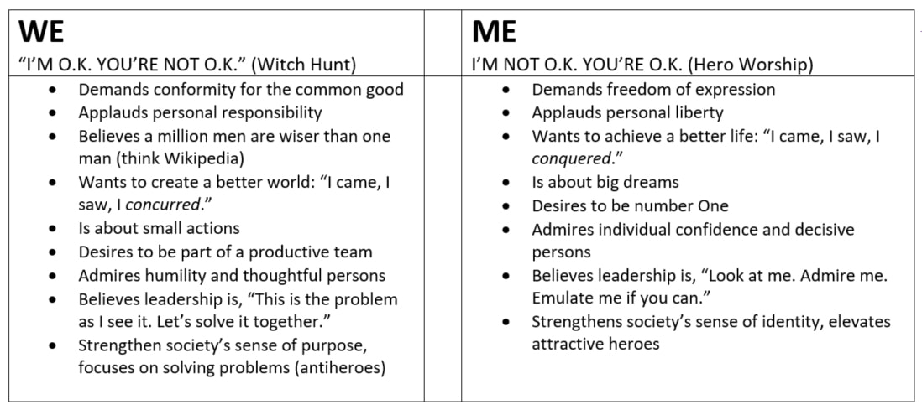
SDAdata.org
Figure: 2.3 Values and beliefs that motivate society in “WE” and “ME” cycles (Williams, 17) ​ Drivers of a “WE” vs. drivers of a “ME”

Slide 34
This shift can be seen in successful advertising campaigns that target a worldview/attitude instead of an age group.
“Remember L’Oréal’s famous ‘Me’ slogan, ‘Because I’m worth it?’ As society passed the tipping point of 2003 and the ‘Me’ became fully unwound, the old slogan was replaced with, ‘Because you’re worth it.’” (Williams, 172)
Notes:
During this same period, the successful Army slogan “Be All You Can Be” (1980-2001) changed to “Army of One” (2001-2006) but didn’t perform well because it was “contrary to the idea of teamwork” said Frank Luntz, American political consultant, pollster, and public opinion guru (Ball). The current, more “WE” focused, slogan is “Army Strong.”

Slide 35
SDAdata.org
Figure 16.5 Tips to create a serious Internet presence during a “WE” cycle. (Williams, 172) ​ Understanding these underlying principles provides guidance and strengthens our ability to reach our target audience.
Notes:
Social media is a powerful tool for member care and service. Never before has “truth in advertising” been so important. The younger generations are the most connected, more than any before them, and they naturally turn to social media to voice their displeasure with a brand or experience. “Your advertising [messaging] may fool one of us. But that one will tell the rest of us.” —Roy H. Williams.

Slide 36
SDAdata.org
Humility, straight talk, and a genuine point of view is what the Adventist Church needs to embrace; we see the effectiveness of this strategy in the success of initiatives like #Gorgeous2God, a community of young Christian women tackling real issues from a godly perspective. True stories from the experiences of real girls are shared and communicated in a candid way that the Adventist Church has not embraced previously. Topics include rape, self-harm, sex before marriage, depression, abuse, and other “uncomfortable” topics.

Slide 37
SDAdata.org
Check Your EMV Score “Emotional Marketing Value”
aminstitute.com/headline
Intellectual | Empathetic | Spiritual
Words which are effective when offering products and services that require reasoning or careful evaluation. | Words which bring out profound and strong positive emotional reactions in people. | Words which have the strongest potential for influence and often appeal to people at a very deep emotional level.
Source: Advanced Marketing Institute
Notes:
Reaching your target audiences in an deep and emotional way is a key to effective communication, marketing, and creating connection. The best headlines and teaser lines receive an EMV score of over 40.

Slide 38
SDAdata.org
Gorgeous2God example: Life is tough but you're not alone. Join our community of young Christian women tackling real issues from a godly perspective.
EMV = 42.86%
aminstitute.com/headline

Slide 39
SDAdata.org
Post reach and interaction will ebb and flow based on personal preferences, that day’s attitude, the news, that evening’s supper, or just the busy-ness of life. Keep posting. Keep interacting. Keep adapting.
Notes:
When you initially revamp your social media, the changes in post engagement should show immediate and positive results. But over time things may plateau or even dip during the holidays. You’ll learn to see patterns over time, keep pressing forward, keep trying new things, adapt to your audience. Often times social media efforts fail because people give up too early.

Slide 40
SDAdata.org
Notes:
Any questions?

