Slide 1
Best Practices for Social Media
Building your strategy and getting started with ads
Jamie Jean Schneider Domm
Notes:
As leaders, you may not be directly responsible for implementing your digital communications, but it is important for you to have a clear understanding of how to build a strong strategy when leading your team. Digital Advertising offers untapped potential for the church, and is necessary for the advancement of our mission. I hope this presentation will help you see the value and potential, encouraging you to empower your communications teams to utilize these technologies. I’m happy to send these presentations to you to share with your team. I cover all of these topics in greater detail on our website: SDAdata.org.

Slide 2
Managing Work Accounts
Preventing problems before they start
SDAdata.org l @DigiEvangelism
Notes:
Let’s highlight some tips related to managing work accounts and campaigns before we get into running a campaign.

Slide 3
Account Management
Create a separate work Facebook account to manage official pages.
Facebook pages should have more than one staff admin on the page to prevent lock-out.
Never connect work profiles to private email addresses or even personal work email addresses.
Create a dedicated social media address (socialmedia@yourministry.com) for your organization and grant multiple people access.
Connect accounts like Twitter, Instagram, and Hootsuite to the work social media email address.
Visit SDAdata.org/resources to download the Social Media guidebook and best practices.
SDAdata.org l @DigiEvangelism

Slide 4
Copyright Laws
Avoiding trouble
SDAdata.org l @DigiEvangelism
Notes:
I also want to point out some copyright law issues, so you can safely proceed with a strategy of your own.

Slide 5
Highlights to Keep in Mind
Just because something is on the internet, it does not necessarily mean it is public domain.
It is generally okay to share items that are on social media; that is the purpose of social media. However, be sure to give credit to the original creator; do not claim it as your original work.
Understand that you are giving up some of your ownership rights when posting. Always read the terms and conditions.
When creating posts, use public domain, fair use, or purchased stock images to avoid copyright infringement.
For more on copyright and trademark basics, visit: SDAdata.org/resources
SDAdata.org l @DigiEvangelism
Notes:
Credit: Jennifer Gray, Associate General Council, General Conference of the Seventh-day Adventist Church.

Slide 6
Digital Strategy
A formula for success
SDAdata.org l @DigiEvangelism
Notes:
A well thought out plan, will get results. If you treat social media like an after-thought, it will perform like one. So here is my formula for success. Most of you are well versed in using social media, but I’m asking you to use it with purpose to achieve specific goals. These principles are scalable to any size ministry, and I hope you will walk away from this presentation with an understanding of strategy.

Slide 7
Framework
Finally, optimize & manage: Trackable and measurable results
Engagement
First, determine: Key performance goals Audience Platforms/channels Timeline Budget
Next, develop:
Content strategy
Partnerships
SDAdata.org l @DigiEvangelism

Slide 8
Why Use Social Media?
Top 7 reasons non-profits use social media, according to Hubspot:
Share news
Increase brand recognition
Educate about a cause and/or mission
Fundraise
Recruit volunteers
Recognize donors
Recruit employees
SDAdata.org l @DigiEvangelism

Slide 9
Summary
Determine purpose & goals.
Determine target audience.
Develop personas.
Choose the right platforms/channels.
Strategize for internal v. external communication.
Use an integrated approach to cut through the clutter (remember “rule of 7”).
SDAdata.org l @DigiEvangelism
Notes:
We talk about some of this in the last presentation. Remember: before you can execute a successful social media strategy, you must clearly identify what you’re aiming to achieve.

Slide 10
Determine performance metrics.
Examples of relevant trackable metrics:
Number of volunteers
Registration numbers/attendance
Increase in followers or likes
Traffic to the website in general or from a specific channel or platform
Empowerment and activity of social media ambassadors
Social media reach
Donations/purchases
SDAdata.org l @DigiEvangelism
Notes:
Once you’ve identified what how you’ll be using social media and who you’re trying to reach, it’s important to implement measures for success. These metrics can be used to determine conversion or retention of members/followers/customers.

Slide 11
Mapping Out A Plan
Event promotion campaigns tend to benefit from a shorter time-frame on social media.
Usually 2-3 months in advance, can be as short as 1-2 weeks
Print/traditional campaigns can start earlier.
Not to be confused with an ongoing content strategy
SDAdata.org l @DigiEvangelism
Notes:
For event/goal specific campaigns that have a start and end date, think about a shorter time-frame

Slide 12
Get organized.
Develop a content calendar.
Share calendar with your entire communications team.
Schedule posts in advance (increased flexibility).
Plan across multiple platforms at once.
Content calendar template: goo.gl/1w2NME
SDAdata.org l @DigiEvangelism
Notes:
You can download this template and adapt it for your needs. I like using google docs to share my calendars with my team. Here is a template for a general content calendar.

Slide 13
Content Strategy
Know your voice; be human and authentic.
Create diversity of content; repurpose and curate.
Promote your mission and message; tell your story in different ways.
Be strategic with placement; post consistently; communicate important information; build urgency.
Optimize & adapt; monitor data, and post content your audience responds to.
Actively engage; focus on member care.
SDAdata.org l @DigiEvangelism
Notes:
Develop your content strategy and your team to implement it.

Slide 14
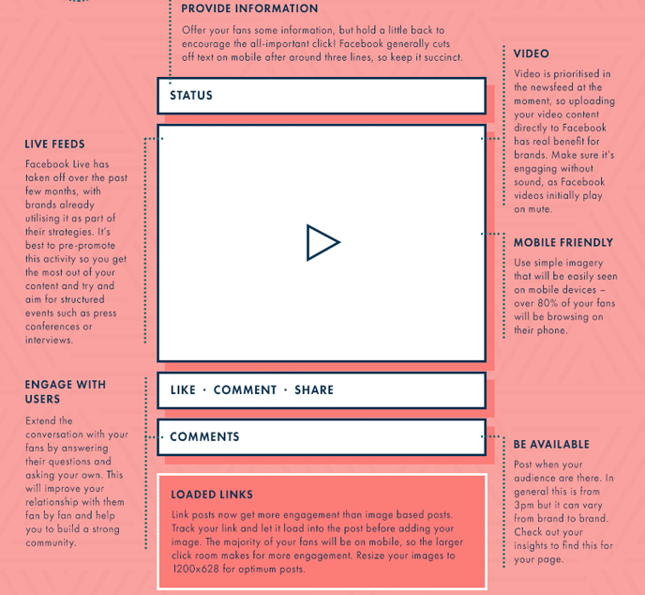
Learn to write for social media.
Get to the point & focus your message.
Less IS MORE (think snackable content).
Include a call-to-action.
Include a link.
Use the lingo of the platform.
Tag relevant accounts.
Use relevant hashtags.
Visit SDAdata.org/resources for a complete guide to writing for social media.
SDAdata.org l @DigiEvangelism
Notes:
Just because you use social media, doesn’t mean you know how to write to achieve a goal.

Slide 15
Guidelines for Choosing Good Photos
Keep it visual, less text is more.
Choose high quality (take your own or use stock images).
Invoke an emotional response/tell a story.
People are attracted to bright colors and group shots.
Keep a consistent look, brand, and color/font palette.
Be creative.
Use contrast to help your image stand out.
Keep it simple.
Resource: SDAdata.org/blog/how-and-where-to-find-free-stock-photos
Notes:
Keep these guidelines in mind when choosing images for ads as well.

Slide 16
80/20 Rule
Social media is not only a conversation but should be viewed like a social gathering.
20% “sales” messages 80% engagement (or content marketing)
Don’t keep telling the same story the same way. Utilize diversity of content and keep it relevant.
SDAdata.org l @DigiEvangelism
Notes:
You wouldn’t hard sell your friends at a get together on your business, but you might talk about your goals, ambitions, and share your general excitement about what you have planned or why it’s important. The same is true for social media. Be authentic, transparent and human.

Slide 17
Partnerships benefit you.
Create and cultivate online relationships. “No person will make a great business who wants to do it all himself or get all the credit.” – Andrew Carnegie
SDAdata.org l @DigiEvangelism
Notes:
Active social media partnerships are key to expanding your reach and branding. Social media is designed for community building. Find organizations to build partnerships with either by location or topic. For events, it is likely that you already have partnerships in place. Magnify their value by partnering for your digital communications campaign.

Slide 18
Who can you work with?
Sponsors/donors
Organizations already involved in the event or program
Participants/speakers
Local churches/related organizations
Conferences & Unions
Make sure the partnerships are mutually beneficial.
SDAdata.org l @DigiEvangelism

Slide 19
Create a POD.
A group used to increase engagement on Instagram or Facebook. Users agree to comment, like, and share each other’s content. Rules vary, but typically fall into three categories:
A: All users must engage with every post within an hour.
B: All users must engage with every post within 24 hours.
C: All users must engage with relevant posts whenever they can.
QODESOCIAL.com

Slide 20
Making Partnerships Easy
Use promotions packets to empower social media ambassadors.
Provides pre-made images and text for social media
Easy to use
You control the message and empower the partner.
If you reach out to 10 contacts who have a “small” following of 1,000 people, you suddenly have the potential to reach up to 10,000.
Learn more & download template: goo.gl/tuYB4E
SDAdata.org l @DigiEvangelism
Notes:
Communicators typically have a lot on their plates, and social media manager is just one of many hats that they wear throughout the work week. Contacts are often willing to promote partner events through their various digital channels, but time and resources are limited. With this reality in mind, providing your partners with a “promotions packet” is an effective and easy way to equip your contacts with the resources they need to easily become social media ambassadors and share your message.

Slide 21
Tracking & Advertising
What to pay attention to & how much to spend

Slide 22
Paid Ads and Budgeting
Facebook is a business that needs to make money, therefore it limits unpaid reach. This means only about 10-20% of your fan base will actually see your posts in their news feed. You can counteract this by boosting key posts to reach more of your fan base and placing ads to expand your reach to new audiences.
Determine your target audiences.
Determine your budget.
Start with a test, then expand based on results.
SDAdata.org l @DigiEvangelism

Slide 23
What’s appropriate to spend?
It depends
Small Budget Example
$500-$1,500 budget
$50/event
$150/large events
$100-250/ quarterly ad campaign (ex: page likes)
Remainder: “What-if Experiments?”
SDAdata.org l @DigiEvangelism
Notes:
A lot of time people will ask me, “how much does it cost to promote online.” But the beauty of social media ads is that it depends on what you can spend. Social media works very well for small budgets and non-profits. A little can go a long way, but it’s important to spend a little. As your confidence grows and your familiarity with reaching your target audiences grow, you can increase your budget as needed. Ultimately your budget depends on the size of your goals and your purpose. A small local ministry may only need to spend $300 a year where as a nationwide campaign would need $3,000 to create impact within a targeted audience. What you can do: Go through my course power points online, and start with small ad budgets with a clear objective…this way you can learn and maximize your results as you grow.

Slide 24
Tracking and measuring results.
Check performance and record results weekly from:
Google analytics
Social media insights
Ad performance
Compare results to the performance goals and metrics you established. Optimize accordingly.
Share report summaries with your team (both good and bad).
Problem solve as a team. Sometimes the best solutions are found outside your industry/department.
SDAdata.org l @DigiEvangelism

Slide 25
Create reports.
There will always be a next time, but will you be better informed?
There’s no point in testing strategies without tracking your efforts.
Social media is both an art and a science. Use data to inform your intuition.
Create summary reports for management; keep detailed reports for yourself.
SDAdata.org l @DigiEvangelism
Notes:
If you’re going to take the time to put together a campaign strategy, take the time to track your performance. Otherwise you can’t build on what you’ve learned or improve for the next campaign, because you didn’t learn from this one.

Slide 26
Types of Social Media Metrics
Activity metrics: quantity of posts made by administrators on social media profiles
Reach metrics: number of people who see your content and audience/demographic data
Engagement metrics: interactions and interest in your brand and content
Acquisition metrics: changes in engagement over time or “relationships developed”
Conversion metrics: actions, sales, and results
Retention metrics: happy customers and brand evangelists
Source: Canva
SDAdata.org l @DigiEvangelism
Notes:
Identify the social media metrics that are the most important for your goals, and decide how to track them over the life of your campaign. If you don’t have a lot of time, set benchmarks and track high-level numbers.
In depth look: https://blog.bufferapp.com/social-media-metrics

Slide 27
Overview of Facebook Ads/Business Manager
How to get started placing ads and types of ads
Notes:
This next section is going to cover Facebook Ads for those of you who are wanting to invest money into your social media effort. I’m limited on time today, but I would strongly encourage you to visit our website to learn about tracking, google analytics & social media insights through my free advanced social media course.

Slide 28
Business Manager basics
Business Manager is a tool for managing access to Pages and ad accounts, geared towards companies who need to give different permissions to lots of people.
Manage access to Pages and ad accounts. Clearly see who has access to your pages and ad accounts and remove or change their permissions as needed.
Keep work separate from personal. Get access to Pages and ad accounts without being friends with your coworkers on Facebook.
Manage multiple campaigns & credit cards. Allows you to separate the billing for multiple different ad projects.
FREE to use. (You pay for the ads you place.)
Content is taken from the Facebook business help section that can be found here: https://goo.gl/Uqx2Y4
SDAdata.org l @DigiEvangelism
Notes:
For conferences, I highly recommend setting up a Facebook Business ads account.

Slide 29
Targeting
Reaching the right people without breaking the bank
SDAdata.org l @DigiEvangelism
Notes:
Facebook acquired Instagram, and so now you can run highly targeted ads on both Facebook & Instagram and take advantage of all the analytics that go with them. It’s actually very easy to do, and it’s scalable to any sized budget. Facebook’s advertising and targeting abilities are still far superior to Twitter or Pinterest advertising, so I recommend starting with Facebook ads as your money will be more effectively used.

Slide 30
Basic Ways To Target
You can target by:
Location: country, state, city, or place
Age
Gender
Language
Interest: choose multiple to reach people interested in a specific topic or part of a particular group.
Connection: fans of your page and their friends
SDAdata.org l @DigiEvangelism
Notes:
You’ll notice that this should closely mirror the categories for finding your target audience that we discussed earlier.

Slide 31
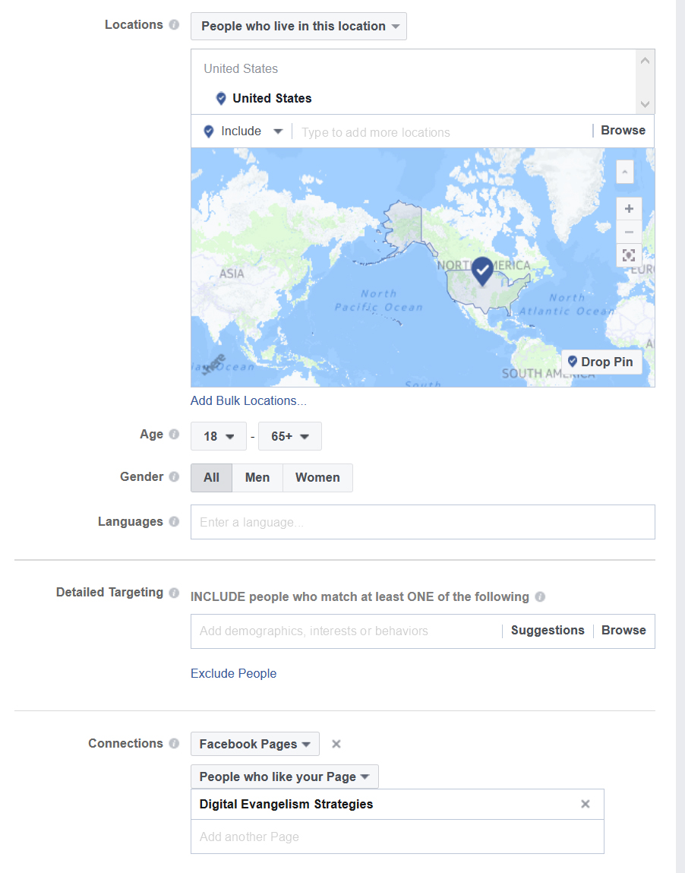
Place, Age, Language & Interest
SDAs & Religious Liberty
Fans of a Page/Connections
Notes:
Go through and explain the targeting on each one.

Slide 32
Ad Placement
Show your ads to the right people, in the right place
SDAdata.org l @DigiEvangelism
Notes:
It’s important to understand where your ads are appearing. Facebook allows you to edit these placements if needed.

Slide 33
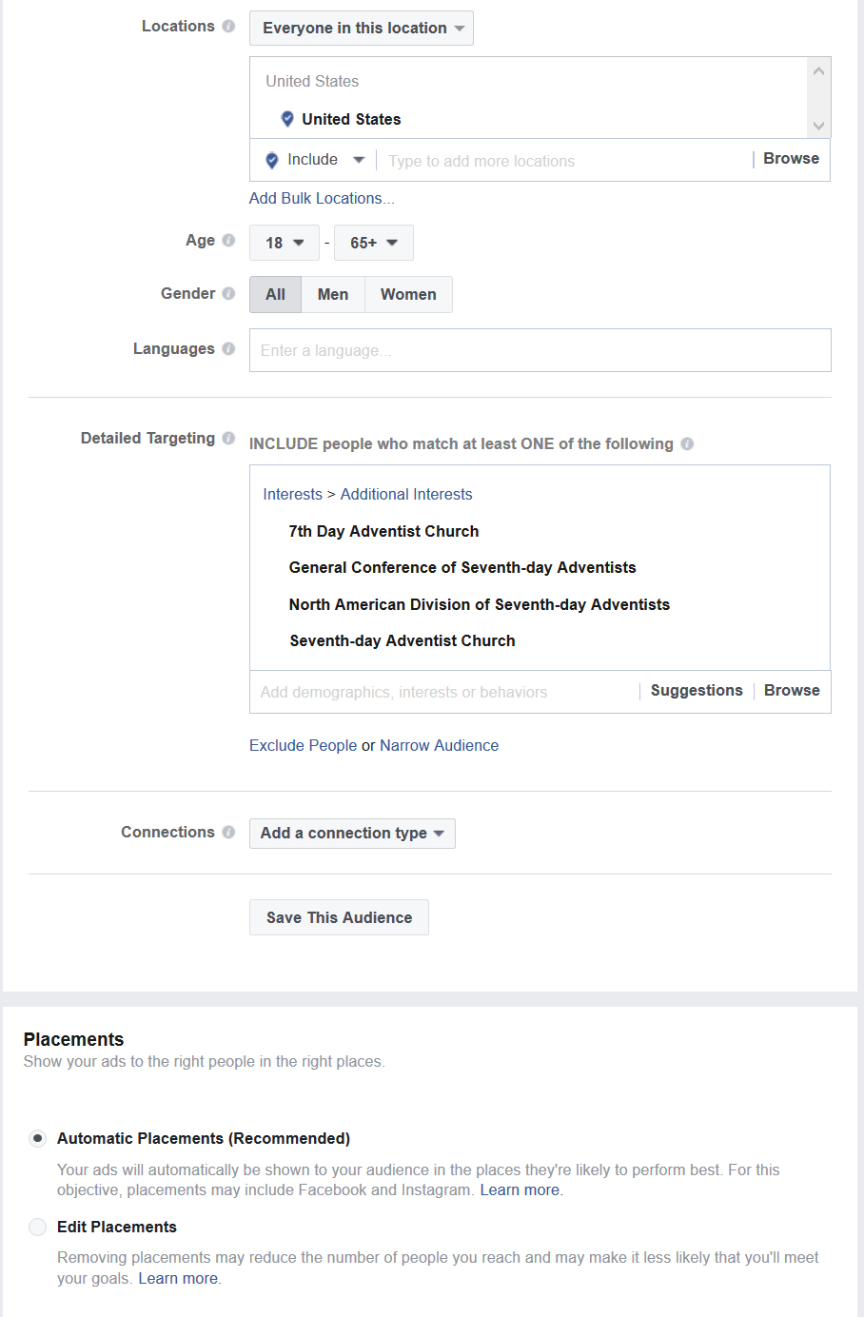
In most cases, leave the placements as automatic and Facebook’s algorithm will place your ads in the locations best suited to optimize ad performance. Over time the algorithm learns and adapts as people respond to your ad. Take advantage of this feature to maximize your ad dollars.
You can, however, edit placements manually if desired or necessary.
SDAdata.org l @DigiEvangelism
Notes:
Placements are found under audience targeting.

Slide 34
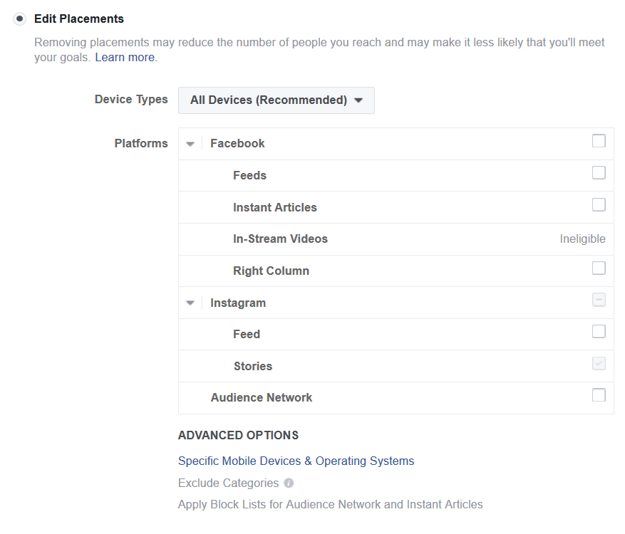
Placements
Facebook: newsfeeds, instant articles, right column
In-Stream videos offer another opportunity to reach audiences by allowing advertisers to deliver 5-15 second mid-roll video ads within live and non-live videos on Facebook.
Instant articles is a tool designed for media publishers to distribute fast, interactive articles to their readers within the Facebook mobile app and messenger.
Instagram: feeds and stories
Audience Network: extend your reach by showing ads to the same target audience on other mobile apps and websites.
Source: Facebook Business help
SDAdata.org l @DigiEvangelism

Slide 35
Budget & Schedule
Define how much you’d like to spend, and when you’d like your ads to appear
SDAdata.org l @DigiEvangelism

Slide 36
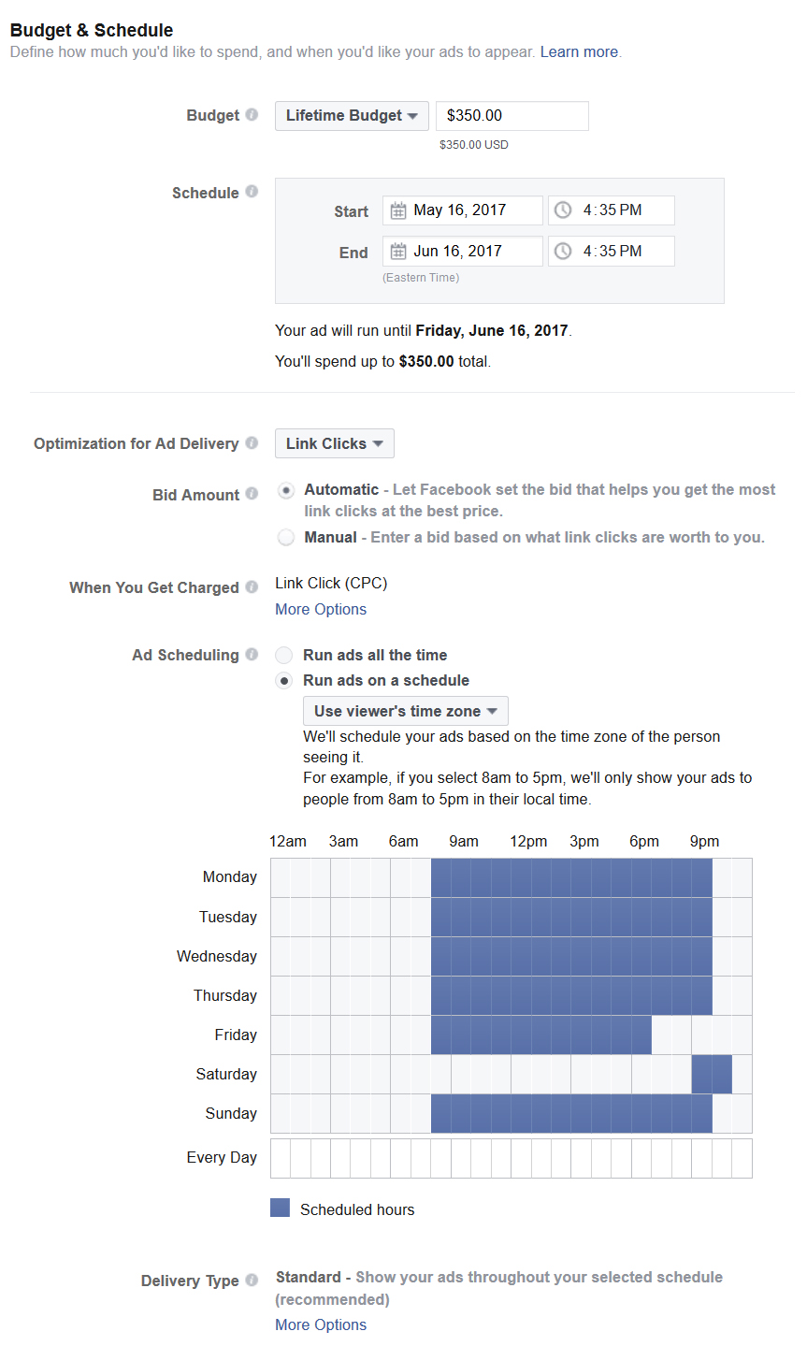
What to consider:
Lifetime versus Daily Budget:
I recommend a lifetime budget to prevent you from accidentally overspending.
Timeframe: you must spend at least $5 a day.
Optimization: generally, let Facebook choose the recommended option.
Bid Amount: automatic is the best option; let Facebook’s algorithm work for you.
Scheduling: you can let Facebook decide or you can choose specific days and times to run ads.
Example: you can set it up so ads don’t run on the Sabbath in the time zone of the person seeing them.
Live Demonstration>>

Slide 37
Types of Ads
Determining purpose
SDAdata.org l @DigiEvangelism

Slide 38
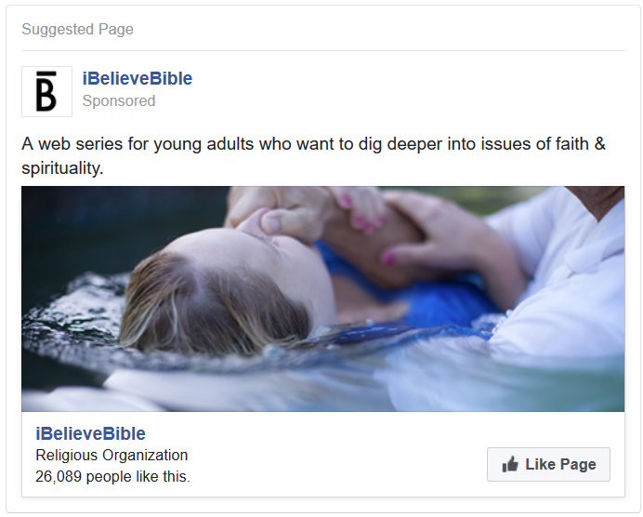
Promote your page.
Page like ads:
Increase your Facebook following.
Create or increase brand awareness among a targeted audience.
SDAdata.org l @DigiEvangelism

Slide 39
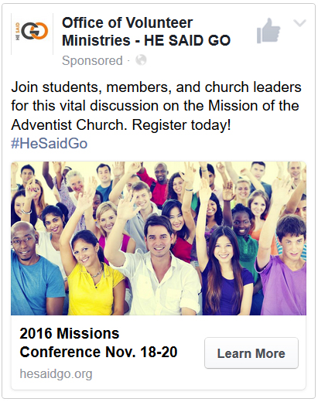
Website Ads
Send people to your website to:
Increase attendance at an event.
Increase traffic to your website.
Promote content or a product.
Increase brand awareness.
Claim an offer.
SDAdata.org l @DigiEvangelism

Slide 40
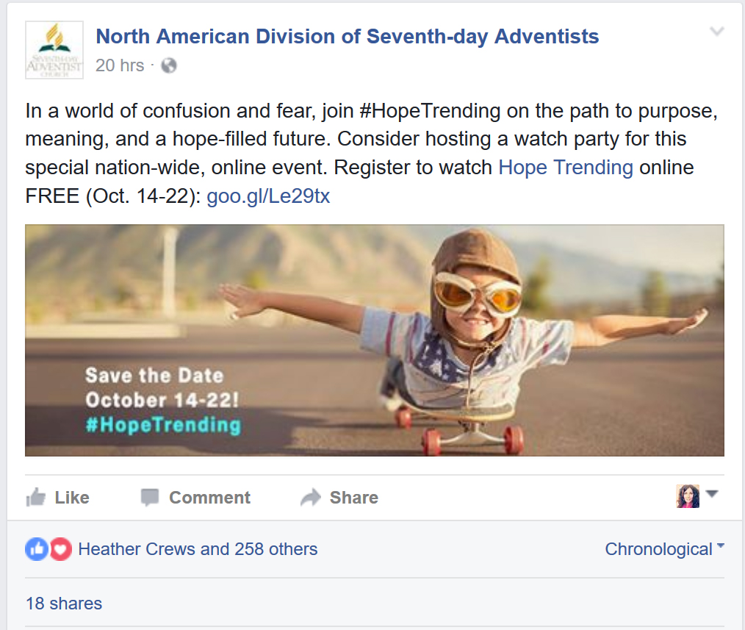
Boosted Posts
Boost your posts in order to:
Ensure your content reaches more of your fans.
Expand the reach of your content.
Facebook is a business that needs to make money, therefore it limits unpaid reach. This means only about 10-20% of your fan base will actually see your posts in their news feed. You can counteract this by boosting key posts to reach more of your fan base.
SDAdata.org l @DigiEvangelism

Slide 41
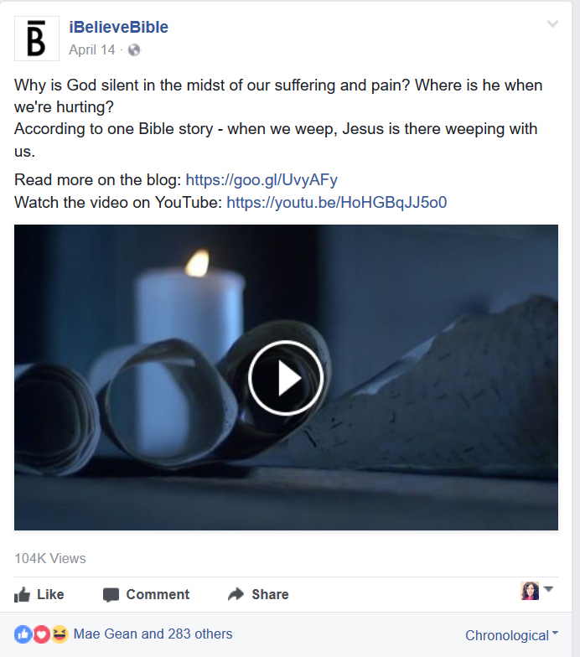
Video Views
Get video views:
Increase video reach to a targeted audience.
Increase video engagements & views.
Tell your story to a wider audience (video is king).
SDAdata.org l @DigiEvangelism

Slide 42
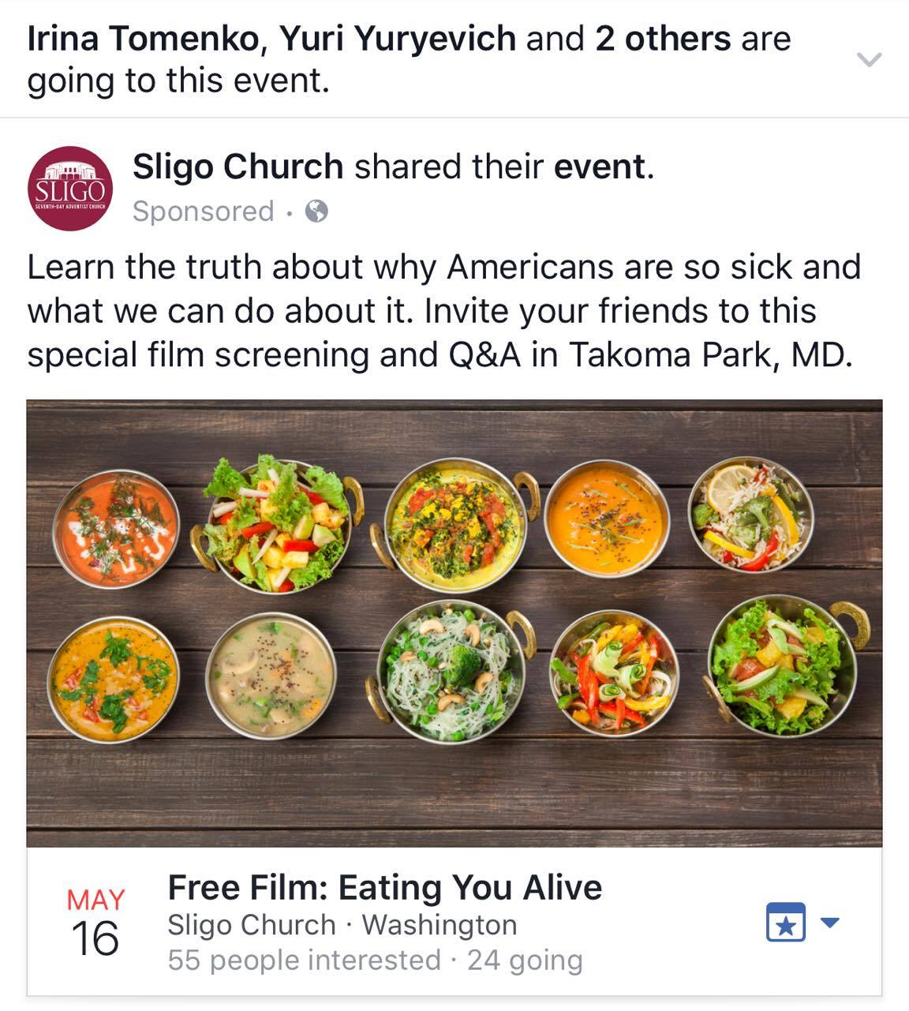
Event Response Ads
Promote a Facebook Event to:
Enable fans to easily share about the event and invite their friends.
Increase attendance and awareness.
Take advantage of crowd mentality (I can see that my friend is going so I want to go too).
SDAdata.org l @DigiEvangelism

Slide 43
General Tips
To optimize the effectiveness of your ads:
Limit text in images & use high quality images.
Facebook has free stock imagery you can use in the images section of the ad creation tab.
Keep text brief but provide context.
Always target your audience.
Include a clear call-to-action.
Be honest; no bait-and-switch marketing.
Include captioning on videos.
Visit SDAdata.org/resources for more information on how to write for social media.
SDAdata.org l @DigiEvangelism

Slide 44
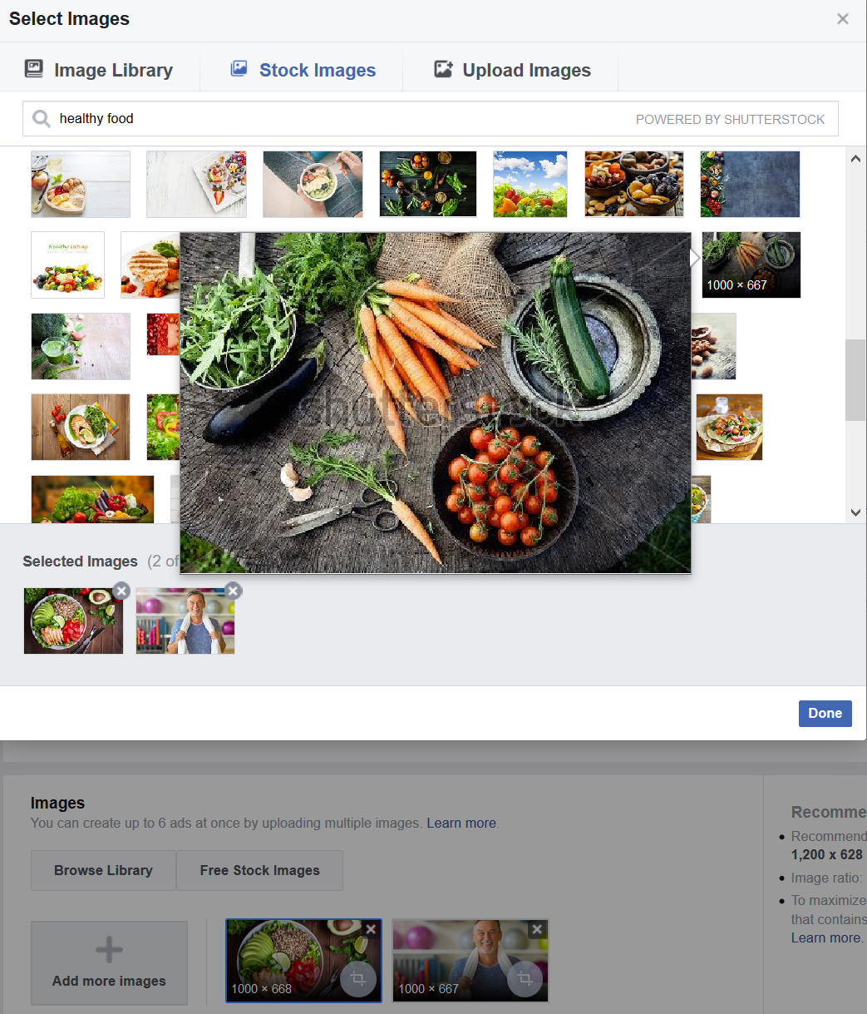
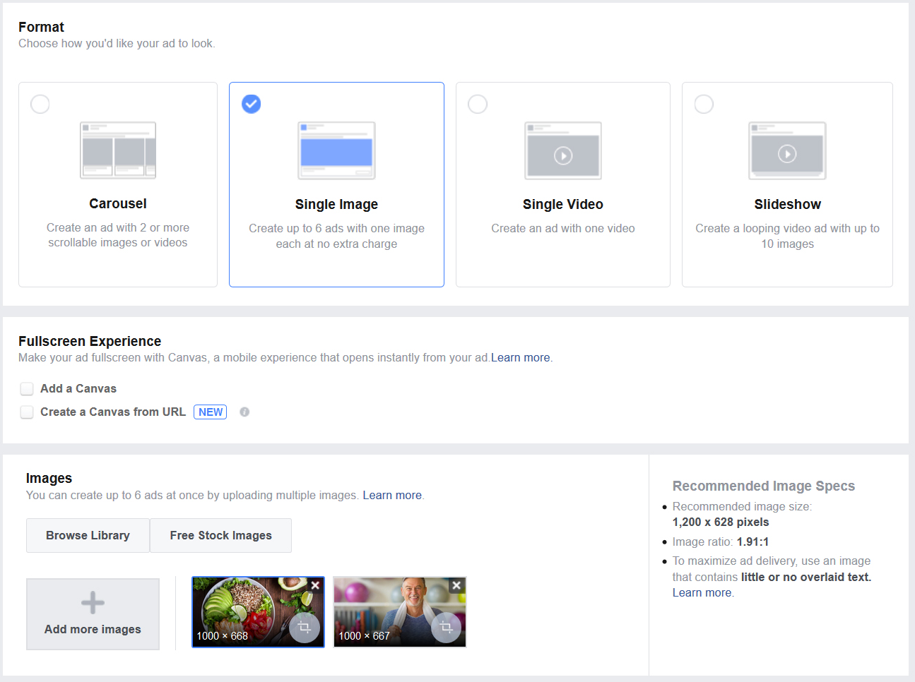
Ad Images
SDAdata.org l @DigiEvangelism
Notes:
You can test up to 6 different images on an ad. I recommend a mix of your own high quality images and stock images. You may also want to consider a slideshow or carousel if that would make sense for what you are promoting.

Slide 45
Analysis
Making sense of the results
SDAdata.org l @DigiEvangelism

Slide 46
Facebook Ads Insights
Check your ad performance regularly to make changes and optimize as needed.
Understand where your ads are appearing and who you are actually reaching.
Understand what the numbers mean.
Monitor engagement/response.
Test images and audiences (A/B Testing).
Connect performance to Google Analytics and follow visitor behavior using trackable links.
Check regularly during the course of a campaign as results will shift over time as the algorithm adapts.
SDAdata.org l @DigiEvangelism

Slide 47
Key Terms
Highlights: as defined by Facebook Business Manager
Results: The number of times your ad achieved an outcome, based on the objective you selected
Reach: The number of people who saw your ads at least once. Reach is different from impressions, which may include multiple views of your ads by the same people.
Impressions: The number of times your ads were viewed
Frequency: The average number of times each person saw your ad
Cost per Result: The average cost per result from your ads
Aim to keep this below $0.50.
SDAdata.org l @DigiEvangelism

Slide 48
Key Terms continued
Relevance: A rating from 1 to 10 that estimates how well your target audience is responding to your ad.
Aim for at least a 6, but an 8-9 rating is preferred.
CTR (Click-through rate): The percentage of times people saw your ad and performed a click (all clicks).
Aim to keep this above 3%.
CPM: The average cost per 1,000 impressions
CPC (All): The average cost for each click
Aim to keep this below $0.50.
SDAdata.org l @DigiEvangelism

Slide 49
SDAdata.org l @DigiEvangelism
Notes:
Any questions before we jump into the next presentation which will focus on tracking, analytics and paid ads?

Slide 50
#DigitalEvangelism
@DigiEvangelism
Notes:
If you have questions directly for me during the rest of the conference, feel free to use my branded hashtag #DigitalEvangelism or reach out by tagging me on Twitter @DigiEvangelism

Slide 51
Connect with us
Follow @DigiEvangelism on Facebook, Twitter, and Instagram for tips, courses, resources, and videos. Or visit SDAdata.org and subscribe to our eNewsletter.
Alvin Kibble, Vice President
alvinkibble@nadadventist.org
Paul Hopkins, Director
paulhopkins@nadadventist.org
Jamie Domm, Digital Strategist
jamiedomm@nadadventist.org
Notes:
If you want to learn even more about how to use social media for evangelism, follow us on Facebook, Twitter, and Instagram for tips, courses, resources, and video tutorials. All Free. You can also visit SDAdata.org and sign up for our quarterly eNewsletter.

