Slide 1
#DigitalEvangelism for Churches
Meeting the Needs of God’s Children in the digital space
Jamie Jean Domm

Slide 2
SDAdata.org l @DigiEvangelism
Notes:
Social media is a vital tool for accomplishing the mission of the church in the 21st century. My purpose is to empower and equip you for using technology to effectively communicate your message and meet the needs of your members and community. I feel that we each have an obligation to be social media ambassadors for the gospel within our sphere of digital influence.

Slide 3
Where the people are
33% of the world population
will be on social media.
Source: TrackMaven
Notes:
Global social media usage is on the rise and this year, 33% of the world’s population will be on social media. Depending on how we respond to this reality, social media presents either a huge opportunity or challenge for the gospel. I believe that the next great awakening, will be a digital one. Not only can we reach our neighbors more effectively, but we have the ability to preach the gospel to millions worldwide, from anywhere, so let’s do it. We need every single one of you to commit to being a digital disciple. We can amplify the three angles message online with a loud voice.

Slide 4
SDAdata.org l @DigiEvangelism
Notes:
There is a great need for training and resources related to digital communications. We, as a church, have dropped the ball but I’m hoping you will join me in this mission to use technology for the Gospel. We’re going to cover a lot of practical information. You can sign up afterwards to receive this presentation. You can always reach out to me on social media with your email address and I’ll happily send it to you.

Slide 5
Blueprint for success
goals/dreams
equipping your team
creativity/innovation
passion
integrated communications
digital strategy
member care
positive results
SDAdata.org l @DigiEvangelism
Notes:
Our department is here to help you determine your goals and dreams, build the foundations of a digital strategy around these objectives, help you create an integrated communications strategy that works together across traditional and digital promotions, train your team and church leaders to embrace these techniques, help you cultivate an atmosphere of creativity, innovation and passion for our shared mission, guide you on path to building meaningful connections with members and community online, and ultimately help you measure and achieve results.

Slide 6
What leadership can do starting today
Include digital strategies in short and long-term visions and goals.
Dedicate funds for social media promotions.
Dedicate time for training you and your staff.
Identify staff who could take on social media as part of their job duties (this may mean taking something off their plate).
Invest in young people; give them space to utilize their skills in this area for the church.
Take advantage of all our free resources, classes, and case studies on SDAdata.org.
SDAdata.org l @DigiEvangelism
Notes:
As leaders you can…

Slide 7
Strategic Planning
Strategic planning is simply the process of being intentional and thoughtful with your digital communications.
SDAdata.org l @DigiEvangelism
Notes:
Your church can no longer go without a digital strategy, the stakes of the gospel are too high. We must learn to be just as effective as secular organizations at using digital media for communication and community building.

Slide 8
Social Media Audit
Evaluate Accounts & Platforms
Analyze Data
Assess Audience Reach & Demographics
Research Effectiveness of Current Strategy
Identify Key Performance Indicators
Implement Branding & Best Practices
Establish Purpose & Goals
For best practices visit: SDAdata.org/social-media-guidelines
Notes:
Evaluate your accounts and platforms, are you using the right ones for your audience and mission, and are there opportunities for consolidation. Less is more. When you streamline your communication efforts, you will achieve greater impact.
Look at your data to determine who you are reaching, effectiveness of strategy, and areas for best practice implementation. Look for issues with your foundation and current strategy, and start thinking about social media goals, target audiences, and key metrics.
Define your purpose for being on social media, and frame your strategy accordingly. Many churches fall into the trap of reactive digital communications verse proactive. Reshape your strategy so that you are ahead of the ball.

Slide 9
How do you want to be known?
[PATH OF CREATIVITY]
Marketing
[KEYWORD THEME]
Public Relations
[ORG NAME]
Corp. Communication
Organizational name in various iterations
Keywords and themes
Concepts that connect to mission and name
External audiences
Internal audiences
Evangelism
A blending of marketing and corporate communications
SDAdata.org l @DigiEvangelism
Notes:
Redeveloping your department and/or your strategy takes a lot of behind-the-scenes homework. Involve people in your team throughout the process so they could share in ownership. This is especially important for choosing a handle or name for your social media profiles.

Slide 10
Branding is the process of revealing the most complete picture of an organization to its audience through perception, experience, and essence. Brands are communicated, not just created. A brand is based entirely on a customer’s experience.
Credit: Heidi Baumgartner
SDAdata.org l @DigiEvangelism

Slide 11
Brand Basics
Brand: represented by its logo, its color, its type, its images, its designs, its tone of voice, its customer service Brand Strategy: defines the message and how to say it Brand Guidelines: a system of managing the brand
Your brand strategy and digital strategy work together, and are part of an overarching grand communications strategy that includes traditional means of outreach and experience.
Digital
Traditional
Branding
Experience
SDAdata.org/branding-image-design-resources

Slide 12
Establish branding consistency.
Make sure all your social media profiles look consistent and use the same name.
Reserve your name on all platforms.
Use a consistent name (15 characters or less; short/simple; stands test of time; no numbers, symbols, or punctuation).
Use the same profile photo & a consistent design look.
Use the same headline, blurb, or bio.
Develop a consistent voice/tone.
SDAdata.org l @DigiEvangelism

Slide 13
There should not be a disconnect between how a person is nurtured in the pews and how they are treated online, or vice-versa.
SDAdata.org l @DigiEvangelism
Notes:
Social media as an extension of your church brand and voice online. Your brand is how your church is perceived.
Strong digital brands create connection and take a comprehensive approach to the member experience. Treat your members online as if you’re talking with them face-to-face. Their online interactions with you should make them want to experience your faith/mission in person. Then when they to come for that onsite experience, it should be a continuation of the positive relationship you’ve built with them online. This applies also in reverse.
How your online followers perceive your ministry influences their perception of not only the Adventist church corporately but God, even if you haven’t put any effort into creating or managing your brand. Because in the absence of your story, people will fill in the blanks themselves.. Your digital voice may be the only opportunity your followers have to see Christ’s love demonstrated in their life.

Slide 14
In all brand touchpoints, tell a consistent story!
Experiences
Employees
Customer Service
Products Services Packaging Proposals
Public Relations Word of Mouth Wearables Ephemera
Networking Presentations Speeches Trade Shows
Websites
Social Media
Videos
Newsletters Publications E-Marketing Literature
Signage Environment Exhibits Vehicles
Advertising Sales Promotion Direct Mail Billboards
Letterhead Business Cards Telephone Voicemail
Brand Touchpoints
Image Credit: Heidi Baumgartner
Notes:
Ephemera = things that exist or are used or enjoyed for only a short time

Slide 15
Understanding Purpose
Start a Conversation
Make Connections
Break down Barriers
Influence Network
Advance the Gospel
Friendly
Human
Approachable
Connect to God
Connect with others
Connect others to gospel
Open communication
Listen
Restore relationships
Calls to action
Get involved
Connect/Follow
Grow God’s kingdom
Encourage social media ambassadors
Credit: Heidi Baumgartner
SDAdata.org l @DigiEvangelism
Notes:
The biggest problem I see with ministries using social media is that they have no clear objectives. You must determine your purpose and shape your online communications accordingly.
The auditing process helps you to evaluate your communication and should led you to rebranding. Define your communication purpose: for example, to advance the gospel and influence your community.

Slide 16
Social Media Goals
Increase fan base.
Increase event attendance & participation.
Increase community awareness.
Encourage social media ambassadors.
Develop digital disciples.
Reach target groups.
Communicate core values.
Create connection.
Define why you are unique.
Set expectations.
Create clarity and focus.
SDAdata.org l @DigiEvangelism
Notes:
Once you have a purpose, you can set goals. Determine what you are trying to achieve. Then came up with a strategy and budget.

Slide 17
Rebranding
Social Media
eNewsletters
Website
Publications
Color Palette
Helpful Resources
identity.adventist.org
SDAdata.org/branding-image-design-resources
Credit: Heidi Baumgartner
SDAdata.org l @DigiEvangelism
Notes:
Next develop your identity across all platforms and channels as part of your overall brand. Social Media does not work in a silo, it should be integrated in your broader communications, both digital and print.

Slide 18
Decide on your target audience.
Things to consider:
Location
Age
Gender
Race/language
Interests
Needs
SDAdata.org l @DigiEvangelism
Notes:
Before you even write a single post, it’s important to know who you’re writing for. Once you decide your target audience, then investigate your audience to determine their needs, interests, and perceptions. Conduct surveys and interviews when possible.

Slide 19
Developing audience personas.
“A persona is a fictional character that communicates the primary characteristics of a group or segment of your audience and takes into consideration needs, demographics, motivations, and environments.” Source: The Guardian
Determining your audience personas can help you develop and write content that will be the most relevant and useful to your audience.
SDAdata.org l @DigiEvangelism
Notes:
The best personas are often created by getting out there and talking to your audience, but social media insights can also prove very useful. Personas give a human face to a collection of information and data and they allow you to classify groups for different social media campaigns.
Armed with this knowledge, you may end up writing two posts on the same subject with a different angle for each customer group.

Slide 20
Choose the right platforms/channels.
Where is your target audience?
Everyone is on Facebook, but it tends to skew older and female.
Twitter skews younger and male. It is a place for news junkies and conversation.
Instagram appeals to an audience under age 25 and offers highly visual content.
Snapchat is the second most used platform behind Facebook and is favored by teens.
Pinterest is most commonly used by women of all ages and planners.
More about each platform: bit.ly/SMPlatformInfo
SDAdata.org l @DigiEvangelism
Notes:
To reach your target audience, you must go to where they spend their time online and use the language they use.

Slide 21
Additional Factors to Consider
What is the best format for your product/message?
Which platform is best suited to meet your goals?
What can you manage well?
Pick a few platforms and do them well!
SDAdata.org l @DigiEvangelism
Notes:
It’s very easy to become overwhelmed by all the possibilities. To avoid that, start with just a few platforms that make sense for your ministry, your available human resources, and your goals.

Slide 22
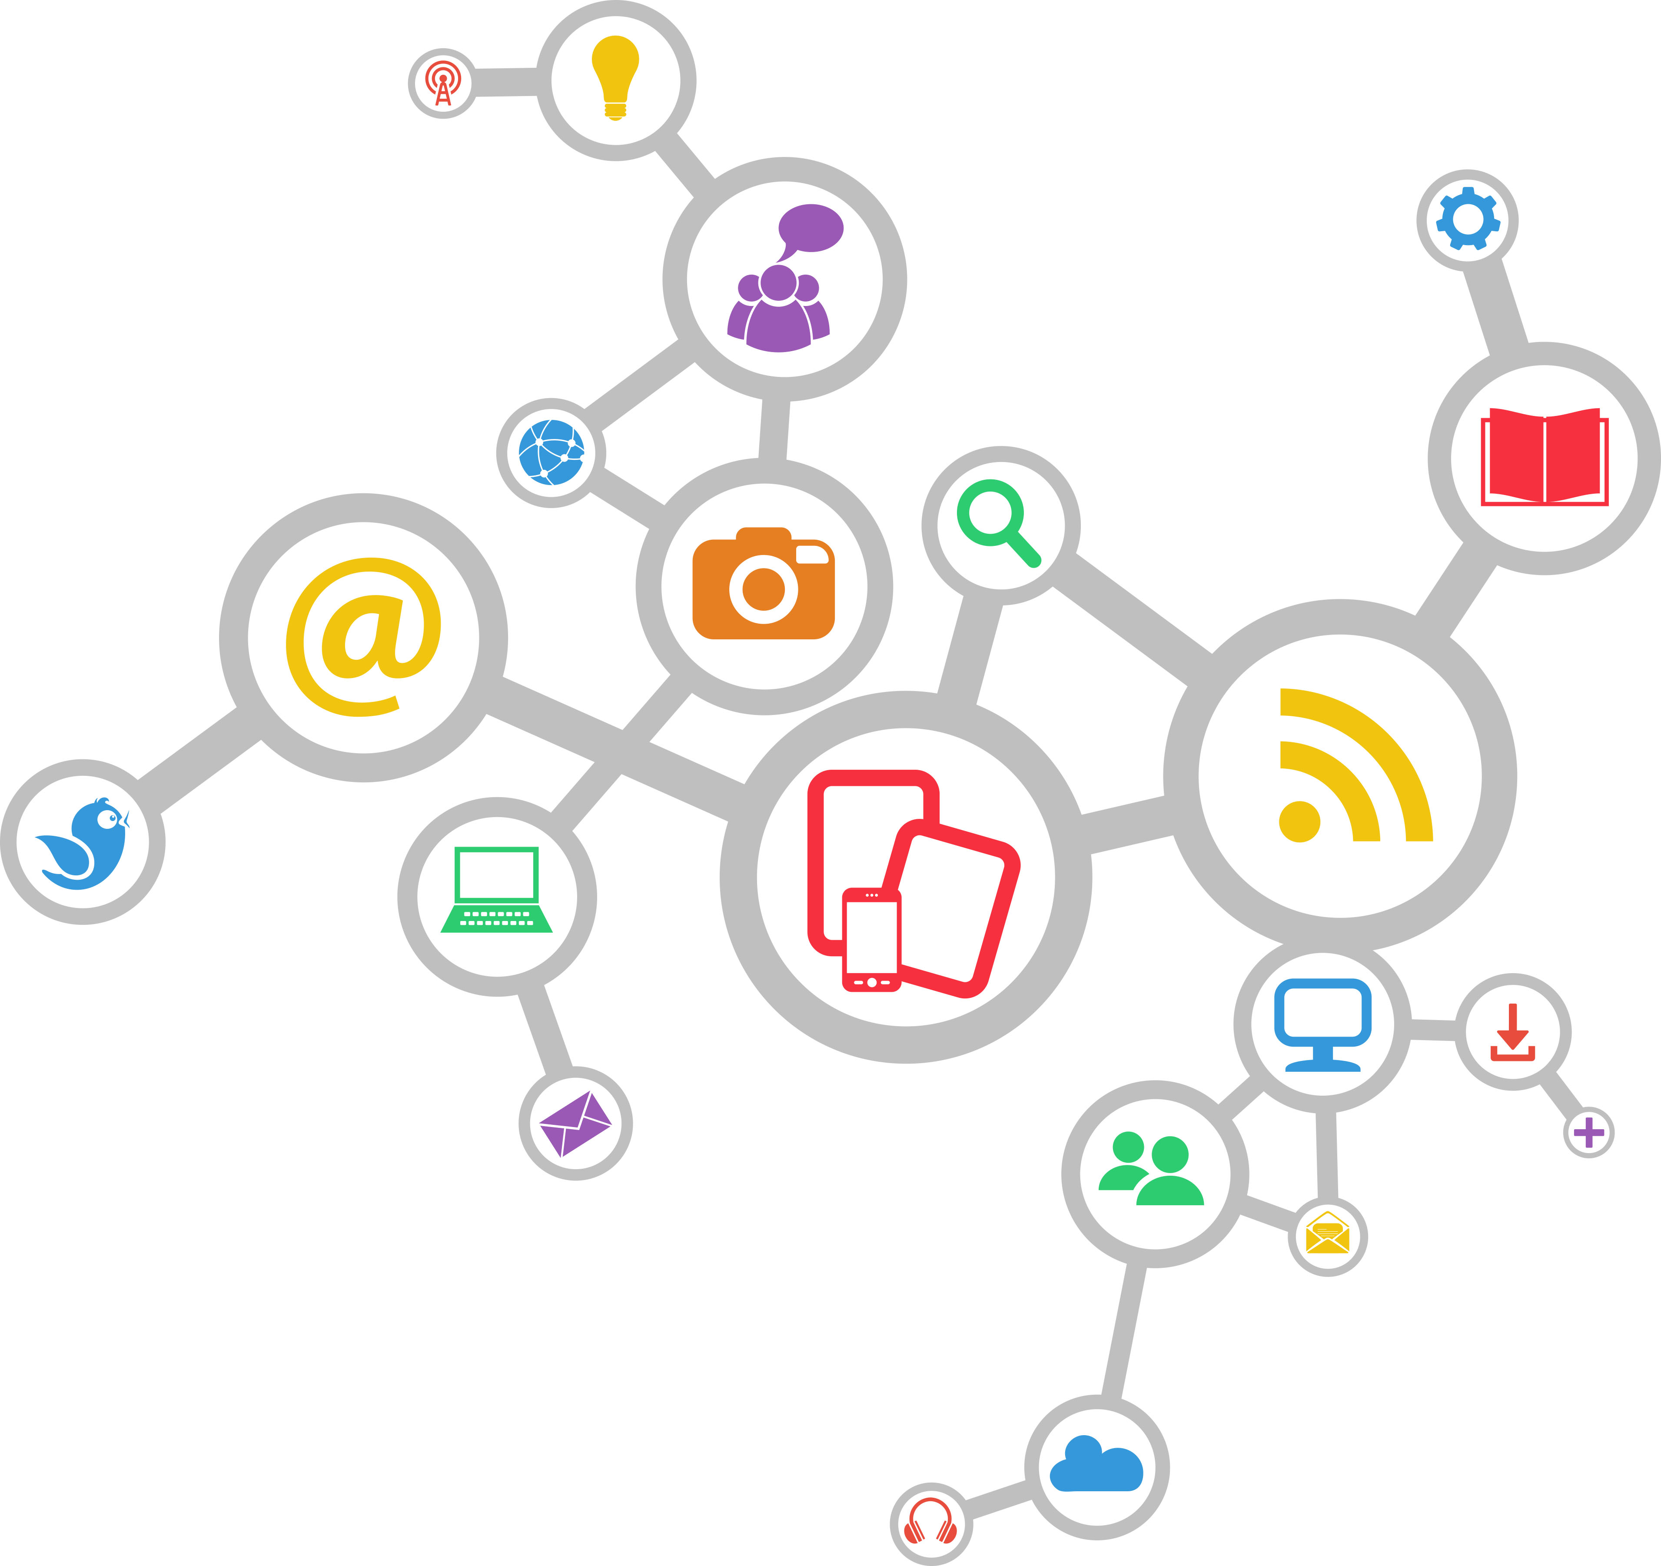
Remember the rule of 7.
The Rule of 7 states that a person needs to be exposed to a message at least 7 times before they’ll take action. Strong campaigns contain multiple touchpoints across different channels:
Print
Email
Social Media
Radio
Television
SDAdata.org l @DigiEvangelism
Notes:
It may take 1,000 tries to reach an individual 7 times with a consistent message. For individuals, your channels might be: in-person interactions and conversations, text messages, flyers, podium announcements, emails, and your social media profiles. Combined, these are your personal brand, think about how to leverage them to reflect Christ and draw people to the gospel.

Slide 23
Cut through the noise.
Develop a comprehensive strategy that makes use of all your available communication tools to cut through the clutter.
Use social media to magnify the impact of traditional means.
SDAdata.org l @DigiEvangelism
Notes:
It is estimated that the average adult is now exposed to over 3,000 marketing messages a day. Therefore, develop a multi-channel, multi-platform strategy to cut through the clutter.

Slide 24
Content Strategy
People search online for answers to their problems; what better place for the church to engage them?

Slide 25
Content strategy
Know your voice.
Create a pattern of frequency.
Provide diversity of content (images, video, news, registration reminders, speaker highlights).
Post content your audience responds to.
Tell your story from different angles in different ways.
Communicate important information such as deadlines.
Build urgency leading up to key dates.
Be human and authentic.
Invite engagement.
SDAdata.org l @DigiEvangelism
Notes:
Speak to your mission and to your audience. That is your voice? Everything you say in your posts should ‘sound’ like your brand and reflect the image you wish to portray.

Slide 26
Strategies to Overcome “Facebook Zero”
The plan has always been to reduce the organic reach of Pages’ posts to zero.
What you can do
Create delightful content: make someone laugh, cry, or surprise/provoke them
Make it shareable: short videos or graphics whose content is entirely within the app
Create dialogue: posts that receive a lot of comments, get ranked higher and shows up in more News Feeds.
Use Facebook Ads: paid momentum can build into organic reach
Consider other platforms: think multi-channel, multi-platform
SDAdata.org l @DigiEvangelism
Notes:
Facebook’s latest announcement that its algorithm will favor posts from friends and family instead of Pages means your church or organization’s Facebook page posts aren’t going to show up in your fans’ news feeds very much anymore

Slide 27
Repurpose what you produce.
You’re already doing most of the work. Publishing it digitally enables you to grow your potential audience exponentially, beyond the worship service.
Sermons (live-streamed too)
Studies for small groups
Blog posts
Messages from the pastor
Videos
Pictures from events
SDAdata.org l @DigiEvangelism
Notes:
A great amount of what you produce for your church ministries is content: sermons each week, studies for your small groups, blog posts, messages form the pastor, videos, pictures from events etc. Always look for content you are already creating and see how it can fit into your overall content strategy
This can be rather inexpensive, with long-term value as the content stays in place for people to discover far into the future. Valuable content will help your audience in a tangible way, either emotionally, physically, spiritually, or psychologically.
Can you imagine if every church live-streamed it’s sermon on Sabbath? We could take over.

Slide 28
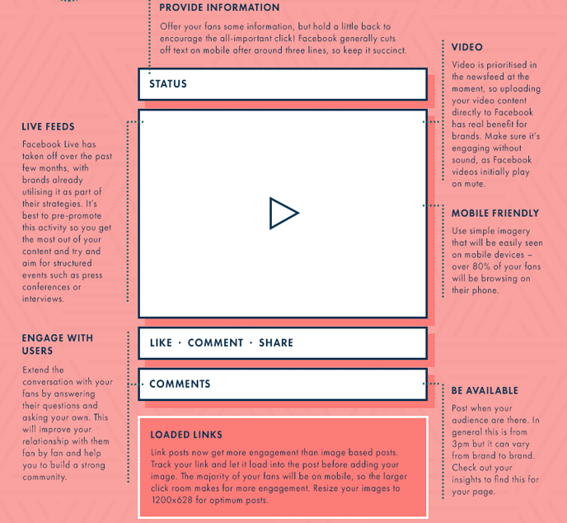
Learn to write for social media
Get to the point & focus your message.
Less IS MORE (think snackable content).
Include a call-to-action.
Include a link.
Use the lingo of the platform.
Tag relevant accounts.
Use relevant hashtags.
Download a comprehensive guide to writing for social media: bit.ly/SMwritingGuide
SDAdata.org l @DigiEvangelism
Notes:
Just because you use social media, doesn’t mean you know how to write to achieve a goal.

Slide 29
Internal v. External
Are you speaking to Adventists or non-Adventists?
Internal:
Church members
Church leaders
North American Division
Faith communities: city/neighborhoods/ministries
External:
Broader community: neighborhoods/city/state/metro areas
Businesses
Related causes
Local news
SDAdata.org l @DigiEvangelism
Notes:
Are you speaking to Adventists or non-Adventists? Your language should change based on the answer to this question. Be careful to not use Adventist speak when addressing external audiences.

Slide 30
Total Member Involvement & Evangelism
[INREACH]
[OUTREACH]
How well are you communicating to your members…really?
Remember: The Rule of 7 states that a person needs to be exposed to a message at least 7 times before they’ll take action.
Strong communication utilizes multiple touchpoints across multiple channels. Examples: emails, bulletin, mailing, flyer, social media, website, podium announcements, etc.
What messages, if any, are going to the community?
Notes:
Total member involvement starts with an informed congregation.

Slide 31
Spectrum of Communication
Marketing
Advertising & promotion
Social media & big data
Inbound marketing > SEO
Community building
Direct marketing (print/online)
Mobile marketing
Education & evangelism marketing
Public Relations
Content development
Social media
E-Marketing
Media relations > news releases
Thought leadership > responding to social issues
Webinars / seminars / tradeshows
Corporate Communication
Website
Newsletters (print/digital)
Statements, policies & letters
Editorials & stories
Crisis communication
Employee communication
Upcoming events
Volunteer opportunities
EXTERNAL
SOME OF BOTH
INTERNAL
Department Function
Administrative Function
Credit: Heidi Baumgartner
SDAdata.org l @DigiEvangelism
Notes:
The church doesn’t quite know what to do with marketing. We are more comfortable in the public relations and corporate communications roles. Thought I think we can do a better job at internal communication than what we’re doing. Digital communications allow us to speak directly to our members.
If you consider marketing to be digital evangelism, determine how you balance out internal and external communication.
Challenge question: What if 25 percent of your week was devoted to external communication online? In a four-day work week, that’s one full day. Your church should be known for something in the greater community. This is your opportunity to set aside time to disciple to them online.

Slide 32
Build a team
To succeed, you must invest the time and manpower.
Position descriptions: SDAdata.org/guidance-for-hiring
SDAdata.org l @DigiEvangelism
Notes:
While expanding your churches influence online can be relatively cheap, it can involve a lot of time. Your team can be made up of volunteers and staff. And I highly recommend giving the younger generations the opportunity to own some of this, especially when it comes to your youth ministries.
If you’re a large church and have the budget, consider hiring a social media manager either full-time or part-time to direct efforts and manage the strategy.

Slide 33
Making Room for Digital Discipleship
Empower the tech savvy members of your church; make them feel that the church values their time and talents.
Create personal ministry opportunities; train empathic people to engage in conversations online and to become content creators.
Engage in “Digital Door Knocking.”
Create a culture of sharing and content engagement.
Utilize and empower influencers and “pods.”
Content Creators
Engagers
Distributors
SDAdata.org l @DigiEvangelism
Notes:
Empower talented young people in your church
Form a team of content creators, you most likely have various church members who could specialize in certain areas. These can be powerful personal ministry opportunities, especially for empathetic persons who can facilitate positive conversations online.
Determine ways to engage in Digital Door Knocking by meeting the needs of people within your community in the digital space, around a digital need or by utilizing a digital tool.
Post your upcoming community events on Facebook and train your members to share and invite their friends and neighbors to events automatically.
Create a culture of sharing and engaging with church content as a means for individuals to help the church’s mission, and expand the reach of their messages. Anybody who is on social media, can share your content. You can event set up training sessions.

Slide 34
Be your own social media ambassador.
For best practices visit: SDAdata.org/social-media-guidelines
Notes:
Set the example for your congregation. You each have a network of followers and so do your staff and volunteers! Talk about how God is moving in your life, invite people to your events, tell them about what your doing. Most people trust their friends over a brand promoting itself. Be the human face behind your ministry or cause. If you can Instagram your lunch, you can do this. Most of you are probably not working in a silo, so find ways to include and involve your team in your strategy.
For best practices on use of personal social media, download the NAD social media guidelines.

Slide 35
Additional Tips
Other ways to improve your social media strategy

Slide 36
Guidelines for Choosing Good Photos
Keep it visual, less text is more.
High quality (take your own or use stock images).
Invoke an emotional response/tell a story.
People are attracted to bright colors and group shots.
Keep a consistent look, brand, and color/font palette.
Be creative.
Use contrast to help your image stand out.
Keep it simple.
SDAdata.org l @DigiEvangelism
Notes:
Keep these guidelines in mind when choosing images for ads as well.

Slide 37
80/20 rule
Social media is not only a conversation. View it like a social gathering place.
20% “sales” messages 80% engagement (or content marketing)
Don’t keep telling the same story the same way. Utilize diversity of content and keep it relevant.
SDAdata.org l @DigiEvangelism
Notes:
You wouldn’t hard sell your friends at a get together on your business, but you might talk about your goals, ambitions, and share your general excitement about what you have planned or why it’s important. The same is true for social media. Be authentic, transparent and human.

Slide 38
Get organized
Develop a content calendar.
Share calendar with your entire communications team.
Schedule posts in advance (increased flexibility).
Plan across multiple platforms at once.
Content calendar template: bit.ly/SMCalTemplate
SDAdata.org l @DigiEvangelism
Notes:
You can download this template and adapt it for your needs. I like using google docs to share my calendars with my team. Here is a template for a general content calendar.

Slide 39
Engaging Your Audience
Post reach and interaction will ebb and flow based on personal preferences, that day’s attitude, the news, that evening’s supper, or just the busy-ness of life. Keep posting. Keep interacting. Keep adapting.
SDAdata.org l @DigiEvangelism
Notes:
When you initially revamp your social media, the changes in post engagement should show immediate and positive results. But over time things may plateau or even dip during the holidays. You’ll learn to see patterns over time, keep pressing forward. Often times social media efforts fail because people give up too early.

Slide 40
Paid Ads and Budgeting
Facebook is a business that needs to make money, therefore it limits unpaid reach. This means less than 10% of your fan base will actually see your posts in their news feed. You can counteract this by boosting key posts to reach more of your fan base and placing ads to expand your reach to new audiences.
Determine your target audiences.
Determine your budget.
Start with a test, then expand based on results.
SDAdata.org l @DigiEvangelism

Slide 41
What’s appropriate to spend?
It Depends
Small Budget Example
$500-$1,500 budget
$50/event
$150/large events
$100-250/ quarterly ad campaign (ex: page likes)
Remainder: “What-if Experiments?”
SDAdata.org l @DigiEvangelism
Notes:
A lot of time people will ask me, “how much does it cost to promote online.” But the beauty of social media ads is that it depends on what you can spend. Social media works very well for small budgets and non-profits. A little can go a long way, but it’s important to spend a little. As your confidence grows and your familiarity with reaching your target audiences grow, you can increase your budget as needed. Ultimately your budget depends on the size of your goals and your purpose. A small local ministry may only need to spend $300 a year where as a nationwide campaign would need $3,000 to create impact within a targeted audience. What you can do: Go through my course power points online, and start with small ad budgets with a clear objective…this way you can learn and maximize your results as you grow.

Slide 42
Member Care
Making the most of your digital influence
SDAdata.org/digital-evangelism-blog/tips-for-your-member-care-strategy
Notes:
Simply having a social media presence is not enough anymore. Your audience expects a response when they engage with you online—often within a few hours. Every opportunity to connect is an opportunity to advance the kingdom of God. Do not waste your digital influence. Social media provides a unique opportunity for long-term member care that can serve to enhance the relationships you cultivate with your members as well as the community your ministry serves.

Slide 43
Bridging the Gap
90% of surveyed consumers have used social media to communicate with a brand.
34.5% said they preferred social media to traditional channels like phone and email.
Q2 2016 Sprout Social Index
Not everyone is ready to come to church; some are not even ready to discuss their issues with someone in person.
Be the voice that answers back and helps open a door for their spiritual experience.

Slide 44
Social media is the new word-of-mouth marketing.
92% of people trust a referral from a friend.
SDAdata.org l @DigiEvangelism
Notes:
Word of mouth is the most powerful form of marketing, your brand and member care strategy should create effective social media ambassadors.

Slide 45
The Proper Care and Feeding of Followers
Your goal in using social media for ministry should be to ultimately understand and fulfill a need, and to make a tangible impact in the real world.
Be available, check engagements regularly, and respond.
Listen and learn.
Focus on building relationships for the next campaign.
Have a live event strategy.
Do not underestimate the power of engagement. There’s no ROI (return on investment) without it!
SDAdata.org l @DigiEvangelism
Notes:
Social media is no different than a conversation. Respond to your audience, share their content, like their comments. Follow the conversation and actively participate. Seek to understand their needs, and respond in a meaningful way. Building relationships can have an impact on brand awareness, trust, financial support, and more. Your goal should be to break down the perceived barrier between the individual and your corporate brand.
Do not underestimate the power of engagement. There’s no ROI (return on investment) without it! Invest the time, build a committee of digital disciples who are available to respond to comments and messages online promptly, and be human. It will pay dividends for your mission. By living out our mission online and exemplifying the character of Christ, we can create social media ambassadors for the gospel, who eagerly share your content and messages.

Slide 46
SDAdata.org l @DigiEvangelism
Notes:
Your online brand is something that must be managed and guarded 24/7. Be prepared to manage or resolve a problem quickly without making it worse.

Slide 47
Address the negative.
Nearly half (46%) of people have used social media to “call out” or complain about a business. That number jumps even higher when you slice the data by generation. Unsurprisingly, Millennials are quick to take their frustration to the keyboard—56% of them have complained or called out brands on social media. That means that millennials are 43% more likely to call out a brand on social media than other generations. Q2 2017 Sprout Social Index Response Assessment Infographic: bit.ly/NADResponseGuide
SDAdata.org l @DigiEvangelism
Notes:
Member care includes addressing the negative. By being actively engaged online, you have the opportunity to turn negatives into positives by addressing issues promptly and resolving problems. This is especially relevant to younger generations who naturally turn to social media first to share their thoughts and feelings. Through a culture of online customer service and digital discipleship, you can build a reputation as an organization that truly cares about its members and the community it serves.
Not sure how to respond, download our response assessment infographic to help you navigate the sometimes volatile waters of social media member care. I have some printed versions for you as well.

Slide 48
Is it positive?
No
Yes
SDAdata.org l @DigiEvangelism
Notes:
I’m not just talking about negative comments, we should also be prepared to engage with and respond to positive comments. Social media is about building relationships in the community. Ignoring the positive is a lost opportunity to connect.

Slide 49
Highlighted resources
NAD Social Media Guidelines
Assessing Your Response infographic
Hashtag library
Courses – Social Media 101 to Advanced
Social media manager position description
Copyright basics
Guide to free stock images
How to write for social media
Content calendars
And more…
Download at: SDAdata.org/resource-menu
Notes:
All of this for free

Slide 50
SDAdata.org l @DigiEvangelism
Notes:
Any questions?

Slide 51
#DigitalEvangelism
@DigiEvangelism
SDAdata.org l @DigiEvangelism
Notes:
If you have questions directly after I leave, feel free to use my branded hashtag #DigitalEvangelism or reach out by tagging me on Twitter @DigiEvangelism

Slide 52
Connect with us
Follow @DigiEvangelism on Facebook, Twitter, and Instagram for tips, courses, resources, and videos. Or visit SDAdata.org/subscribe to sign up for our eNewsletter.
Alvin Kibble, Vice President
alvinkibble@nadadventist.org
Paul Hopkins, Director
paulhopkins@nadadventist.org
Jamie Domm, Digital Strategist
jamiedomm@nadadventist.org
Notes:
If you want to learn even more about how to use social media for evangelism, follow us on Facebook, Twitter, and Instagram for tips, courses, resources, and video tutorials. All Free. You can also visit SDAdata.org and sign up for our quarterly eNewsletter.

