Slide 1
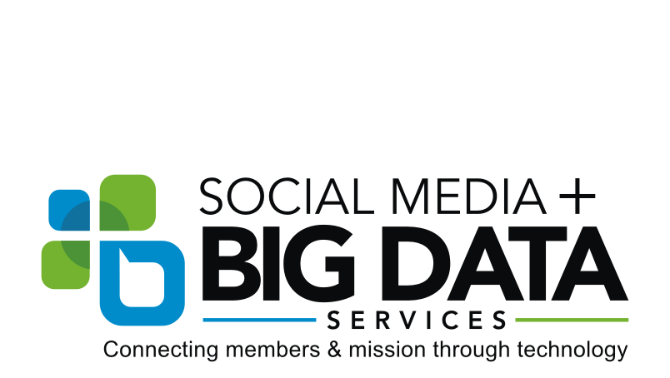
#HopeTrending Digital Strategy Summary Report Jamie Schneider, Digital Strategist

Slide 2
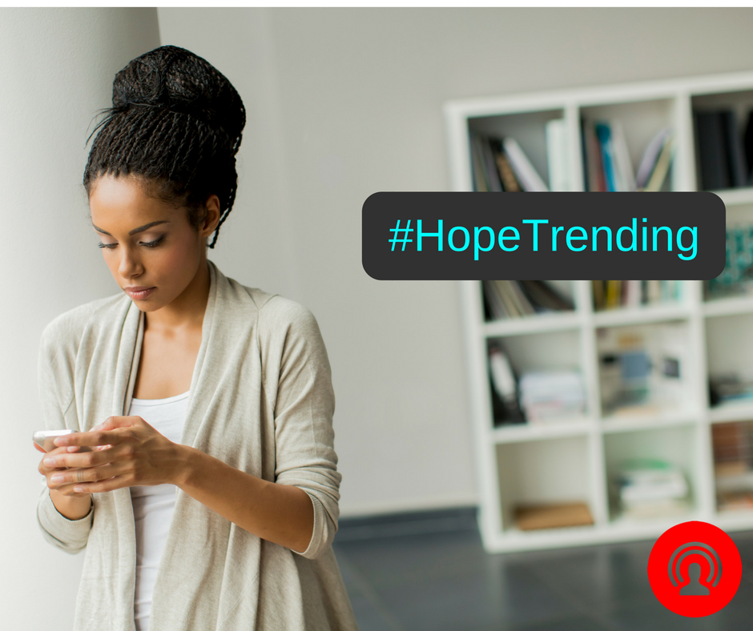
#HopeTrending
Highlights:
Facebook Accounts Reached: 835K
Engagements on FB: 209K
Total Video Views over 3 seconds on Facebook: 233K
Countries reached: Over 149
#HopeTrending Impressions on Twitter: Peaked at 1.2 Million per 1,500 Tweets
Overall website visits (sessions): 49,319 - 25.7% as a result of social media
Trackable impressions (low estimate): 2,099,219
Total Spent: $1,927.82

Slide 3
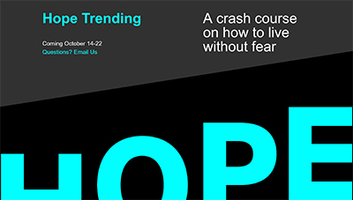
#HopeTrending
Event Summary:
Free, live-streamed event.
Live participatory experience that engaged directly with the audience. (Twitter used as second screen.)
Out-of-the box idea and global.
Accessible wherever there was internet.
Follow-up strategy via hosts, local church members, and social media.

Slide 4
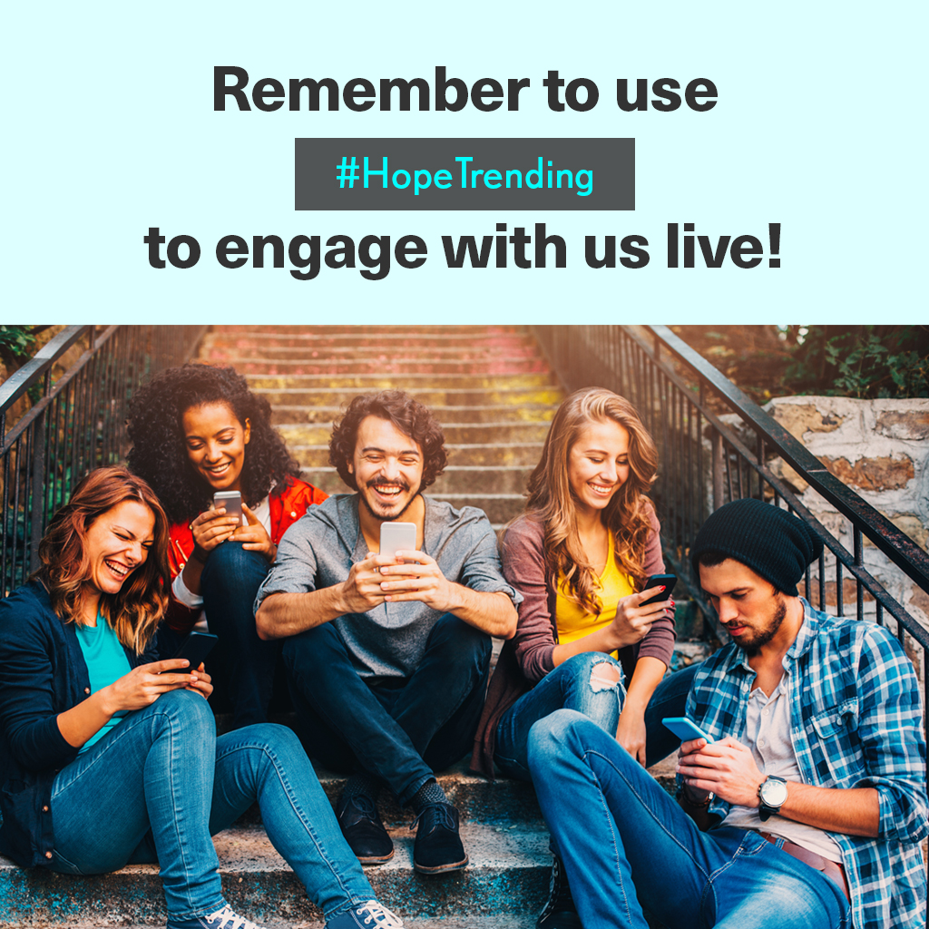
#HopeTrending
Event Summary Continued:
9 events (plus 1 bonus episode).
1 hour long.
Presentation, discussion and live Q&A.
Social media ambassadors.
Hosted a Pioneer Memorial Church in Berrien Springs, MI.

Slide 5
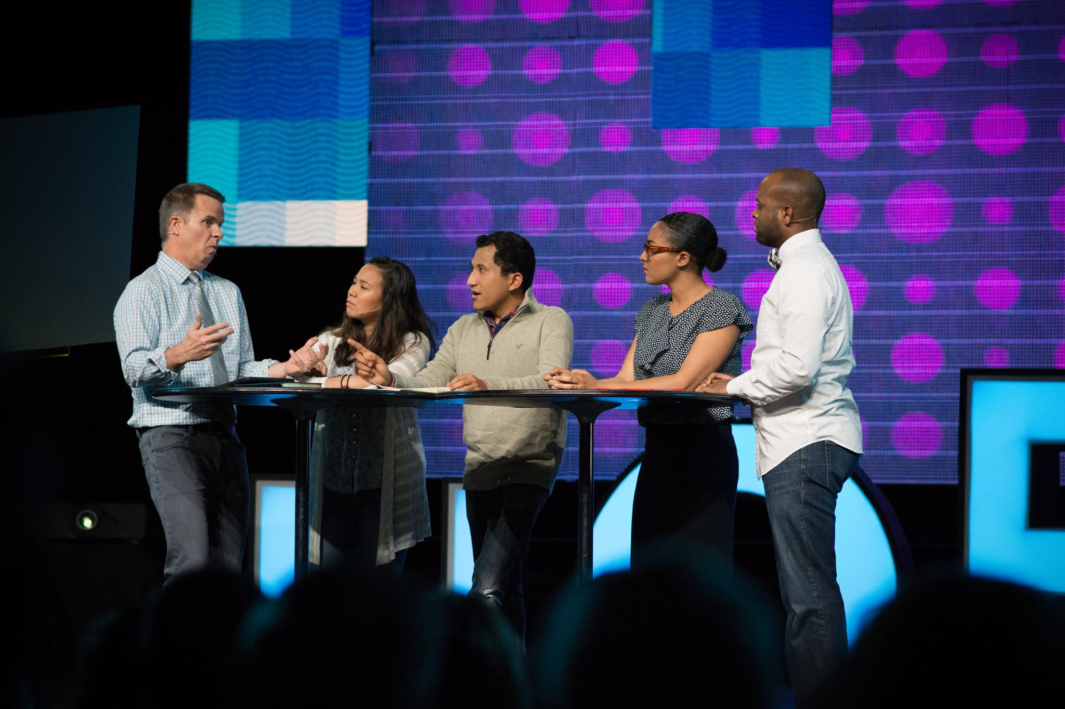
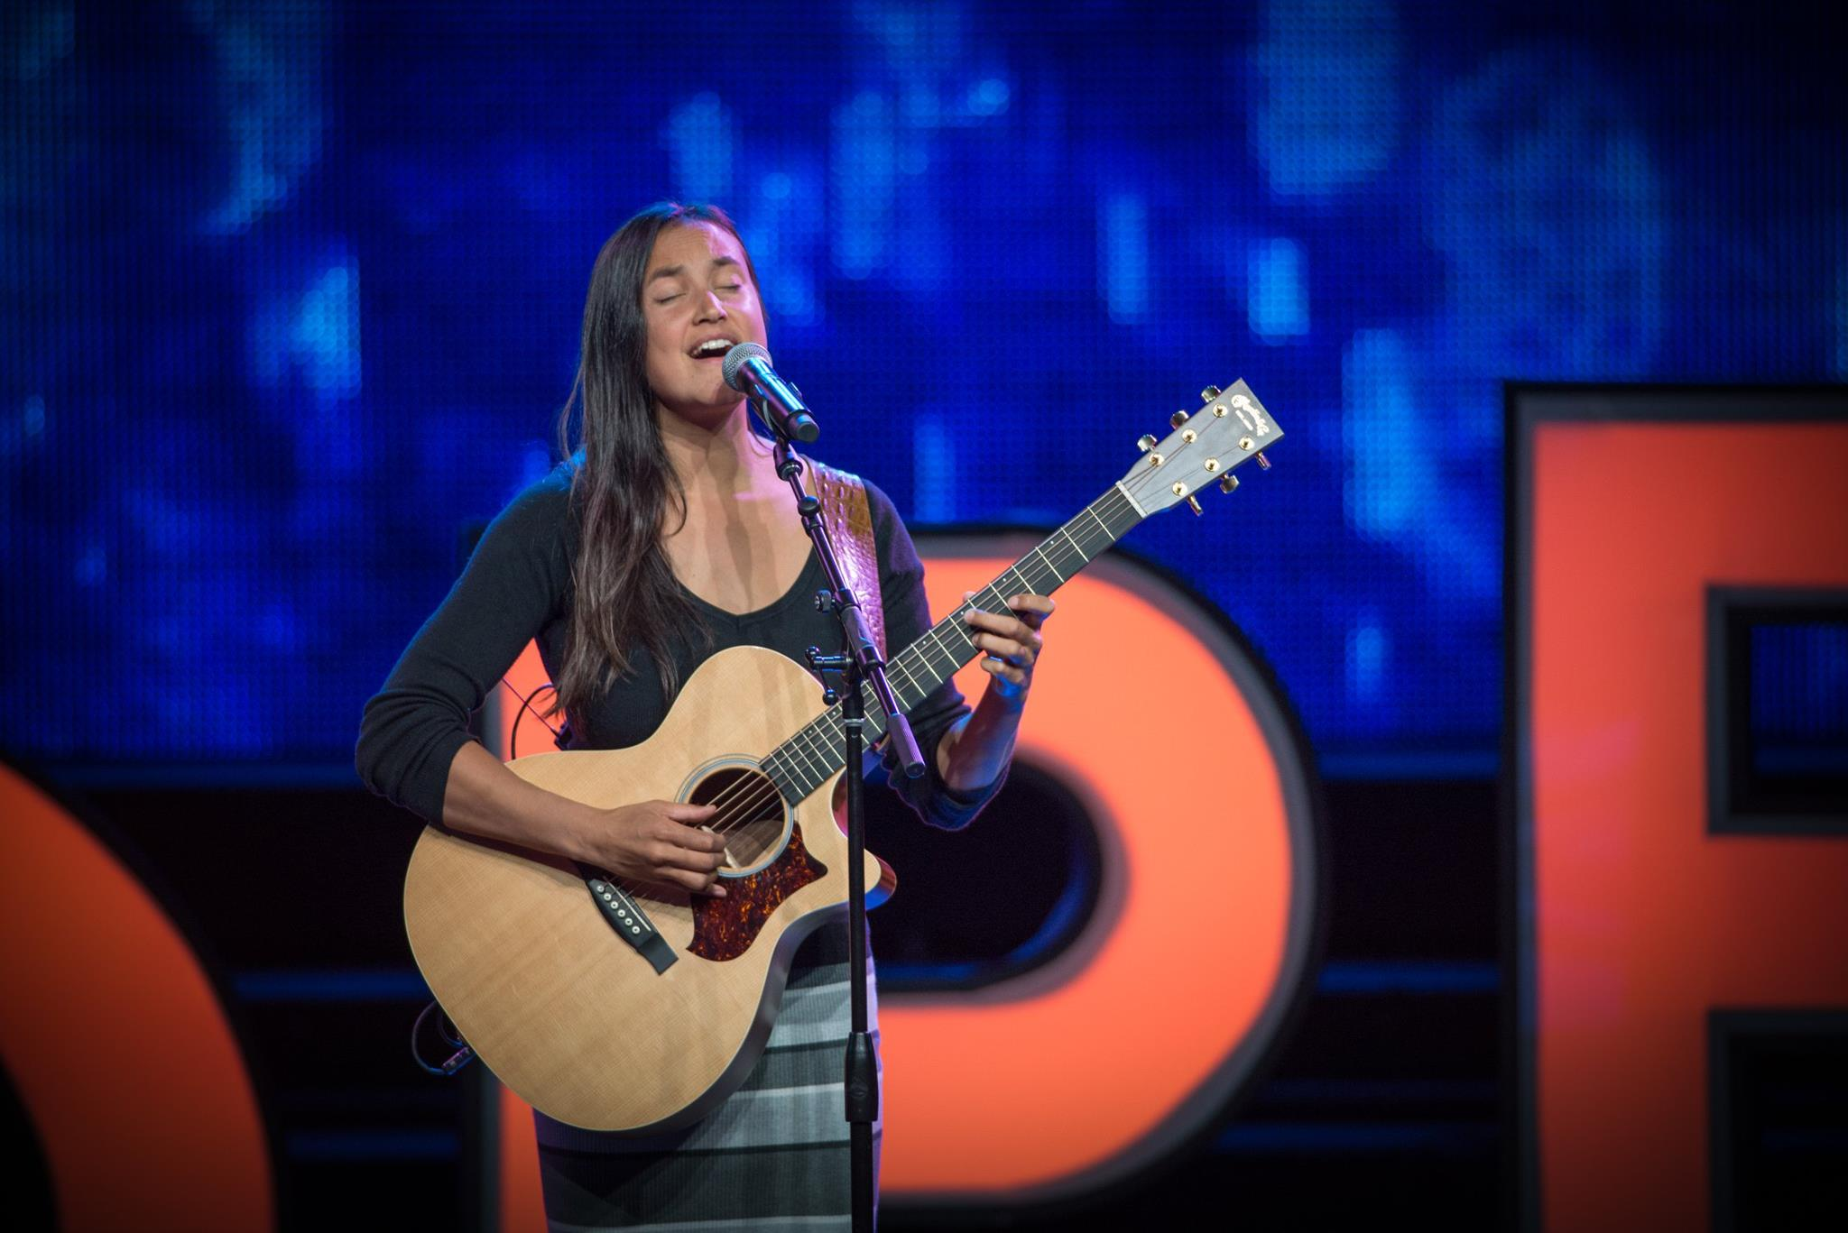
#HopeTrending
Campaign Summary:
4 month social media content strategy to build a following and promote event (schedule available upon request).
Cross promotions with NAD, Hope Channel, Adventist Church, including shares of the live-stream on their Facebook pages.
The communications style, platforms, images, design, everything was geared towards young people.
Multi-Channel, multi-platform (Facebook, Twitter, Instagram, email, digital ads, Adventist Review, Lake Union Herald and Ministry Magazine etc.).
Placed targeted ads on Instagram and Facebook to build a following and push host party registration.
Content mix: custom videos, speaker highlights, pro host tips, countdown, important updates, watch party shout-outs, and costumer service.
Live-tweeted event and shared participant created content. Also Tweeted in Spanish.
Used photos from the event and video snippets to generate daily content during the series.

Slide 6
#HopeTrending
Member Care Element:
Identified and encouraged social media ambassadors at the live event as well as had ‘member care’ teams working around the clock: monitoring the conversation and responding to inquiries in real time.
Questions from the online community were provided to the discussion panel.
Interacted directly with the online community on air by responding to questions and sharing testimonials.
Teams dedicated to prayer and answering theological questions of participants online as comments are posted and messages are sent.
Crisis management of high risk participants.

Slide 7
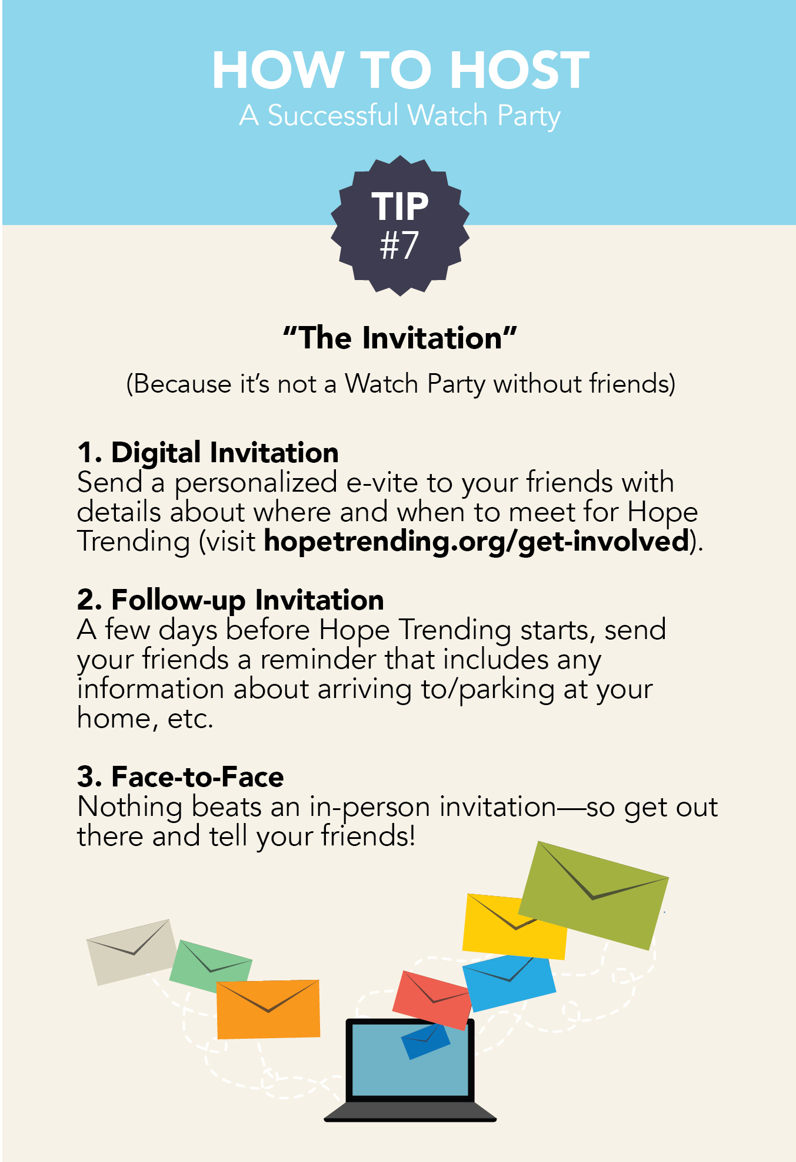
#HopeTrending
Additional Info:
Funded by the North American Division, Members of the Pioneer Memorial Church and the Michigan Conference. (budget available upon request.)
Developed a branding concept that was streamlines across all communication channels.
Budget was limited, marketing was focused on social media.
‘Getting Started Guide’ was created and sent to watch party hosts with information on how to host, where to watch, tips on hosting, etc.
A special, digital #HopeTrending Edition of Steps to Christ was created in partnership with the Ellen White Estate.
Dedicated website was created with a custom database tool for managing watch party registration information internally as well as track attendance.
Wirecast was used to live-stream the broadcast on Facebook LIVE.

Slide 8
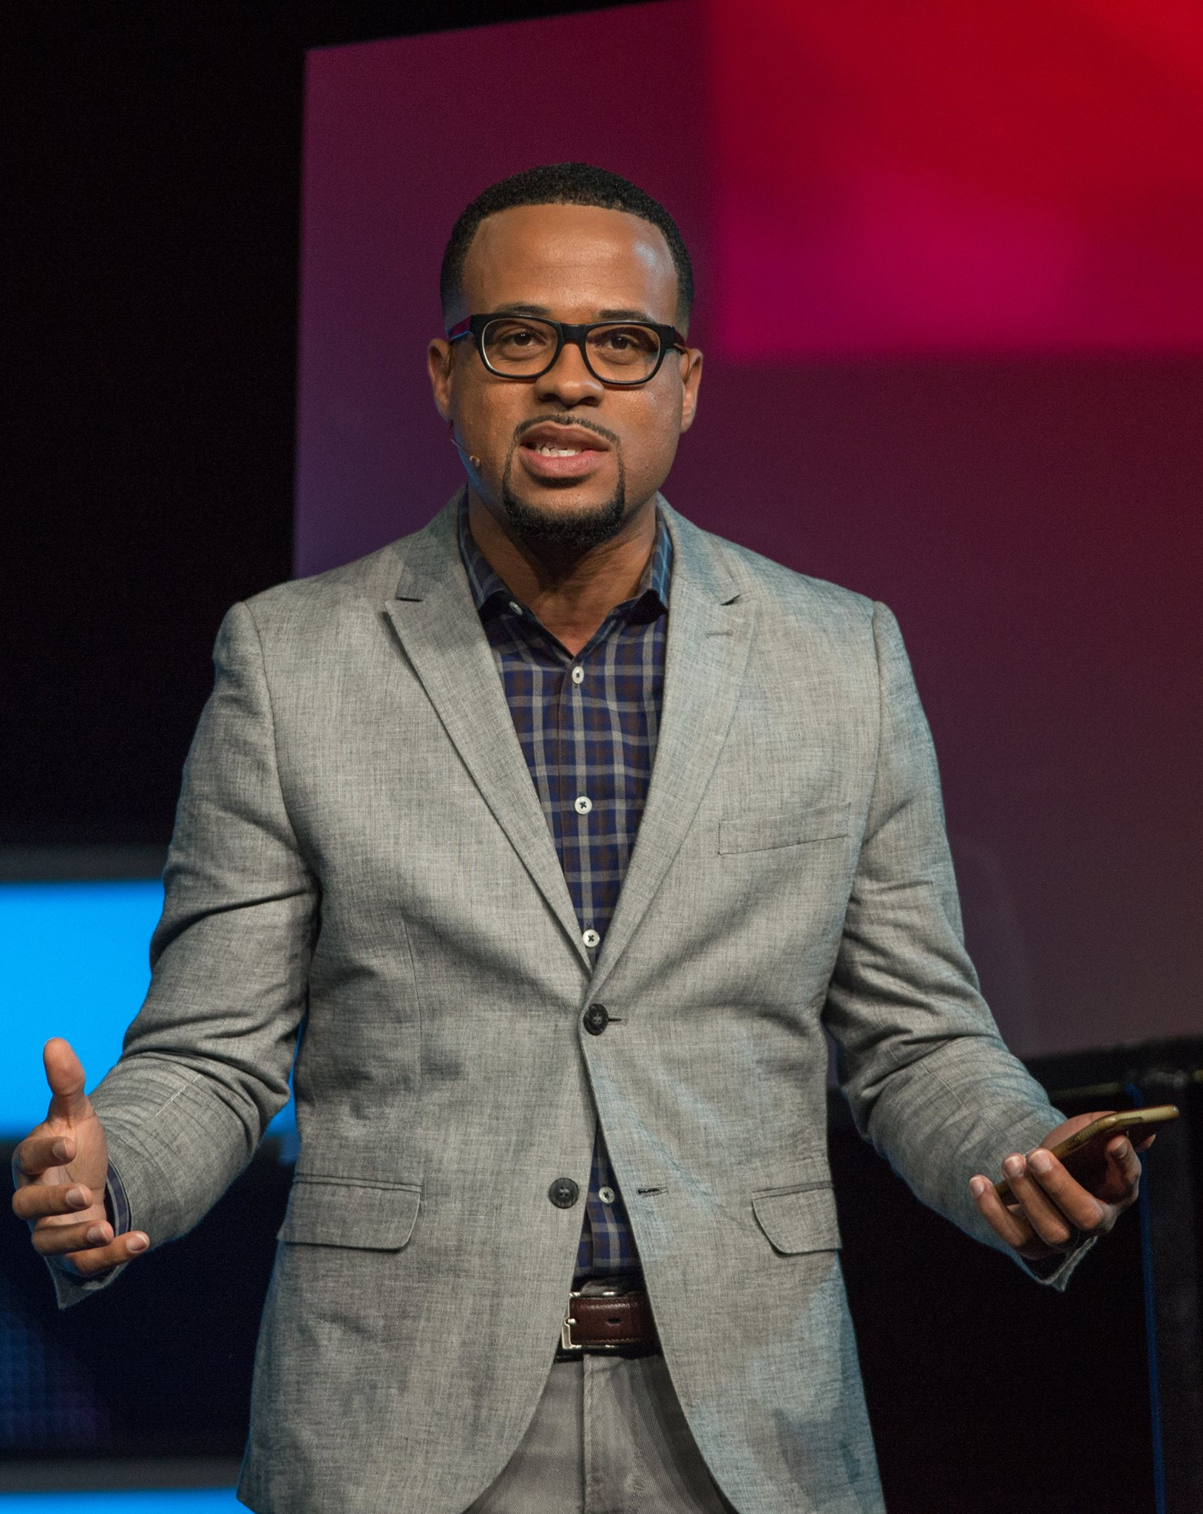
#HopeTrending
What Made This Event Unique?
Live-Steamed in HD on Facebook.
Young adults spend 7-12 hours a day behind a screen, 5 hours on social media.
We met young people where they are, not where we wanted them to be.
They became part of the conversation and could engage with us directly. (breaking down the barrier between the corporate church and the individual member.)

Slide 9
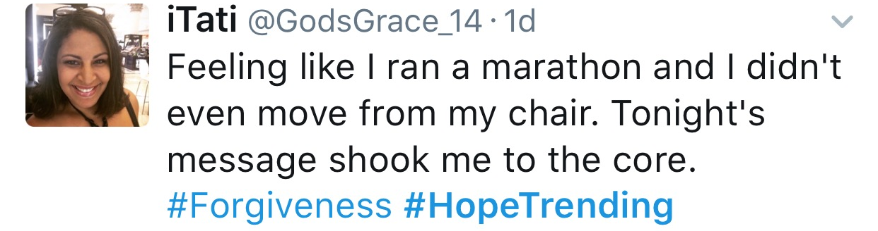
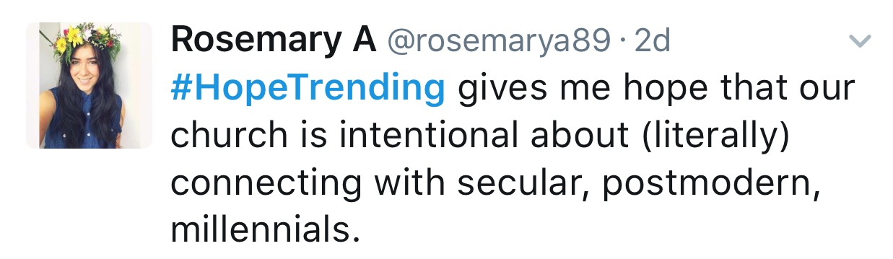
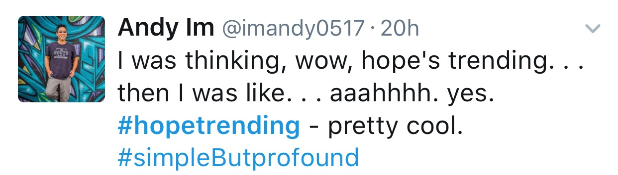
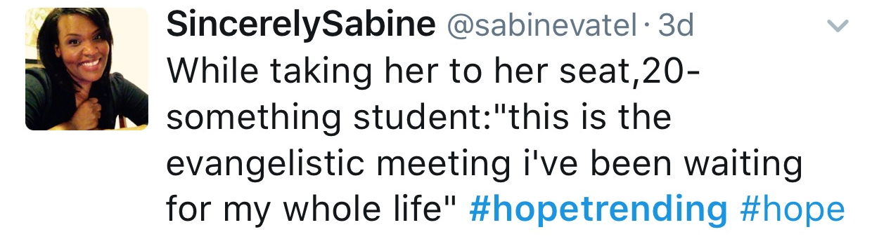
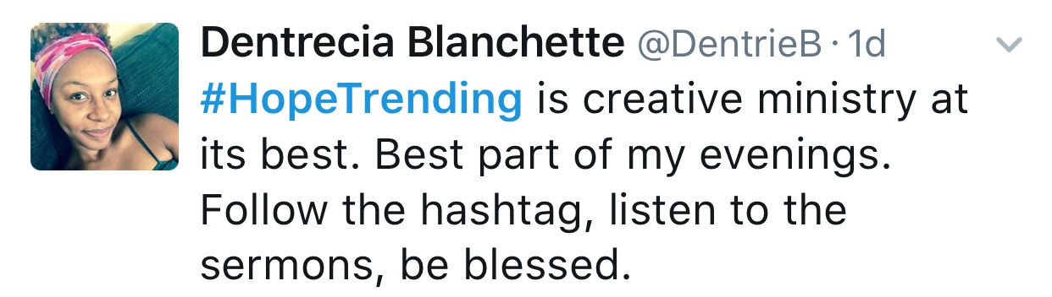
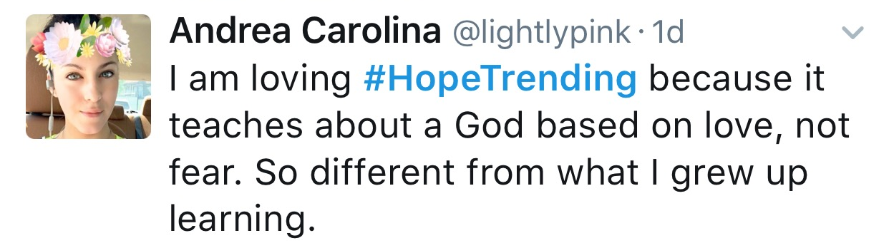
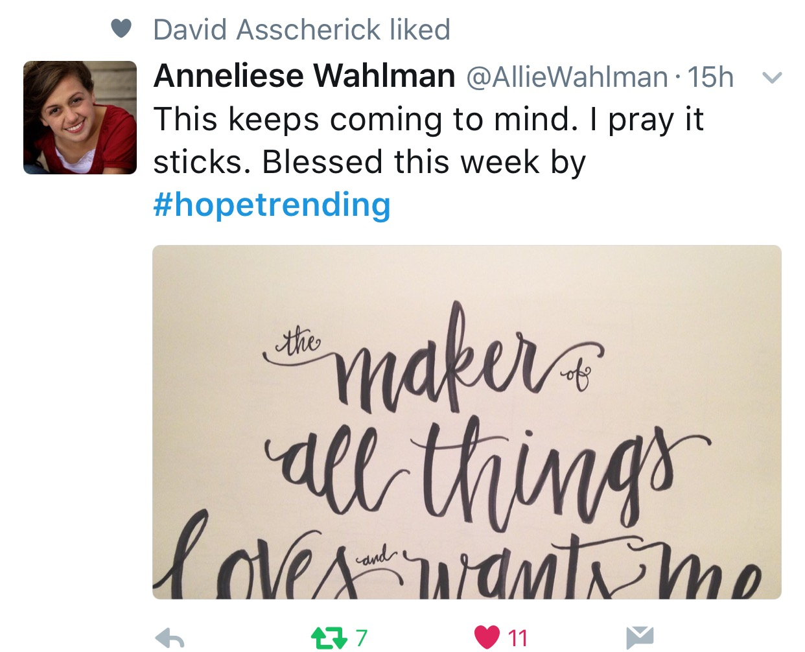
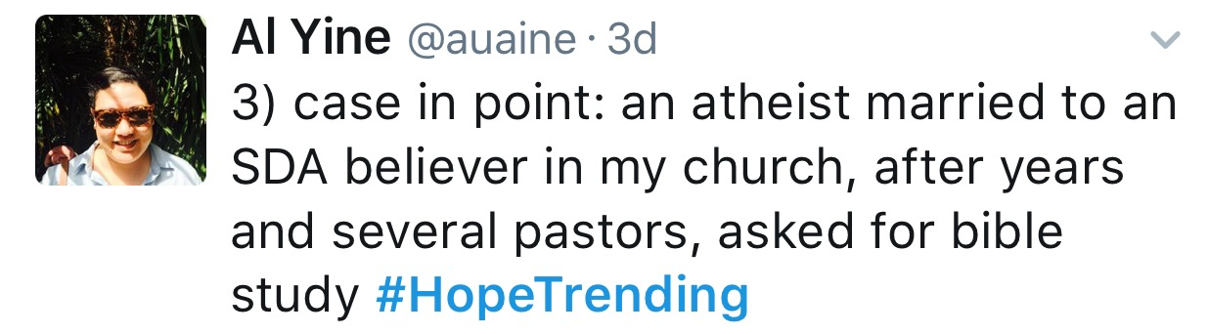
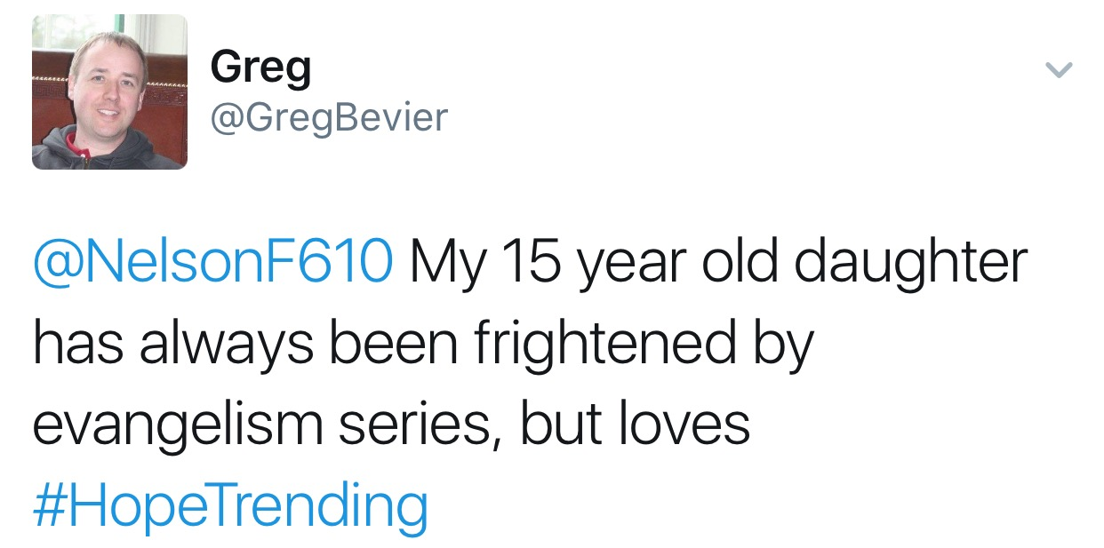
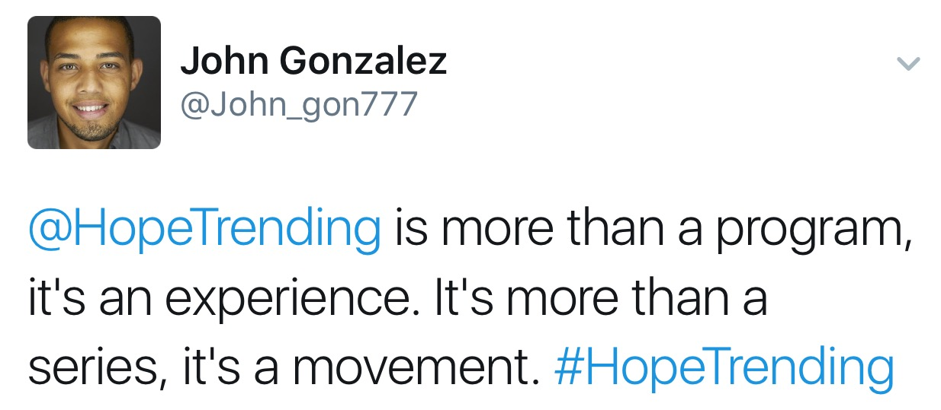
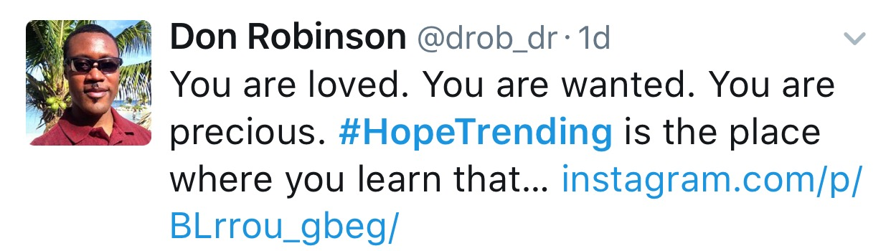
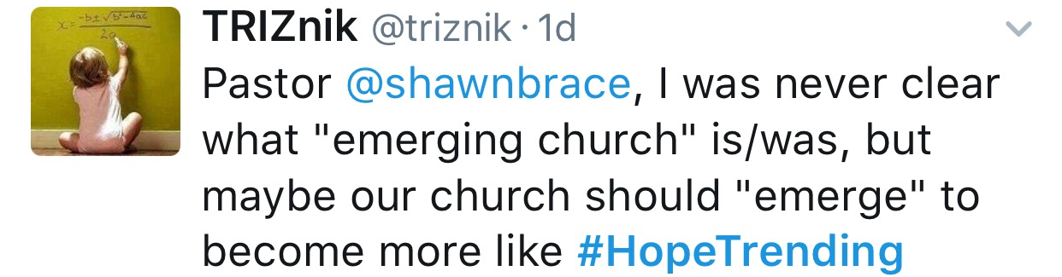
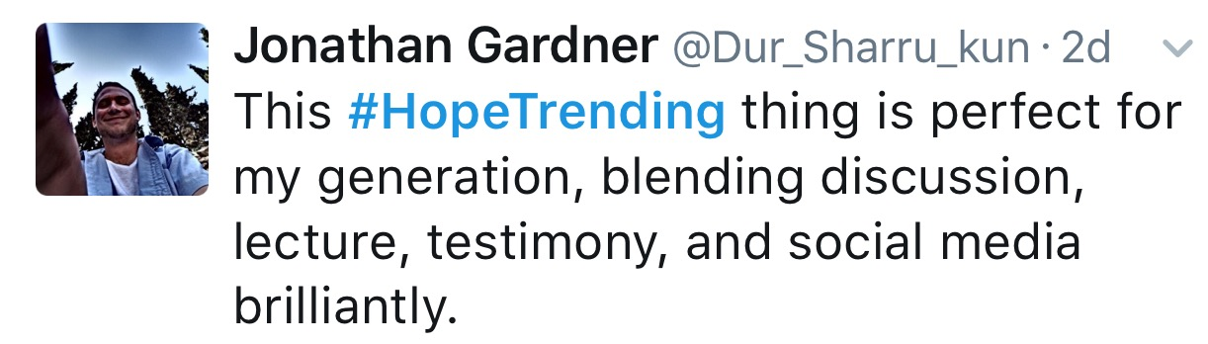
#HopeTrending Testimonials
#HopeTrending broke the bounds of evangelism in the 21st century and had a world wide impact.
Notes:
This is just a sample of testimonies. More are available upon request.

Slide 10
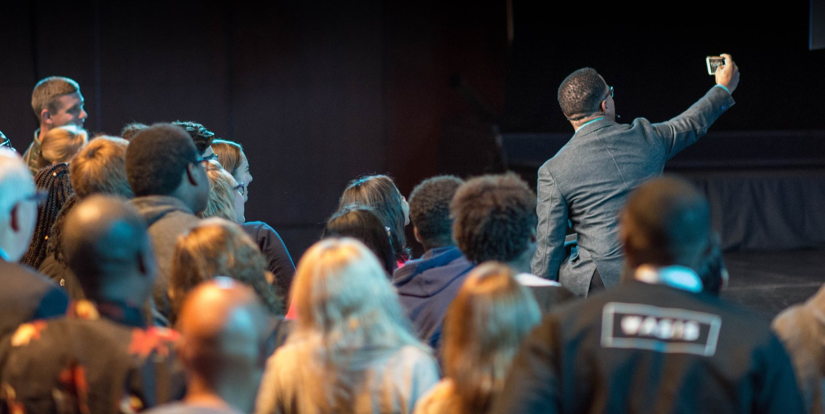
#HopeTrending
Campaign Performance By the Numbers

Slide 11
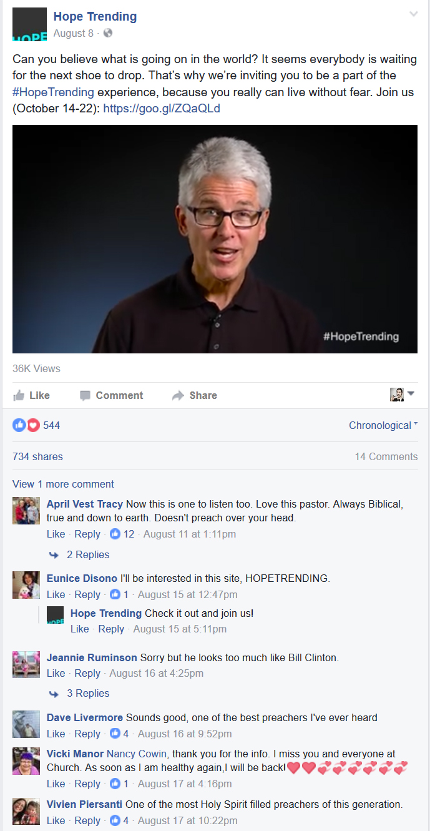
#HopeTrending
Summary of Paid Ads:
Total Spend: $1,927.82
Impressions: 387,143
Clicks: 11,441
Average CTR: 4.39%
Interest & geo-targeted ads to Adventist young adults in US & Canada.
Interest & geo-targeted ads to Adventists & Christians within 25 miles of Berrien Springs.
Boosted key posts & videos on #HopeTrending & NAD Facebook pages.
Ran both Instagram and Facebook Ads.

Slide 12
#HopeTrending
Growth was steady until the launch of the campaign, which saw an increase of 249% in social media followers over the course of the event.

Slide 13
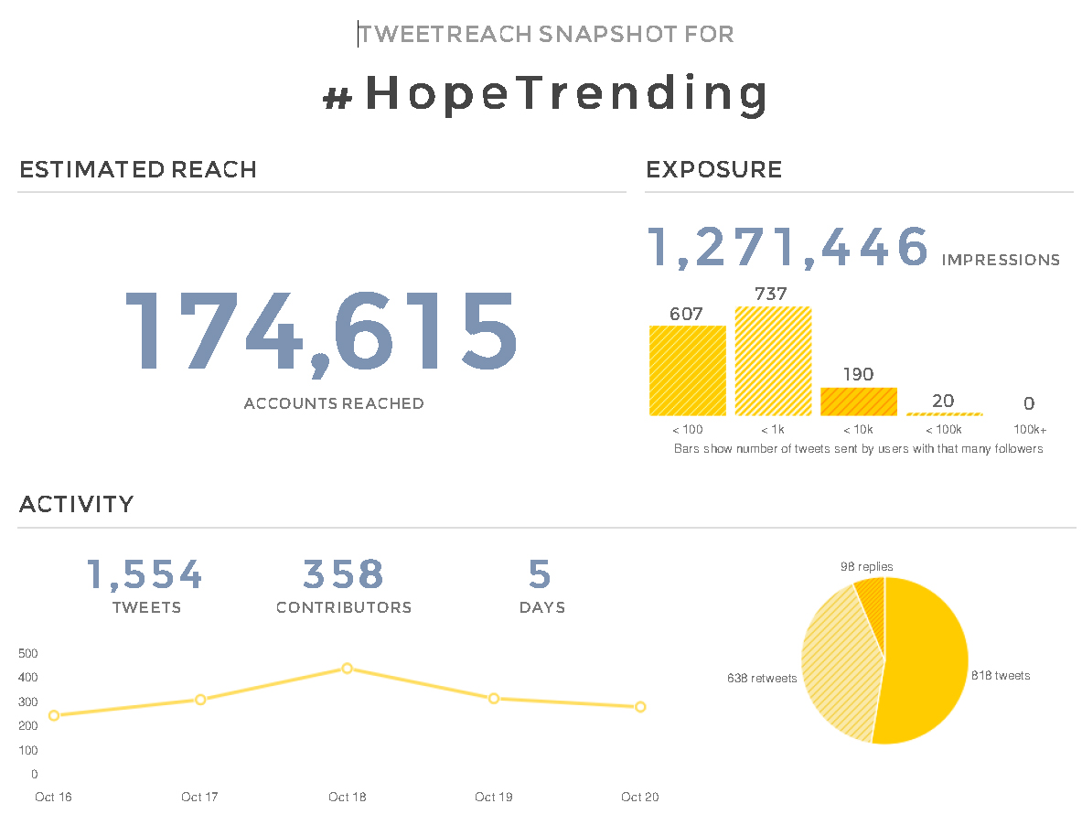
#HopeTrending
Hashtag Reach & Impressions on Twitter:
As a result of retweets and use of #HopeTrending by participants and social media ambassadors, the official hashtag reached over 174K accounts on Twitter with an estimated 1,271,446 impressions (per 1,500 tweets; please note that this does not reflect the total number but is only a snapshot of performance.).
7.3 impressions per account reached, which implies high engagement and loyalty.
Notes:
Twitter only keeps data for about 7 days and we currently do not have the data software that could give us the full picture.

Slide 14
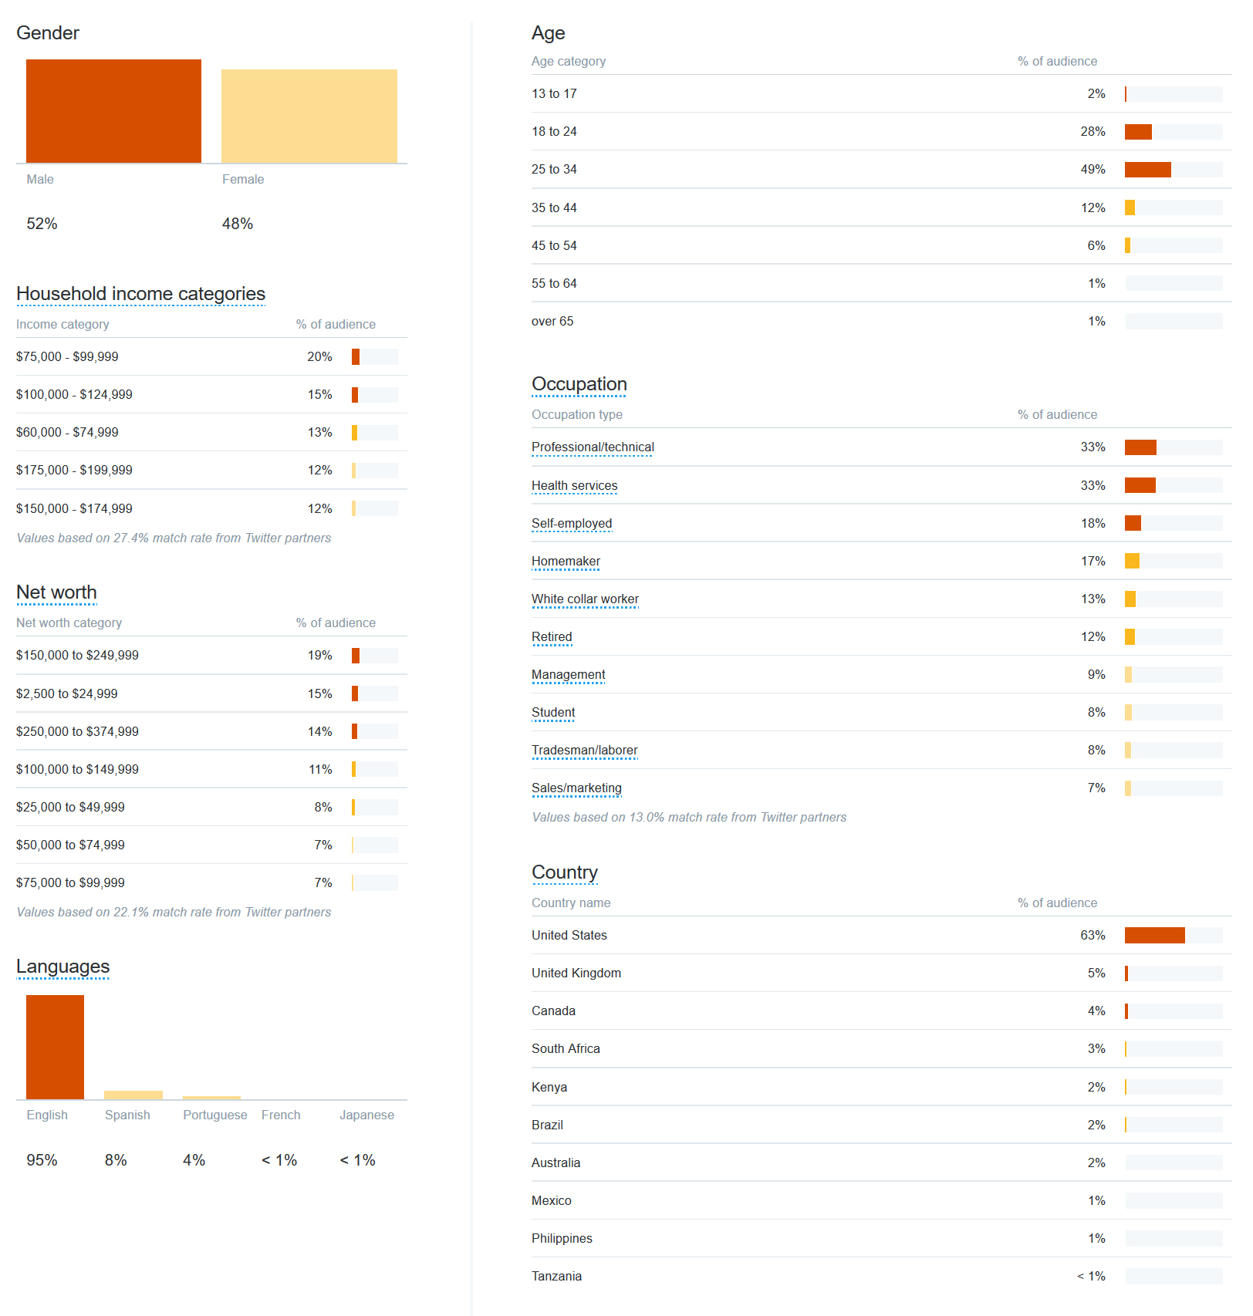
#HopeTrending
Demographic Reached on Twitter:
79% were under 35 years old
95% spoke English
8% spoke Spanish
Over 10 countries reached. (Twitter provides limited geographical data.)

Slide 15
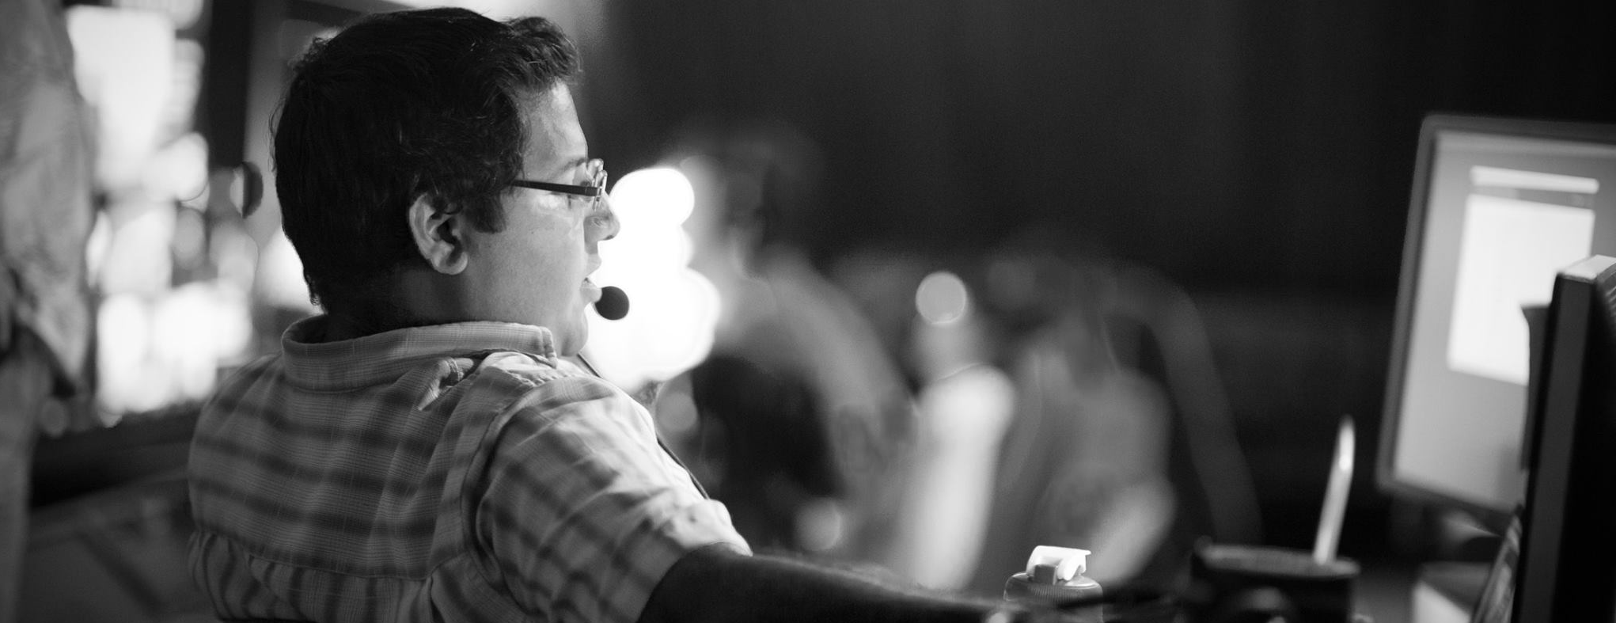
#HopeTrending
Facebook Reach and Engagement: 28 day time period
Accounts reached: 827,773 (peaked at 835,455 - 9/28-10/24)
Video views: 185,238
Post engagements (likes, comments, shares, etc.): 209,193

Slide 16
#HopeTrending
52.5% reached on Facebook were under 35 years old. Before the live event, this number was 70%. This change may be due to the TV viewing audience, since the Hope Channel skews older.

Slide 17
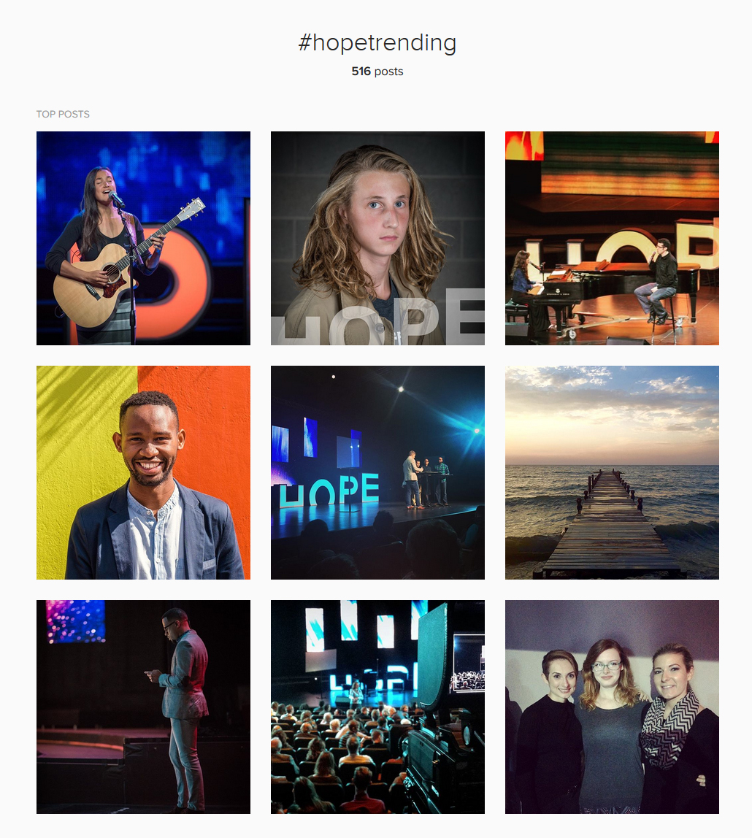
#HopeTrending
Instagram Summary:
516 total posts on Instagram with #HopeTrending.
89 posts from the official account.
On average, posts from the Hope Trending account received over 200 impressions each.
Data from Instagram is still fairly limited.

Slide 18
#HopeTrending
Total estimated (low) social media impressions for duration of event: 2,099,219
Please note: Facebook records individuals reached, not impressions, so the number for Facebook can be considered a low estimate of impressions.
This number does not reflect the number of impressions for entire campaign, nor Instagram impressions.

Slide 19
#HopeTrending
Website Summary:
Time Frame: June 1 -November 14
Traffic from Social Media: 25.7%
- Down from 40.5% before the live event launch. This change is most likely the result of people coming to the website after watching on TV
Users: 22,451
Sessions: 49,319
Pageviews: 133,080
Pages/Session: 2.70
Average Session Duration: 2:35
Bounce Rate: 48.47%
- Industry standard low is 60%
New Sessions: 45.49%

Slide 20
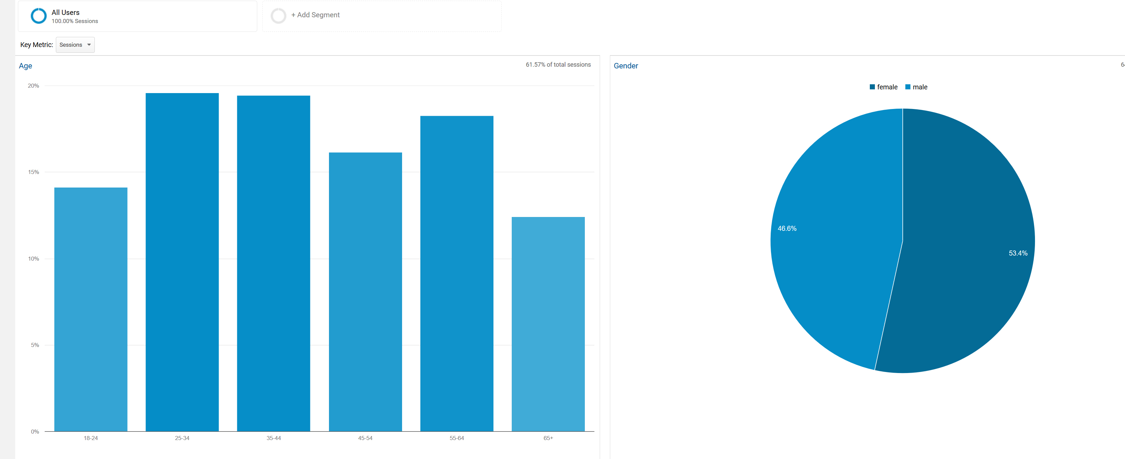
#HopeTrending
Only 33.71% of visitors were under 35. This makes sense since an older audience is less likely to feel comfortable viewing the programs on social media. Also watch party hosts may have skewed older, and would have watched from the website.

Slide 21
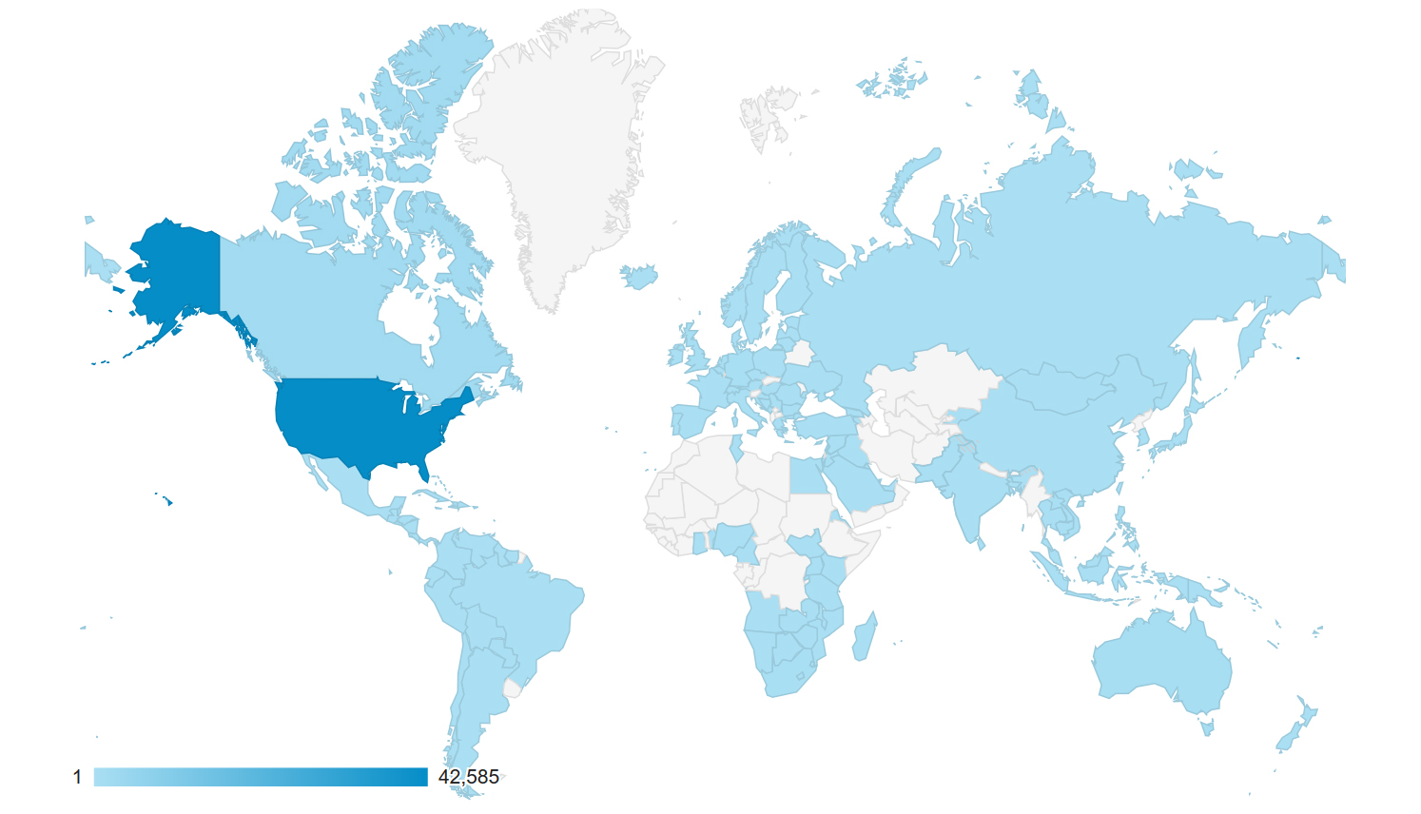
#HopeTrending
Top 10 Country Hits:
United States
Canada
Australia
United Kingdom
Jamaica
South Africa
Philippines
Kenya
Germany
Brazil
Website influence: reached over 150 countries.

Slide 22
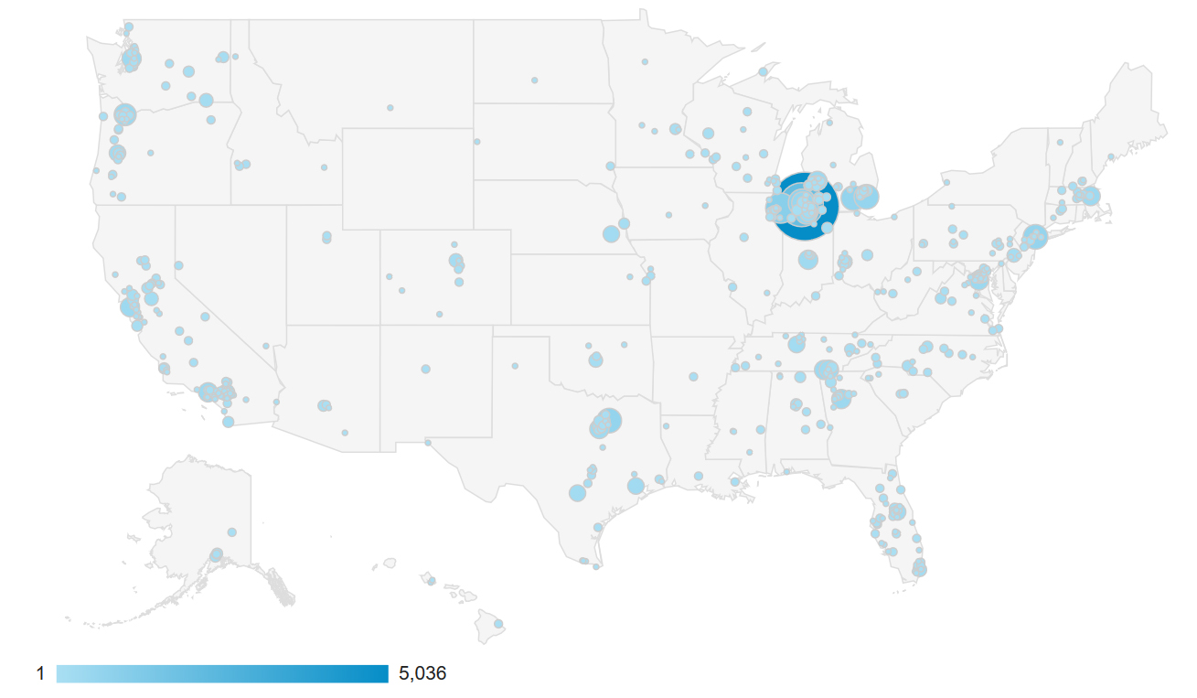
#HopeTrending
Website influence: 42,585 total visitor sessions from the United States. This map represents the hot spot cities.

Slide 23
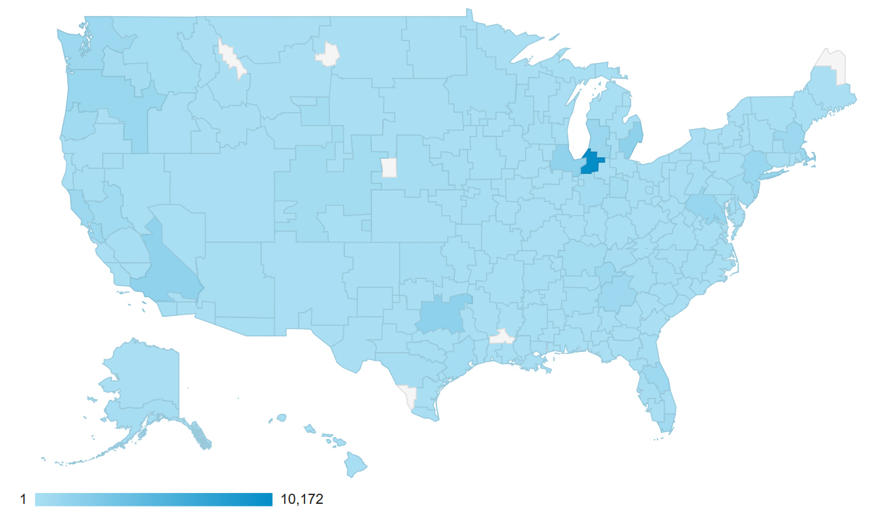
#HopeTrending
Website influence map by metro area.

Slide 24
#HopeTrending
Please Note: Hope Channel and Esperanza TV views are not trackable. Therefore they are not included here.
Twitter video views are not trackable at this time.

Slide 25
#HopeTrending
Native hosted videos and Facebook LIVE are effective ways to expand reach and engagement for videos and live events.

Slide 26
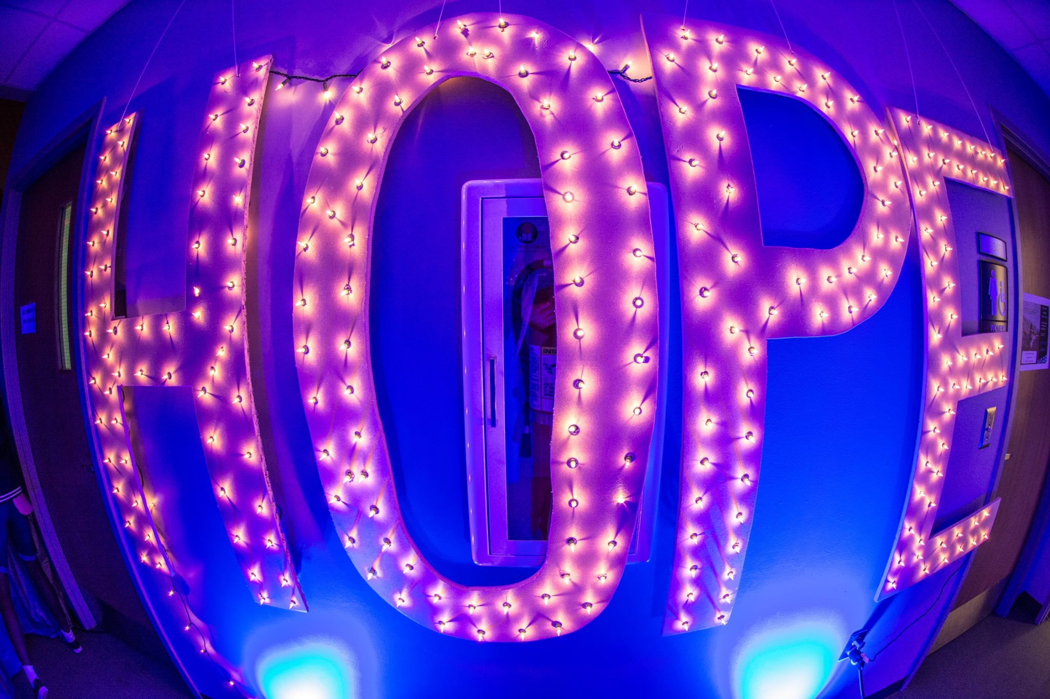
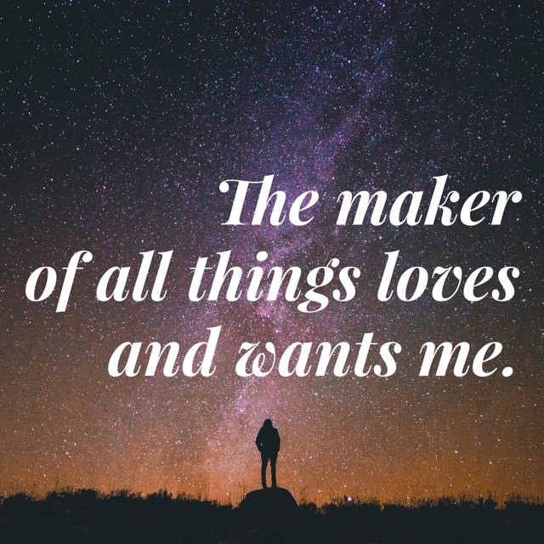
#HopeTrending
Other Performance Metrics:
Registered Watch Parties: 255
Onsite Attendance:
Requests for more information:
Pledges:
Baptisms:
This information was not available at the time of this report. Ideally this information should also be reported on.

Slide 27
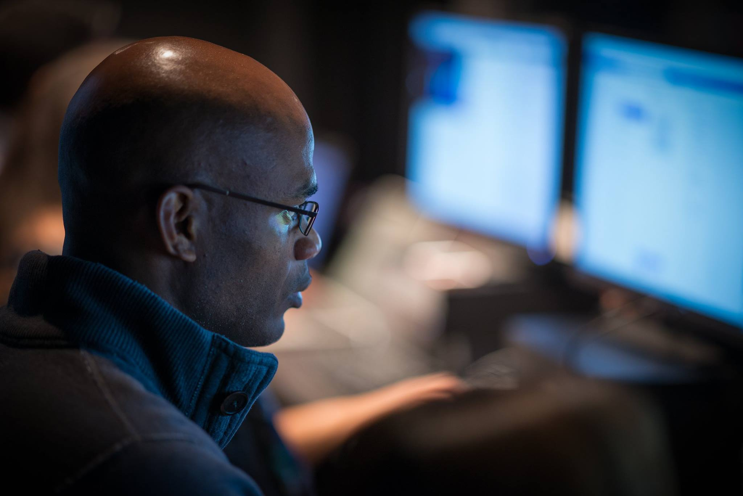
#HopeTrending
Observations and Recommendations:
It was excellent to have teams dedicated to different aspects of the live digital communications. Next time, make sure the strategist knows about the teams in advance and can coordinate better with the team leaders to avoid confusion.
Dedicate a larger budget to social media promotion and reach even more people. Perhaps spend less on print.
Be sure to send out a survey the day after the event ends to get people when it is fresh in their memory.
Overall, it went very smoothly and everyone should be proud of this accomplishment.

Slide 28
#HopeTrending
Visit SDAdata.org for more resources, blogs, and case studies.
Have questions? Email jamieschneider@nadadventist.org.
To view Hope Trending content, visit HopeTrending.org or @HopeTrending on Facebook, Twitter or Instagram.

