Slide 1
Social Media Etiquette
JAMIE DOMM, DIGITAL STRATEGIST
Notes:
To today’s topic is an important one, and most would agree, long overdue.

Slide 2
SDAdata.org
HELPING YOU BE EFFECTIVE DIGITAL ADVOCATES FOR CHRIST
Notes:
Social media is about connecting with others. We know that effective evangelism is based on relationships. What kind of relationships are you developing in the digital space?

Slide 3
Today we’ll cover:
Ways to include digital strategies in your overall communication strategy
NAD Social Media Guidelines
Practical tips for maintaining professionalism
What to avoid to keep your digital influence positive
Advice for protecting yourself and the church
Possible consequences to poor social media management
Visit SDAdata.org for more resources.
Notes:
To help you answer that question…Today’s main purpose is to share practical tips for maintaining professionalism, what to avoid to keep your digital influence positive, advice for protecting yourself and the church as well as possible consequences to poor social media management. We’ll also touch on ways to include digital strategies in your overall communication strategy. More in-depth coverage of these topics can be found on our website.

Slide 4
Notes:
Social media is a vital tool for accomplishing the mission of the church in the 21st century. My purpose is to empower and equip you for using technology to effectively communicate your message and meet the needs of your members and community in a way that properly reflects the character of God and our church identity.

Slide 5
SDAdata.org
What church leaders can do starting today:
Include digital strategies in short and long-term visions and goals.
Dedicate funds for social media promotions.
Dedicate time for training you and your staff.
Identify staff who could take on social media as part of their job duties (this may mean taking something off their plate).
Invest in young people; give them space to utilize their skills in this area for the church.
Take advantage of all our free resources, classes, videos, and case studies on SDAdata.org.
Notes:
As leaders you can…

Slide 6
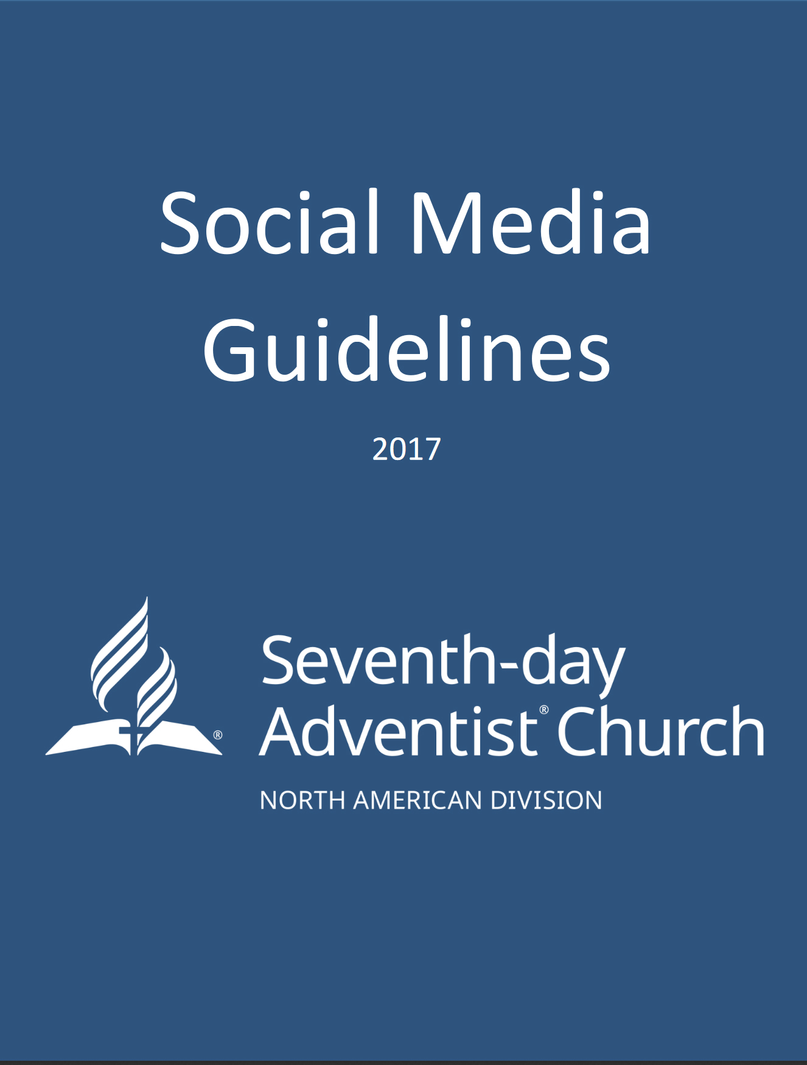
Highlighted resource
The purpose of this document is to provide resources and guidance regarding best practices for professional social media communication for all denominational entities and individuals under the North American Division.
Download: SDAdata.org/social-media-guidelines
Notes:
To help you, we’ve created the NAD social Media Guidelines. I highly recommend that you download this from our website…The purpose….

Slide 7
SDAdata.org
Your guide to:
General social media best practices
Intellectual property laws
Member care
Visual and video marketing
Paid advertising tips
Account management best practices
Key hashtags for Adventists
Communication with underage members
Personal use of social media
Additional resources
Notes:
This short 10 page document is your guide to… How many of you would appreciate some guidance in these areas? Organizations of all sizes and types are encouraged to adopt these guidelines. Social media is constantly changing. Therefore this will be a living document that will be constantly evaluated, and will be updated regularly to reflect your needs. Be sure to check our website for an updated version periodically.

Slide 8
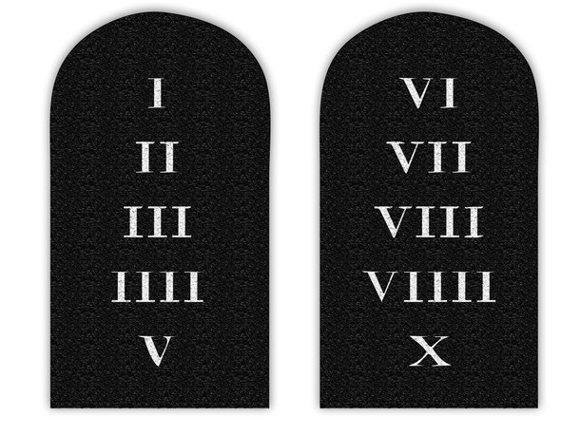
SDAdata.org
What it is not:
a “letter of the law” or set in stone
Notes:
Again, the main purpose of the document was to provide guidance to our church employees as they engage others on social media and represent the church through official brand accounts or personal accounts. It is not meant as a way of dictating what the church as an entity will deal with in society as a whole. The personal use of social media guidelines were created after numerous requests from many church entities that were seeking guidance in dealing with their employees’ activities and statements on social media. They were not intended as a "letter of the law" that wouldn't allow for common sense issues that the church needs to engage society in. It is not set in stone, but rather it’s the start of a conversation.

Slide 9
Employee Guidelines
TIPS FOR AVOIDING EMBARRASSING SITUATIONS AND OTHER MISUNDERSTANDINGS
Notes:
I encourage you to download and read through our guidelines careful. Many of you are pastors with a potentially large digital influence, what you do with that influence matters…I want to take the time to highlight some important points that will help you avoid embarrassing situations and other misunderstandings.

Slide 10
SDAdata.org
It doesn’t matter how high your privacy settings are, your activity is always public.
Notes:
Social media is public by nature and has blurred the lines between your work for the church and your personal life. It doesn’t matter how high your privacy setting are, your activity is always public. As a representative of the church, your individual accounts are no longer just personal. This can be a positive thing. You can avoid challenges by keeping the upcoming guidelines in mind while using your personal social media accounts. My goal is to help you avoid problems. Most of the problems people experience online are related to what they post as employees of any given organization.
[SMITHSONIAN Example]

Slide 11
Think before you post.
T = Is it True? H = Is it Helpful? I = Is it Inspiring? N = Is it Necessary? K = Is it Kind?
Notes:
If there’s only one thing you remember from this presentation, remember to think before you post. Every opportunity to share, is an opportunity to either advance or hinder the kingdom of God.

Slide 12
SDAdata.org
Ask yourself:
Would someone know you are a Christian based on your social media?
What values or whose character do you reflect?
Would someone like Christians based on your conduct online?
Are you making the most of your digital influence?
“For the name of God is blasphemed among the gentiles because of you.” Romans 2:24
Notes:
I once heard a sermon where the pastor asked: If you were hauled into court today, is there enough evidence to convict you of being a Christian. So could you be found guilty of being a Christian based on your digital influence?

Slide 13
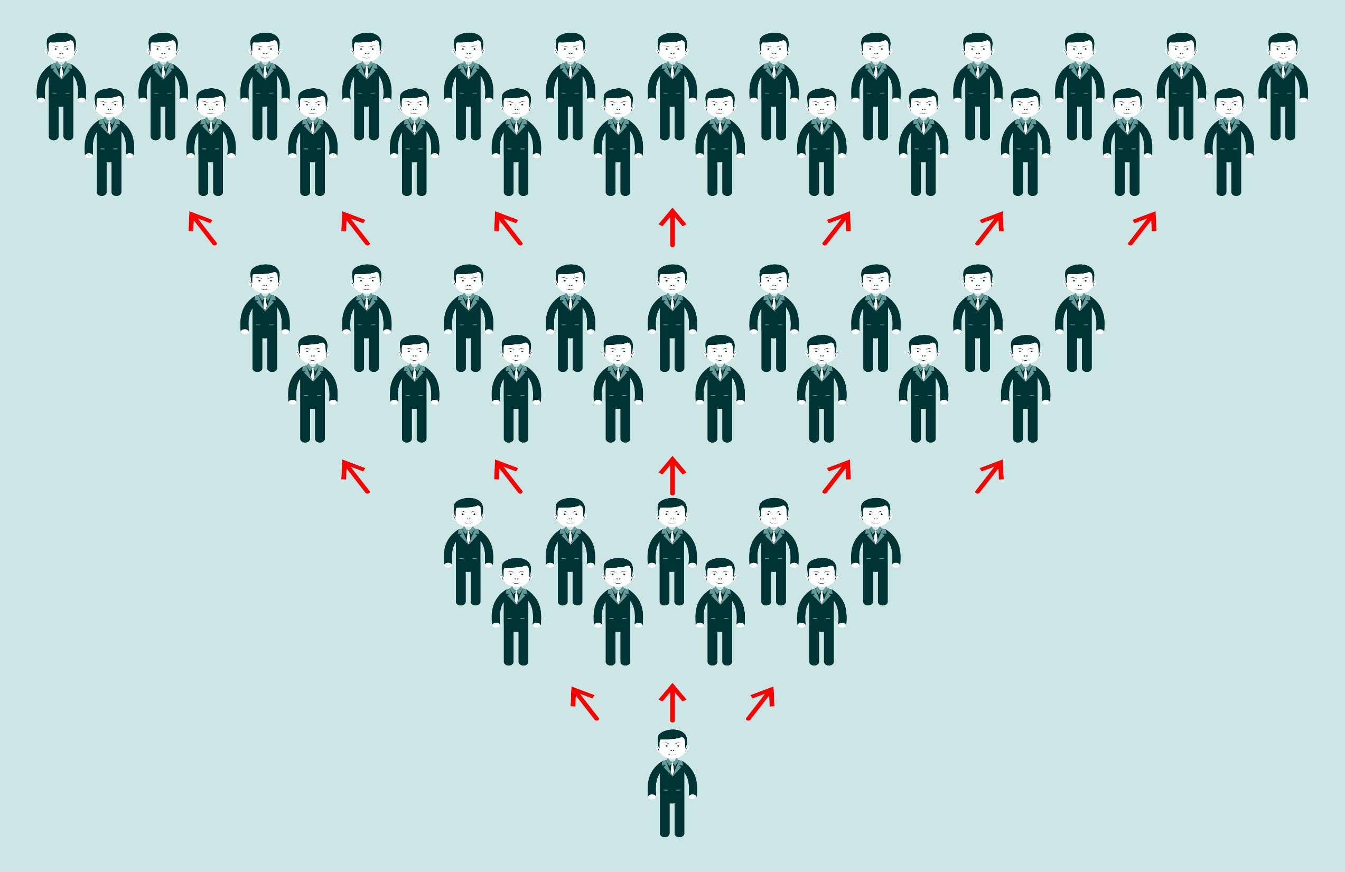
More often than not, the person we need to set boundaries with is ourselves.
Notes:
Your personal social media is a great opportunity to share your story and contribute to a collective conversation. It’s our job to share the gospel and share our collective story within the context of our faith. Let’s talk about how to keep that positive and effective. You can have hundreds, thousands, even millions of people viewing your messages. But, as so often is the case, the person we need to set boundaries with is ourselves.

Slide 14
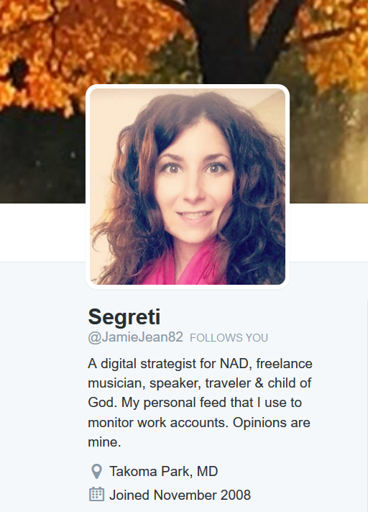
Disclose your affiliation:
Notes:
You are allowed to associate yourself with your organization or church when posting, but you must clearly brand your posts as personal and purely their own opinions.

Slide 15
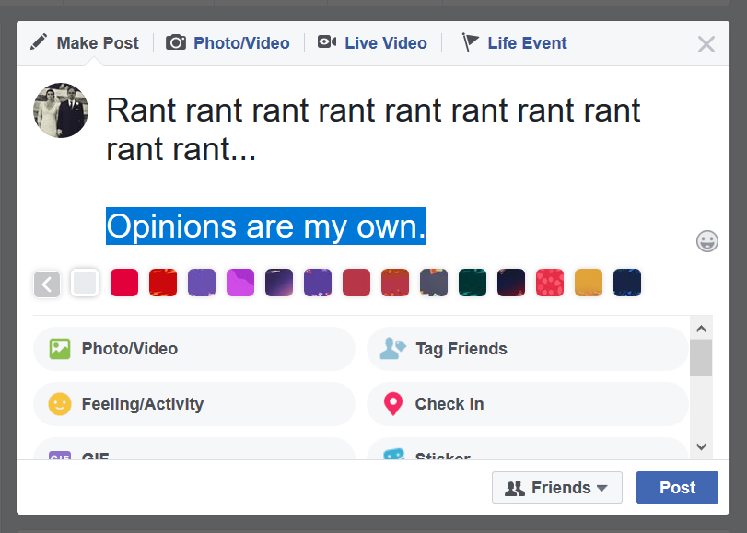
SDAdata.org
Notes:
For example, declaring that your opinions are your own does not give you a free pass to say anything you’d like on your personal social media.

Slide 16
Evangelism based on digital relationships “Social networks represent the digital reflection of what humans do: we connect and share.” —Jeremiah Owyang (Partner at Altimeter Group)
Notes:
However I do encourage you to be human, have fun, exchange ideas, and connect with others. Your life and work can be a powerful witness to what God is accomplishing through you and your work. Your actions will always be a more powerful witness than your words. Don’t be afraid of using social media to share your story, and engage with others. The appeal of social media is that it speaks to a basic human need, and that need is to connect and share. As a social media strategist, I want you to use social media personally and for your church or ministry. I don’t want you to leave this presentation thinking that your personal social media can be nothing more than empty platitudes. There are plenty of opportunities to engage in constructive ways online.

Slide 17
Tell stories.
Stories never tell us what to think, they give us something to think about.
Stories don’t tell us what to feel, they cause us to feel.
SDAdata.org
Notes:
Storytelling is a powerful means of communication online because stories never tell us what to think, they give us something to think about. Stories don’t tell us what to feel, they cause us to feel.
This is why they are effective in reaching people, and connecting with them. To share stories is human and approachable. So share your story.

Slide 18
SDAdata.org
Act responsibly & ethically:
Be honest, be professional, and be kind.
Always verify content with credible sources.
Respect intellectual property rights.
Honor others’ privacy.
Do not post or release information that is considered confidential.
Notes:
Be honest, be professional, and be kind. I encourage you to maintain a high standard of ethics. You are not just representing you, you are also always representing our faith.
Always verify questionable content with credible sources before sharing information and remember to honor others’ privacy. Respect the intellectual property rights of others and always give credit where credit is due. Do not publish, post, or release information that is considered confidential. Though you may share the church’s public statement on a matter.

Slide 19
We have all these problems...
JOIN US?
Notes:
But do not use your social media as a sounding board for the issues you see in the church. It would be considered outrageous to knock on a door to invite someone to join our faith, and start by lambasting the very church you’re asking them to join. Don’t do it online. Your words could cause someone to leave the faith or never join. It is likely that you have friends or followers on social media that are not Christians, or are questioning and struggling with their faith. As a member of the church, you are always representing the church. This is especially true for pastors and others in leaderships roles. It’s not that the church doesn’t have problems, but those issues should NOT be handled in the public forum.

Slide 20
SDAdata.org
Represent our values:
We recognize and value diversity of opinion within our church community, but as an employee, your followers may confuse your opinion with the official position of the church.
Notes:
Social media can be a powerful witnessing tool; remember that your posts can have a greater impact and reach than you realize. We recognize and value diversity of opinion within our church community, but as an employee, your followers may confuse your opinion with the official position of the church. While this is most likely not your intention, please prevent confusion by avoiding posts that conflict with your organization’s official positions on matters and observe principles of impartiality.

Slide 21
Images and language
SDAdata.org
Notes:
It hurts me to have to say this but….Do not post sexually explicit images of yourself or others. Do not use profanities or violent language.
I’ve seen it from Adventist college professors, youth leaders and yes, even Pastors.

Slide 22
Your social media activity can affect future employment.
Notes:
Employers do look at your social media, this kind of behavior can hurt your chances at future employment in the church. As leaders in the church, we serve a diversity of people with a diversity of ideas. We can’t do that effectively if we demonstrate a strong negativity bias towards certain groups or ideas online.

Slide 23
SDAdata.org
Avoid conflict:
Take it offline.
Have a private discussion.
Don’t respond.
Always show respect.
In the case of trolls and bullies, simply block them.
Not sure how to respond? Use this infographic: goo.gl/EJMTDc
Notes:
Representing our values and serving a diverse membership also ties into avoiding public discussions of controversial topics like politics where emotions can run high and can result in inflammatory or inappropriate discussions.
If you really want to chat with someone, take it offline or have a private discussion. Many discussions are significantly more productive in person. It is generally accepted that 93% of our communication is non-verbal (Mehrabian & Wiener, 1967; Mehrabian & Ferris, 1967). Online communication strips away the context of tone and intention. Many comments online are misunderstood without this context and provoke controversy and conflict instead of positive discourse.
Sometimes the best response is no response. In the case of trolls, simply block them. Not everyone can be reasoned with, and publicly is not the best place to try. If an argument breaks out between two of your friends on your page, delete the post. Lastly, always show respect for others’ opinions.

Slide 24
85%+ Social Media posts would never change their mind.
67% felt that social media was not an appropriate place to discuss politics.
(Social media marketing firm Rantic)
Notes:
Social Media Marketing Firm Rantic polled 10,000 Facebook users and found that, by and large, political posts were extremely unlikely to change anyone’s views regardless of their leanings left or right. However, social media posts were likely to annoy people and even inspire them to unfriend posters. Over 85% of them said they would never changed their view of an issue based on a Facebook post. About two-thirds of the study’s participants also said that social media was not an appropriate place to discuss politics, while around half said they judged others based on their political opinions.

Slide 25
SDAdata.org
How many people are you willing to drive out of the church to make a point or to “win” your argument?
Notes:
When asked why they left the church, a sizable portion of former members cite something that was said to them or how they were treated by other members. My question to you is this: How many people are you willing to drive out of the church to make an point or to “win” your argument? Especially when we know it’s not even effective to have these discussions online. Public figures have the potential to magnify division and take thousands out of the church. For those of us on an individual level, we may discourage someone from ever considering Christianity.

Slide 26
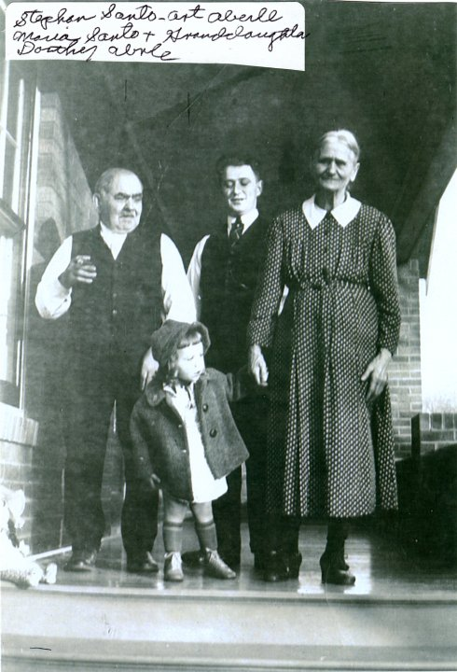
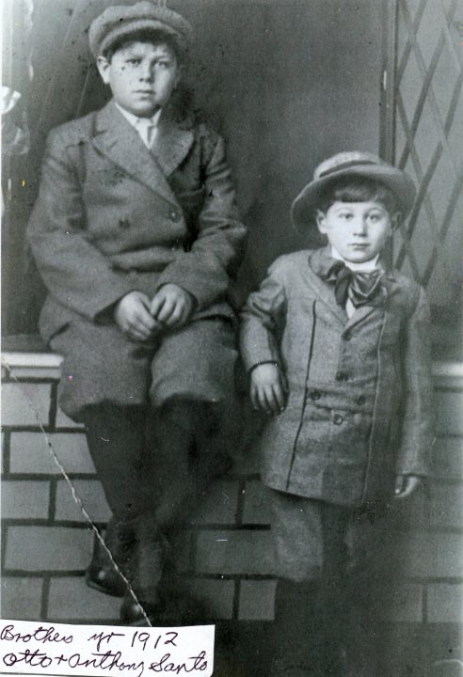
Storytelling helps bridge the gap and tear down barriers to understanding.
To create a real connection, show vulnerability.
—Michael Simmons, Harvard Business Review
Notes:
So what is an appropriate way to engage? Here is a good example of using storytelling in an effective way around a controversial topic is: [Build the wall example]. Instead of taking sides, one of my friends simply told the powerful story of their father’s immigration to America. Christ often told stories or parables to get is audience to think, instead of speaking directly against the government, leadership or ideas. If we feel that we absolutely have to join the conversation online, let’s follow His example…and share your stories and experiences.
You can put others at ease by sharing your full humanity.

Slide 27
SDAdata.org
To “win” souls, we must connect with a person’s experiences.

Slide 28
SDAdata.org
Notes:
Remember everyone can see your conversation, and many people probably know you work for the church; be mindful of how you are representing yourself and our faith. I cannot stress this enough. We talk about a life lived as a reflection of Christ but turn into devils on social media. People say things on social media that they would never dare to say in person. You should NEVER say anything on social media that you wouldn’t say to someone’s face. Choose your words wisely, and make the most of your digital influence.

Slide 29
SDAdata.org
“He who is careless and heedless in uttering words or in writing words for publication to be sent broadcast into the world, sending forth expressions that can never be taken back, is disqualifying himself to be entrusted with the sacred work that devolves upon Christ’s followers at this time. Counsels to Writers and Editors 61.1, EGW
Notes:
Ellen White knew how to do the figurative mic drop better than anyone. I implore you to take this quote to heart.

Slide 30
We are ALL publishers now.
Notes:
Times have changed; we are all writers and publishers now. But with this ability comes responsibility. This quote stands as a powerful and relevant reminder of the solemn task we have been charged with. I encourage everyone who is on social media to read her Counsels to Writers and Editors.

Slide 31
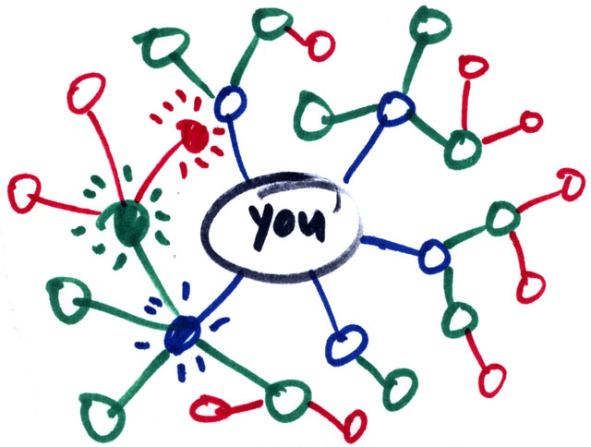
SDAdata.org
Protect your work family:
We are all connected online, and you CANNOT control how far your post reaches.
Resolve work issues privately (offline).
Seek counsel.
Direct your concerns to HR.
Notes:
As you may have noticed, your coworkers and YOU are imperfect people. Everyone has good and bad days. Do not air work grievances on social media or use your channels as a sounding board for the problems you see in the church. Others may be negatively impacted and turn away from the church. You could also embarrass yourself or endanger your job. The Adventist community is very closely connected online so your posts may be widely seen. It is always best to seek counsel offline and/or direct your concerns to HR. Focus on the positive and, like any family, resolve issues privately. [DIRECT REPORT EXAMPLE]

Slide 32
SDAdata.org
Protect underage members:
Be careful about what personal information you share about members, especially children.
Avoid images of underage children’s faces unless a photography waiver or release form has been signed by a parent or legal guardian.
Notes:
Protect underage members: Be careful about what personal information you share online about members and especially children. Avoid images of underage children’s faces unless a photography waiver or release form has been signed by a parent or legal guardian.

Slide 33
Communicating with young people:
Avoid private conversations with underage followers or members on personal social media accounts.
Engage with them only from the official ministry accounts to answer questions, respond to comments, and meet their needs.
In case of emergency or if a child appears at risk, please contact the proper authorities immediately.
Notes:
Ministry social media profiles that are geared towards underage members should be designed to address their specific needs, educate, provide resources, and spiritual guidance as well as have a reasonable relationship to the mission and function of the ministry they reflect.
Avoid private conversations with underage followers from your personal account. Based off of NYC Department of Education Guidelines.

Slide 34
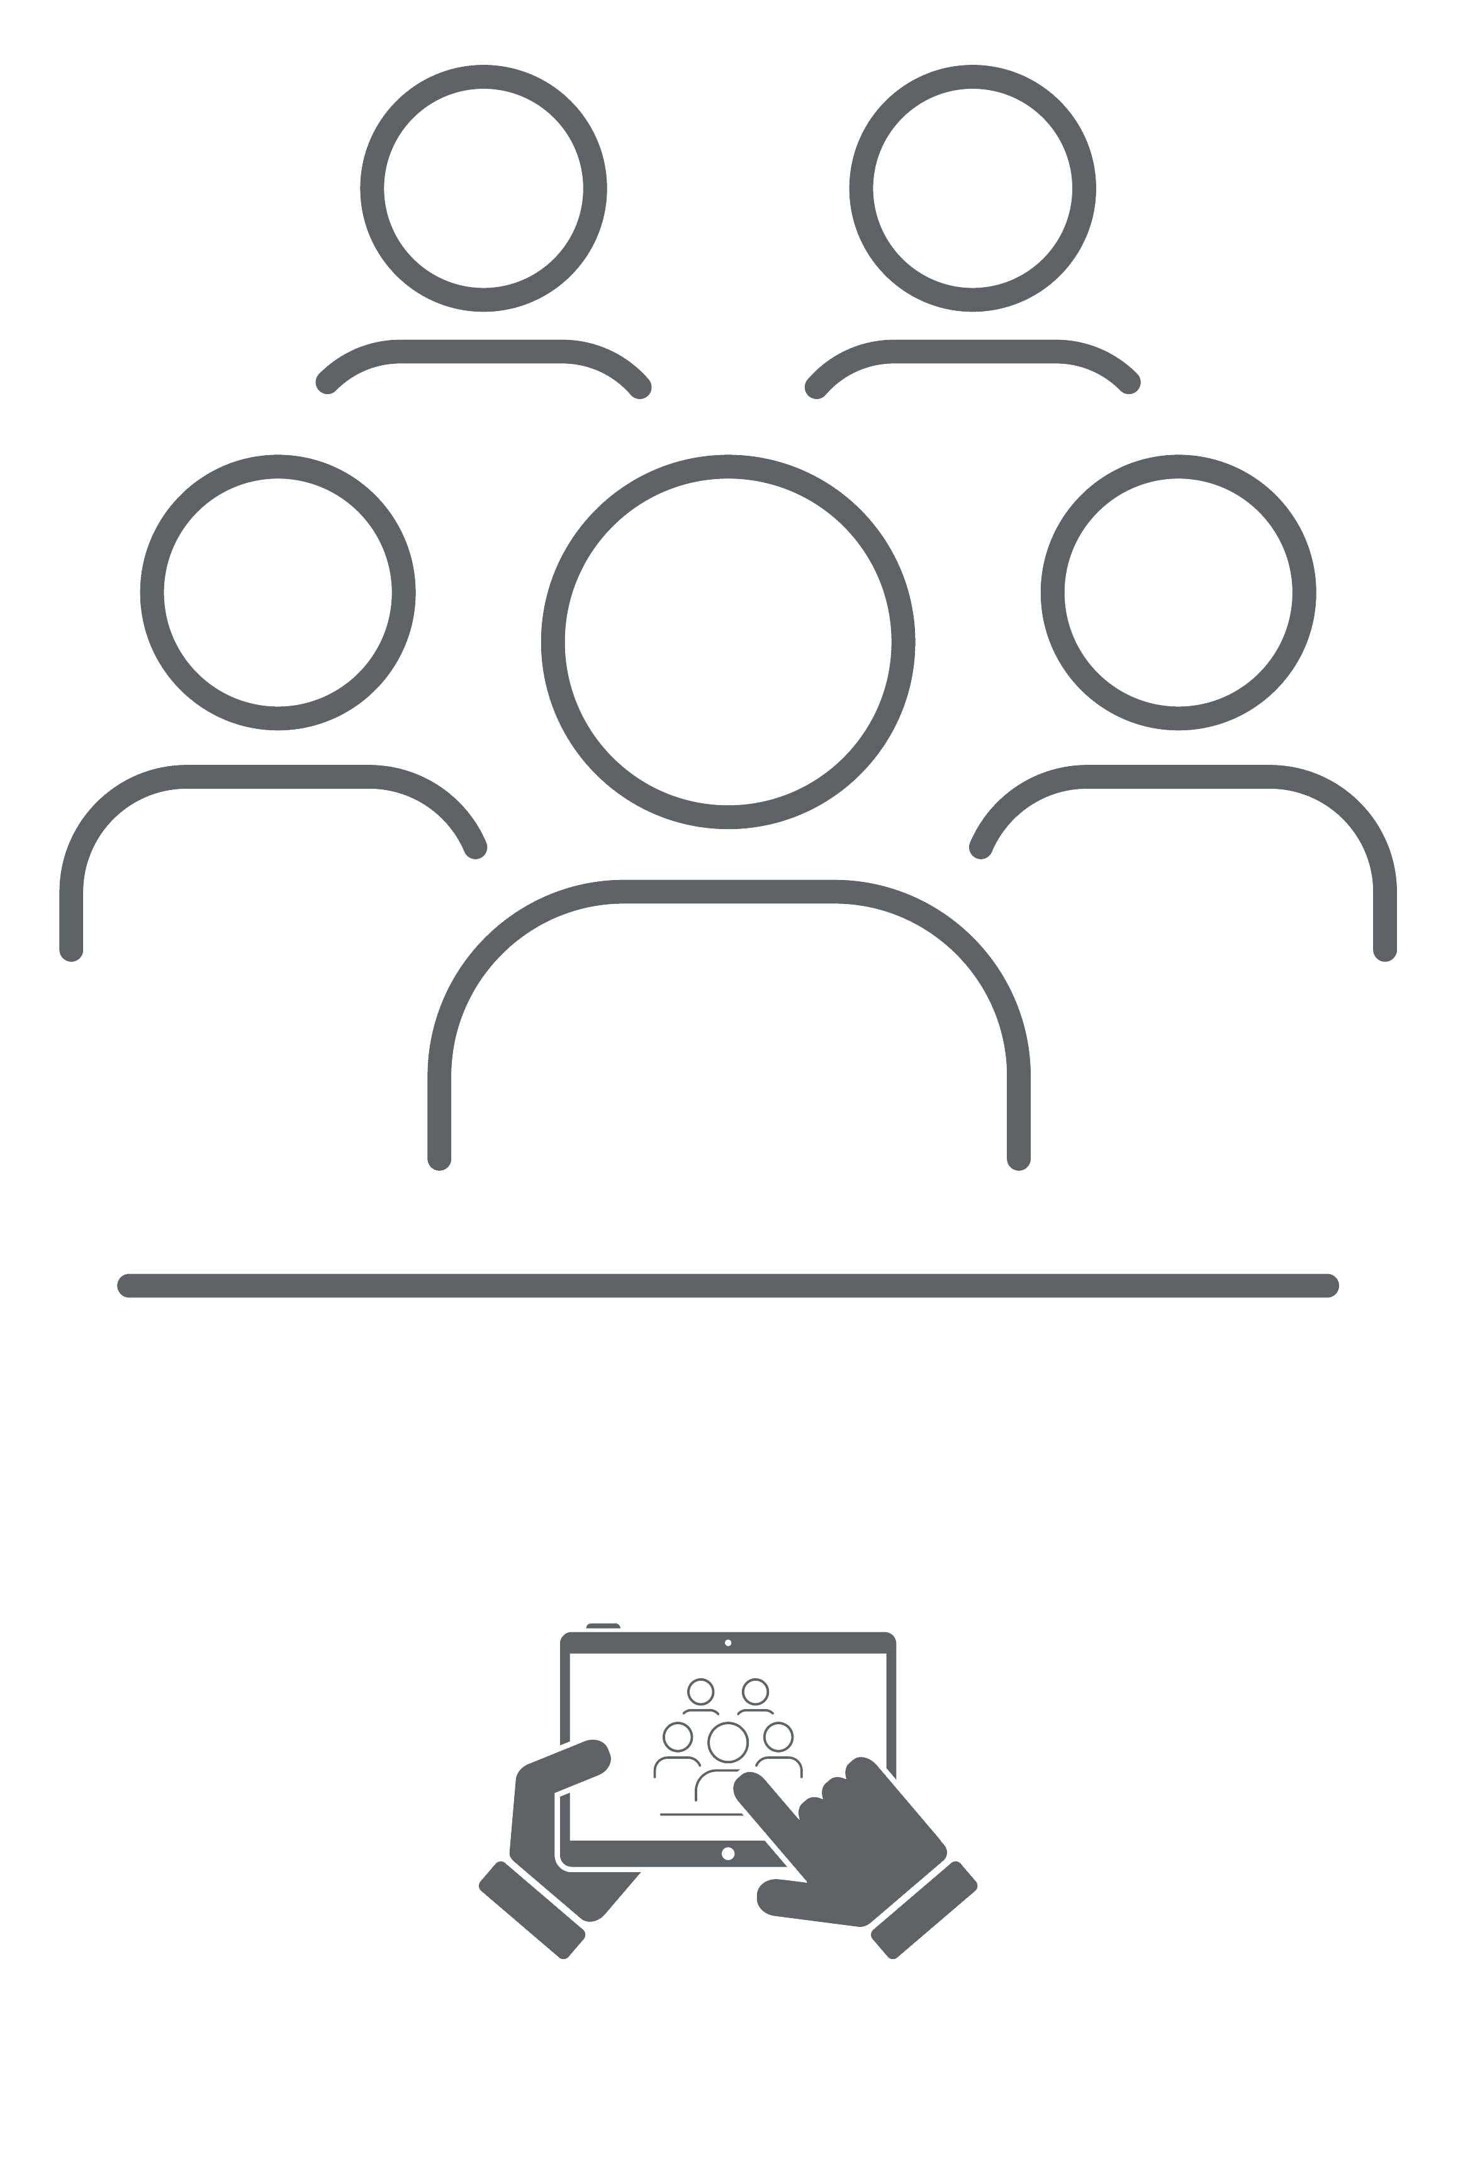
SDAdata.org
Transparency is the key to protecting yourself, the organization, and the child.
Notes:
Transparency is key to protecting yourself, the organization, and the child. Engage publicly with underage members when possible.

Slide 35
SDAdata.org
Keep us informed.
Notes:
Social media is dynamic and constant. If you see something that should be addressed related to the social media activity of or about our organization and mission, let us know. The internet is vast, we need your help to spot issues before they get out of control. For example, legitimate complaints aired online at a conference that should be addressed or false statements made about the church or event or person that are gaining traction or going viral. When this happens, contact the relevant social media or communications manager.

Slide 36
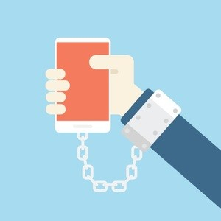
SDAdata.org
Create balance.
Social networking already accounts for 28% of all media time spent online, and users between the ages of 15-19 spend at least 5 hours per day on social media. The average young adult spends 7-12 hours a day behind a screen. 18% of social media users can’t go a few hours without checking Facebook, and 28% of iPhone users check their Twitter feed before getting up in the morning.
Notes:
Social media can be addictive, know when to turn it off. It is healthy to actually take breaks from social media. Especially if you’re like me and it’s your job. Make time for people face to face. Social media is only meaningful if it results in something tangible. Don’t let social media affect your job performance or your personal life. Don’t check social media while driving or walking, and maintain good posture. This might seem really ridiculous to state, but the number of injuries to pedestrians distracted by cell phones have more than doubled since 2005 and the American Journal of Public Health noted that increased use of social media is positively correlated to a higher general population suicide rates and depression.
Remember, the Devil wants us distracted. We have all the right tools to preach the gospel around the globe, but we’re too focused on the things that don’t matter. That includes putting down the phone, and being in the moment with friends and family.

Slide 37
SDAdata.org
If you are unsure whether or not to share something online, err on the safe side and simply don’t.
Notes:
We all share the same goal. Follow these policies and be a living testimony to the church’s values and beliefs.

Slide 38
SDAdata.org
Freedom of speech does not mean freedom from consequences.
You could:
Inhibit our ability to accomplish our mission
Turn someone away from the church
Get your organization in legal trouble with partners or members
Get fired
Notes:
Just in case you are forgetful or ignore the guidelines previously mentioned, here’s what could happen. It’s embarrassing to lose your job for something that’s so easily avoided.

Slide 39
SDAdata.org
10 Commandments of Social Media Use:
Think before you post.
Be a living testimony.
Share stories and create meaningful connections.
Act responsibly and reflect Christ always.
Avoid conflict and controversial topics.
Protect your work family; resolve issues internally.
Protect underage members & your organization.
Keep us informed.
Create balance.
Err on the safe side.

Slide 40
SDAdata.org
Notes:
Young people are leaving the church at a startling rate. They spend 7 to 12 hours a day behind a screen. Up to 9 hours of that time is spent on social media. Remember, many of them are reading your posts even when they don’t comment or react. What messages are you sending them? We must take the gospel where they are, and not where we want them to be. But when our actions and our speech contradict each other, we only have ourselves to blame for the rising egression.

Slide 41
SDAdata.org
Notes:
Any questions?

