Slide 1
Social media Safety
Privacy, employee guidelines, and best practices
Notes:
Thank you for coming to this session on social media safety. Last fall, I sent out a survey to North American Division staff to gauge the need for training in social media. It was clear from those results, that people wanted to know more about how to protect themselves online. I tried to be fairly comprehensive, so some of these topics will overlap with general IT safety tips. Some of these tips come from sources that you can access through links in the notes of this presentation.
I firmly believe that social media and other digital communications are vital tools for accomplishing our mission in a 21st century world, so I want people to use social media. But I also want you to be safe.

Slide 2
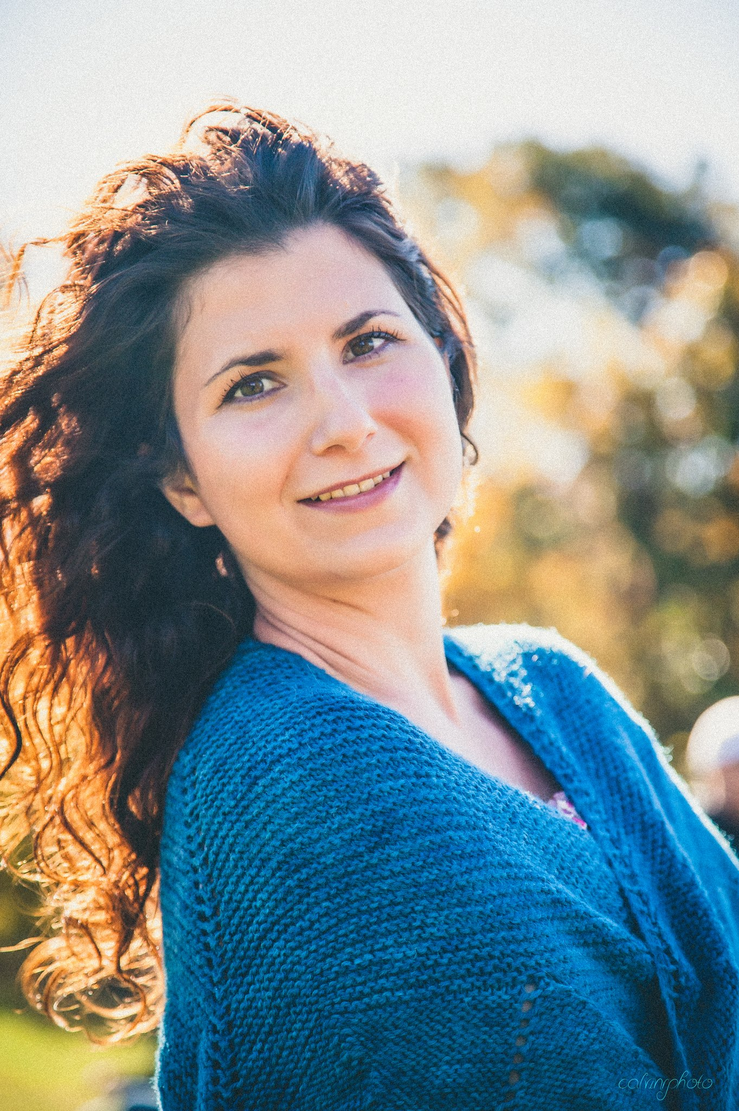
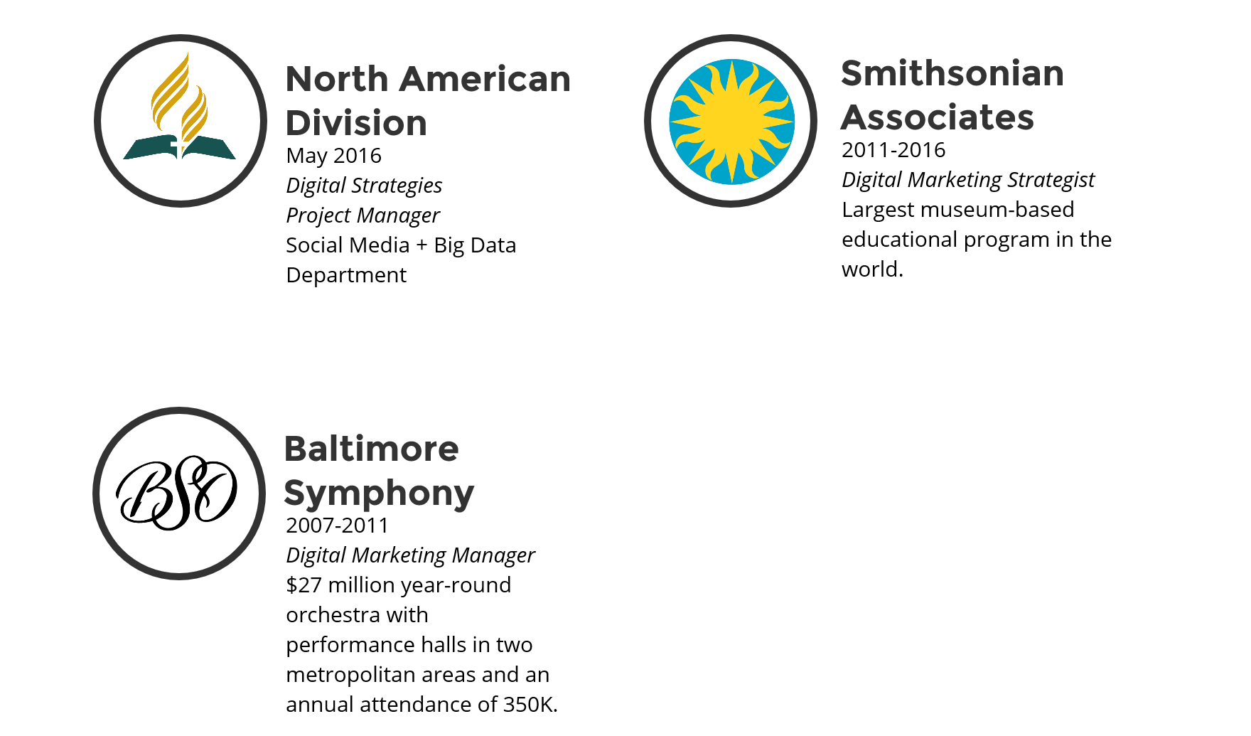
Who am I?
Notes:
Some of you I don’t know, so a little bit about who I am. With nearly 10 years experience, my specialty is building multi-channel, multi-platform digital strategies from the ground up with limited budget and resources. I am part of a new department at NAD called Social Media & Big Data that serves to connect members & mission through technology.

Slide 3
What will be covered
General Tips for Protecting Yourself Online
Employee Guidelines
Copyright Laws
Tips for Managing Work Accounts
Live Demonstrations and Questions
Notes:
Feel free to grab an outline for your reference.

Slide 4
Protecting yourself online
8 simple tips
Notes:
Protecting yourself online has a lot to do with the choices you make and being smart about what you are doing. This first section will cover a few general tips, for more in-depth information, I recommend you connect with the IT department and attend one of their in-depth security presentations. But what we will cover today, should serve you well.

Slide 5
1. Security software
Make sure security software is installed that protects your computer from viruses, malware and spyware as well as includes a firewall.
Set it to scan regularly.
Update or renew regularly.
Beware of “Scareware.”
Recommended security software: Sophos, Checkpoint, and McAfee
Notes:
Scareware are pop-up messages or unsolicited emails that tell you that your computer is compromised and want you to purchase software to repair it. These messages aim to trick users into believing your computer is already infected, and that purchasing the software will help get rid of it. Checking your security settings and making sure your pop-up blocker is on may help avoid this. There have also been instances where users have received a phone call purporting to be from a security company advising them that their computer is at risk. Quite often the message and the software are fake.

Slide 6
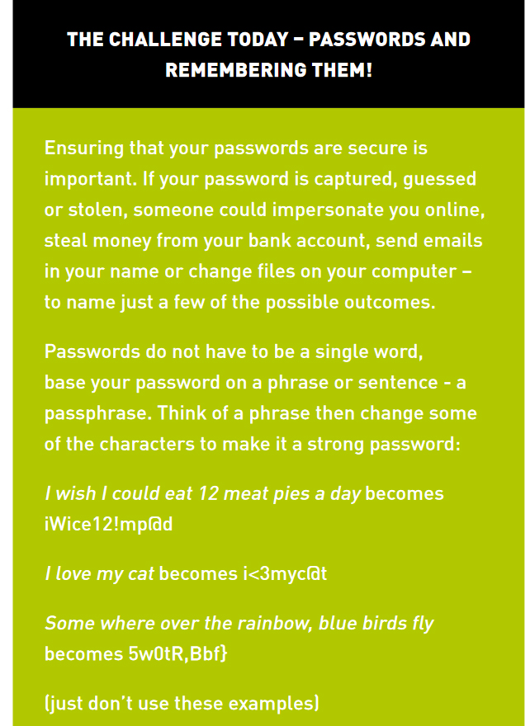
2. Passwords
Use different passwords for each account and change them regularly.
Don’t store a list of your passwords in a word document.
Select “no” when your computer offers to remember passwords to websites, especially banking, social media, and email accounts.
Use passphrases.
Notes:
You could adapt your favorite bible verse for example to a passphrase. This way, as long as you use a few random capitalizations and symbols, you can write down the phrase and keep it somewhere and no one will be able to guess your password!
Image Source: Australian Government Online Safety Handbook, 2nd Edition

Slide 7
3. Keep Your software updated & Networks secure
Update software when prompted.
Make sure your wifi has a strong password.
Turn off your internet when you’re not using it.
Notes:
Now some software companies have gotten quite aggressive with their automatic updates, but in general make sure your software is up-to-date, as the latest version is the most secure.

Slide 8
4. Make good choices
Always log out of your internet banking session.
Never respond to requests for personal or financial information online, even if it looks like it’s from your bank.
Ignore suspicious emails that play on your emotions.
If it sounds too good to be true, it’s not, ignore it.
Avoid using public computers to access personal information.
Check your credit report regularly; there’s an app for that now.
Don’t email your passwords to anyone, EVER!
Think carefully before you click on links and attachments, particularly in emails and on social networking sites.
Only open emails from people you know and scan attachments before opening.
Don’t click on suspicious links.
Only download items from trusted websites.
Read the license agreement and terms of use before you download software.
Do not respond to chain letter messages.
Looks for ‘https’ in the url or the secure website badge before providing credit card information.

Slide 9
Identifying suspicious links
The link came in an unsolicited email (or from a friend, but the email doesn’t seem like something they would write).
Hover over the link to see the destination in the bottom left corner (or elsewhere) of your screen.
There are a bunch of % in it (masks URL encoding).
Expand shortened links with Untiny.
Scan the link with a link scanner: Norton SafeWeb, URLVoid, ScanURL

Slide 10
5. Check your privacy settings on Social media
Don’t accept friend requests from strangers.
Set up a private account for Instagram, etc.
For personal accounts, only allow friends to see your posts on Facebook.
Allow only friends of friends to find you on Facebook.
Update your ad settings.
Purge contacts regularly.
Consider using a deviation of your name.

Slide 11
6. Report or block bullies
Bullying can now occur 24/7, reach into the home, and spread to a large audience.
Increase your security or block them.
Never respond to negative comments, but save them as evidence with a screenshot.
Report threats to the proper authorities or schools.
Monitor your child’s online use and let them know you support them.
Do not talk to strangers and educate your children to protect them from “groomers.”
Notes:
Cyberbullying has become a major issue, especially with children.
Groomers are typically child predators who aim to gain their trust and then take advantage of them.

Slide 12
7. Limit what you share
Social media is always public.
Don’t post information that can make you and your family vulnerable (date of birth, address, daily routine, travel plans, children’s schools).
Don’t post inappropriate pictures of yourself or others.
Don’t post pictures of children.
Safety first ➔
Notes:
Be very careful about what personal information you share online. Never publically share your home address, social security numbers, login credentials to ANY account (especially passwords), credit card information, security question answers, complete birth date, etc. Only friend people you actually know. Don’t share travel plans, because crime reports now report that 75% of home burglars use social media to find targets. Be very careful about what information and images you share about your children. The newer generations potentially have their entire life story shared online, which is a gold mine for identity theft. I personally recommend that you don’t post pictures of your children period. Always use common sense and discretion.

Slide 13
8. Create Balance
Social networking already accounts for 28% of all media time spent online, and users aged between 15-19 spend at least 5 hours per day on social media. The average young adult spends 7-12 hours a day behind a screen. 18% of social media users can’t go a few hours without checking Facebook, and 28% of iPhone users check their Twitter feed before getting up in the morning.
Notes:
Social media can be addictive, know when to turn it off. It is healthy to actually take breaks from social media. Especially if you’re like me and it’s your job. Make time for people face to face. Social media is only meaningful if it results in something tangible. Don’t let social media affect your job performance or your personal life. Don’t check social media while driving or walking, and maintain good posture. This might seem really ridiculous to state, but the number of injuries to pedestrians distracted by cell phones have more than doubled since 2005 and the American Journal of Public Health noted that increased use of social media is positively correlated to a higher general population suicide rates and depression.
Remember, the Devil wants us distracted. We have all the right tools to preach the gospel around the globe, but we’re too focused on the things that don’t matter. That includes putting down the phone, and being in the moment with friends and family.

Slide 14
Enable ‘night shift’ mode
The blue light that smart phones emit inhibits production of melatonin, which is a key hormone the brain uses to tell our bodies to sleep.
Notes:
Tune out roughly two hours before bedtime for optimal sleep, and if you must check your phone, enable night shift. The blue light emitted from our phones tricks us into thinking it’s still daytime. Night shift reduces this problem by changing the color of the screen to a warmer, reddish hue at dusk and resets to the usual blue tones in the morning. There is some debate as to whether this does actually work, I can tell you that it absolutely works for me.

Slide 15
Summary:
Install security software and keep it updated.
Use strong passwords.
Keep your software updated and your networks secure.
Make good choices.
Regularly check your social media privacy settings.
Only talk to and friend people you know.
Report and/or block bullies.
Limit what you share online, err on the side of caution.
Protect children.
Create balance; limit your screen time.
More information: https://www.ncjrs.gov/internetsafety/
Data: http://securingthehuman.sans.org/resources/newsletters/ouch/2016

Slide 16
Employee guidelines
Avoiding embarrassing situations or other misunderstandings
Notes:
Social media is public by nature and has blurred the lines between your work for the church and your personal life. It doesn’t matter how high your privacy setting are, your activity is public. This can be a positive thing. You can avoid challenges by keeping the upcoming guidelines in mind while using your personal social media accounts. My goal is to help you avoid embarrassing situations or other misunderstandings. We spent the last few minutes talking about general online security, but more often than not, most of the problems people experience are related to what they post as employees of any given organization.

Slide 17
Think before you post
T = Is it True? H = Is it Helpful? I = Is it Inspiring? N = Is it Necessary? K = Is it Kind?
Notes:
If there’s only one thing you remember from this presentation, remember to think before you post. Every opportunity to share, is an opportunity to either advance or hinder the kingdom of God.

Slide 18
What you should do
Notes:
Your personal social media is a great opportunity to share your story and contribute to a collective conversation. I’m a positive person, so let’s talk about how to keep it positive.

Slide 19
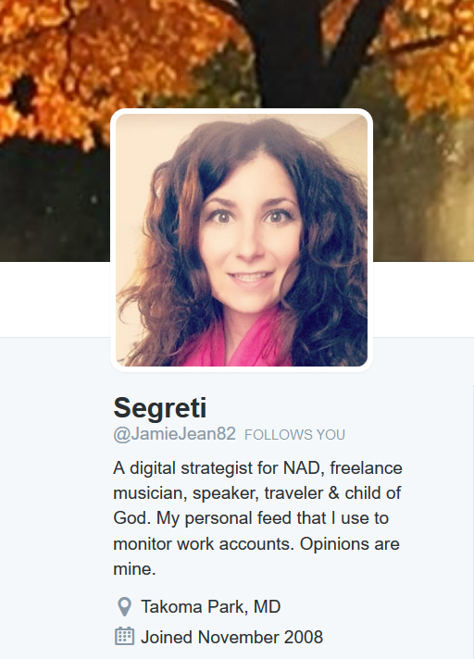
Disclosing Your Affiliation:
Notes:
If you are a public figure, you may have to disclose your affiliation. However, your opinions should be labeled as purely your own.

Slide 20
Evangelism based on Digital relationships
“Social networks represent the digital reflection of what humans do: we connect and share.” —Jeremiah Owyang (Partner at Altimeter Group)
Notes:
Your life and work can be a powerful witness to what God is accomplishing through you and your work. Don’t be afraid of using social media to share your story, and engage with others. The appeal of social media is that it speaks to a basic human need, and that need is to connect and share. As a social media strategist, I want you to use social media.

Slide 21
Act Responsibly & Ethically:
Be honest, be professional, and be kind.
Always verify content with credible sources.
Respect intellectual property rights.
Honor others’ privacy.
Do not post or release information that is considered confidential.
Notes:
Be honest, be professional, and be kind. I encourage you to maintain a high standard of ethics. You are not just representing you, you are also representing your faith.
Always verify questionable content with credible sources before sharing information, and honor others’ privacy. For example, if someone is going through a divorce or is struggling with an illness, don’t make it public for them. Respect the intellectual property rights of others and always give credit where credit is due. The internet is made for sharing; it’s generally okay to share what is in the public domain on social media. Lastly if you are privy to such information, do not publish, post, or release information that is considered confidential. Though you may share the church’s or organization’s public statement on a matter.

Slide 22
Represent Our Values:
We recognize and value diversity of opinion within our church community, but as an employee, your followers may confuse your opinion with the official position of the church.
Notes:
Again social media can be a powerful witnessing tool, but please remember that your posts can have a greater impact and reach than you realize. We recognize and value diversity of opinion within our church community, but as an employee, your followers may confuse your opinion with the official position of the church. (Notice the blind Twitter birds following the blind bird.) While this is most likely not your intention, please prevent confusion by avoiding posts that conflict with your organization’s official positions on matters and observe principles of impartiality.

Slide 23
Avoid Conflict:
Would someone know you are a Christian based on your social media? What values do you reflect?
Take it offline.
Have a private discussion.
Always show respect.
Or in the case of trolls, simply block them or do not respond at all.
Notes:
This ties into avoiding public discussions of controversial topics like politics where emotions can run high and can result in inflammatory or inappropriate discussions. Remember everyone can see your conversation, and many people probably know you work for the church; be mindful of how you are representing yourself.
If you really want to chat with someone, take it offline, have a private discussion or in the case of trolls, simply block them or do not respond at all. Not everyone can be reasoned with, and publically is not the best place to try. If an argument breaks out between two of your friends on your page, delete the post. Lastly, always show respect for others’ opinions.

Slide 24
“He who is careless and heedless in uttering words or in writing words for publication to be sent broadcast into the world, sending forth expressions that can never be taken back, is disqualifying himself to be entrusted with the sacred work that devolves upon Christ’s followers at this time. Counsels to Writers and Editors 61.1, EGW

Slide 25
Protect Your Work Family:
We are all connected online, and you CANNOT control how far your post reaches.
Resolve work issues privately (offline).
Seek counsel.
Direct your concerns to HR.
Notes:
As you may have noticed, your coworkers and YOU are imperfect people. Everyone has good and bad days; please do not air work grievances on social media or use your channels as a sounding board for the problems you see in the church. Others may be negatively impacted and turn away from the church. You could also embarrass yourself or endanger your job. We have all heard those stories about people getting fired because of something they posted online. The Adventist community is very closely connected so your posts may be widely seen. It is always best to seek counsel offline and/or direct your concerns to HR. Focus on the positive, and like any family, please resolve issues privately.

Slide 26
Keep Us Informed:
Notes:
Social media is dynamic and constant. If you see something that should be addressed related to the organization or mission, please let us know. The internet is vast, we need your help to spot issues before they get out of control. For example, legitimate complaints aired online at a conference that should be addressed or false statements made about the church or event or person that are gaining traction. When this happens, contact your social media or communications manager.

Slide 27
We all share the same goal
If you are unsure whether or not to share something online, err on the safe side and simply don’t.
Notes:
Follow these policies and be a living testimony to the church’s values and beliefs. I don’t know about you, but I want to go home soon. Social media is another tool for sharing the gospel; let’s use it wisely.

Slide 28
Freedom of speech does not mean freedom from consequences
You could:
Inhibit our ability to accomplish our mission.
Turn someone away from the church.
Get your organization in legal trouble with partners or members.
Get fired.
Notes:
Just in case you are forgetful or ignore the guidelines previously mentioned, here’s what could happen. It’s embarrassing to lose your job for something that’s so easily avoided.

Slide 29
In summary
Think before you post.
Be a living testimony.
Act responsibly and reflect Christ always.
Avoid conflict and controversial topics.
Protect your work family; resolve issues internally.
Keep us informed.
Err on the safe side.

Slide 30
Managing work accounts
Preventing problems before they start
Notes:
Let’s talk about how to prevent problems before they start.

Slide 31
Account management
Create a separate work Facebook account to manage official pages.
Facebook pages should have more than one staff admin on the page to prevent lock-out.
Never connect work profiles to private email addresses or even personal work email addresses.
Create a dedicated social media address (socialmedia@yourministry.com) for your organization and grant multiple people access.
Connect accounts like Twitter, Instagram, and Hootsuite to the work social media email address.
Notes:
If you are an account manager for an official account, by law you must hand over access to the account when you leave. It’s important to understand, you do not own the brand account.

Slide 32
Protecting underage members
Be careful about what personal information you share about members, especially children such as full name, school, address, age, location, etc.
Avoid images of underage children’s faces unless a photography waiver or release form has been signed by a parent or legal guardian.
Notes:
Protect underage members: Be careful about what personal information you share online about members and especially children. Avoid images of underage children’s faces unless a photography waiver or release form has been signed by a parent or legal guardian.

Slide 33
Communicating with young people
Avoid private conversations with underage followers or members on personal social media accounts.
Engage with them only from the official ministry accounts to answer questions, respond to comments, and meet their needs.
In case of emergency or a child appears at risk, please contact the proper authorities immediately.
Transparency is key to protecting yourself, the organization, and the child.
Notes:
Ministry social media profiles that are geared towards underage members should be designed to address their specific needs, educate, provide resources, and spiritual guidance as well as have a reasonable relationship to the mission and function of the ministry they reflect.
Avoid private conversations with underage followers: Transparency is key to protecting yourself, the organization, and the child. Engage publically with underage members when possible. Based off of NYC Department of Education Guidelines.

Slide 34
Copyright laws
Avoiding trouble

Slide 35
Highlights to keep in mind
Just because something is on the internet, it doesn’t mean it is in the public domain.
It is generally okay to share items that are on social media; that is the purpose of social media. However, do not claim it as your original work and give credit to the creator.
Understand that you are giving up some of your ownership rights when posting; always read the terms and conditions.
When creating posts, use public domain, fair use or purchased stock images to avoid copyright infringement.
For more on copyright and trademark basics, visit: http://www.sdadata.org/resources.html
Notes:
Credit: Jennifer Gray, Associate General Council, General Conference of the Seventh-day Adventist Church.

Slide 36
Need low cost images?
Plenty of low cost (or FREE) image and design resources:
WikiCommons
Canva (with social media templates)
Lightstock
iStock Photo
Facebook stock images (for ads)
And more…
Notes:
There are a lot of FREE or low-cost web based tools out there like Canva with pre-made templates for social media images, that will also help you avoid copyright issues. If you’re short on high quality images, there are also photo stock resources available online where you can get free images or nice images for very low cost that are safe to use. On Canva, each image is only $1.

Slide 37
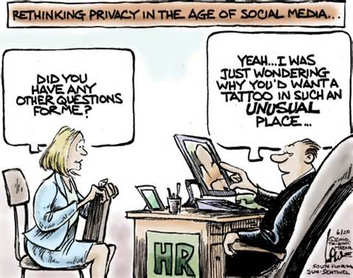
Social media Privacy Settings live demonstration

Slide 38
Additional Resources:
http://www.sdadata.org/resources.html
https://www.ncjrs.gov/internetsafety/
http://securingthehuman.sans.org/resources/newsletters/ouch/2016
http://staysafeonline.org/stay-safe-online/protect-your-personal-information/social-networks
https://www.thinkuknow.co.uk/
http://www.safekids.com/kids-rules-for-online-safety/
http://www.netsmartz.org/InternetSafety
https://www.getsafeonline.org/social-networking/social-networking-sites/
http://www.ncpc.org/topics/internet-safety/social-networking-safety
https://adventistrisk.org/prevention-resources/solutions-newsletter/june-2013/quick-tips-online-safety-for-students
https://adventistrisk.org/prevention-resources/solutions-newsletter/february-2015/4-steps-to-securing-your-social-media
http://safeonlinedate.com/the-ultimate-guide-to-online-dating-safety-stats-facts-tips/
http://www.copyright.gov/

Slide 39
Questions?
Follow @DigiEvangelism on Facebook, Twitter, and Instagram for digital marketing tips and tricks.
Visit SDAdata.org for more resources, blogs, and upcoming videos.
Email me at: jamieschneider@nadaventist.org
Notes:
I know this is a lot of information. So I wanted to allow for plenty of question and answer time. I’m also happy to live-demo anything else you want to see.
All of you will receive a copy of this presentation after the class. Feel free to email me if for some reason you do not receive a copy. For more information on how to use social media for evangelism, check me out on social media or visit our website.

