Slide 1
Washington Conference
Case Study: The Application of Smart Data for Religious Non-Profit Decision Making
A three-part presentation by Heidi Baumgartner (client), Harvey Alferez (data scientist), and Paul Hopkins (facilitator) with a Q&A Session facilitated by Jamie Domm (coach)
NAD Adventist Ministries Convention | Albuquerque, New Mexico | January 2019

Slide 2
THE BEGINNING
We like what you are doing with social media, and we want to help take you to the next level.
Notes:
It all started with a conversation that could be summarized as: “We like what you are doing with social media, and want to help take you to the next level.”
Hello—I’m Heidi Baumgartner, communication director for Washington Conference. I wish I could be with you in person at the Adventist Ministries Convention. Right now, I am expanding my responsibilities as a “mommy.”
Today, I’d like to give you a highlights tour about what Washington Conference is learning with social media and big data as it relates to decision making. Harvey and Paul will be adding more context and data science background in their presentations.
I have colleagues in the room who can answer any questions you may have for the Q&A session at the end of this presentation.
I remember when the North American Division approached Washington Conference in late 2016 about a potential social media and big data partnership. Dan Weber, Paul Hopkins, and Jamie Schneider Domm came in person to pitch the idea to our Executive Committee team.

Slide 3
THE WHY
We wanted to go beyond “we’ve always done it this way” to make better organizational decisions.
Notes:
THE WHY: We joined this partnership because we wanted to move beyond gut reactions and traditions of “we’ve always done it this way” to seek greater effectiveness in ministry. Institutionally, our church as a whole has a history of making decisions based on mental shortcuts and anchoring biases.
So here is our thesis: Intuition-based decision making has its place, but with the availability of tools, that shouldn't be the primary option. Better decisions at our organization require quantitative and qualitative information, weighted with the traditions and experiences we know.
.

Slide 4
THE INITIAL CHALLENGES Understanding Big Data
Digital Cookie Crumbs
Patterns
Trends
Associations
Big Data + Decisions
Individual Information → Force Multiplier
Community Survey → Big Data
Historical View → Forward-Looking View
Tradition or Gut-Feeling Decisions → Data-Driven Decisions
Pages of Documentation → One-Page Summary of Findings
Notes:
THE INITIAL CHALLENGES: One of our first tasks was to demystify the concept of “big data” for our executive team.
Big data allows you to find and analyze digital cookie crumbs for patterns, trends, and associations related to human behavior. Instead of finding out information from one person, let’s say, in a survey, we are using data as a force multiplier to look at results from a multitude of people and their cookie crumbs of preferences. This data can be obtained through primary or secondary research to help us move beyond a historical view to a forward-looking view.

Slide 5
Growth Areas & Data to Examine
School Enrollment
Reconnecting with Members
Young Adult Engagement
CULTURAL SHIFT: Big Data Decision Making
Church Growth
Church Planting
Notes:
There wasn’t particularly any resistance in the adoption process—mostly curiosity. Our executives needed to understand how data could be used and applied in our ministry context. This partnership would represent a cultural shift for us.
We sat down as a team for a roundtable discussion about our top 5 desired growth areas. We identified these as: school enrollment, church growth, church planting, reconnecting with members, and young adult engagement. But really there is a sixth area: applying big data to church, school, and ministry growth.
Defining these key growth areas is helping us focus our ministry efforts, cultivate innovation, look for solutions, and have better overall strategic planning. For example, we brought these growth areas to the table to help focus the conversation at a local church-sponsored Hackathon where we talked about accelerating ministry through technology.

Slide 6
Auditing Process
Audience Reach?
Effective Strategy?
Time, Money & People Investment?
Gaps?
Growth Dreams?
Mission Connection?
Notes:
THE AUDIT: In the beginning, the NAD initially helped us audit our current social activities and identified areas of growth. This was a humbling and eye-opening experience that served as a wake-up call that we had fallen into a reactive trap versus taking proactive steps forward.
All our social media handles were different, for example. We did not have a strong content plan. We had an interested but not overly engaged audience. Our social posts were present but not particularly consistent or frequent. And then there was the challenge of time and how to integrate more social activities into an already full work load. We definitely had room to grow!
Additionally, we looked at our traditional methods of conference communication and identified our audience reach, time investment, mission connection, budget expenses, personnel requirements and growth dreams. Some activities we retired, scaled back or grew as a result.
Jamie Domm started weekly coaching sessions with me, answered my questions, and provided insight, encouragement and training along the way. This was a positive experience and interaction. After the first year or so, our coaching sessions went to an “as needed” status.

Slide 7
Our #PewView Start
Adopted a hashtag
Gives voice to ministry leaders
455+ #pewview posts since 2017 and most are from Washington Conference
Notes:
This is one example of how we are using data in social media.
I previously had no love for hashtags, and decided to create a hashtag library to make my life easier. You may find and adapt the full hashtag library that is available at sdadata.org.
We stumbled upon a little used hashtag that is now giving our ministry leaders a voice each week.
#PewView are Sabbath morning reports from conference leaders who are at a local church. They text or email the photos and captions to me. I format, schedule and share the images every one or two hours on Sabbath afternoon between 1 and 9 pm—the timeframe when we now know our audience is most likely to be online.

Slide 8
Quick Hashtag Library
Friendly hashtags
#HappySabbath
Audience hashtags
#waadventists
#nwadventists
#nadadventists
#Adventists
#adventistas
Conference hashtags
#washconf
#washingtonacts
#wacampmeeting
Ministry hashtags
#waeducation
#waevangelism
#wayouth
Full Hashtag Library
www.sdadata.org/resources
Notes:
Our hashtag library is much simpler now, and includes friendly greetings, audience identification, conference connection, and ministry hashtags.
We started cultivating our content to be friendly, fresh, and approachable so we could nurture stronger human-to-human connections.
Sabbath is our busiest day on social media with the best reach of the week! We share similar content on Facebook and Instagram, and format it appropriately for each platform (namely, only one or two hashtags on Facebook, maybe, and between 5-11 hashtags on Instagram).
So far, we haven’t integrated Twitter into our strategy as this audience is mostly international for us.

Slide 9
Audience Growth
E-News
E-Marketing
5,506 subscribers
Baseline for growth
10 years of cultivation
Integrated eAdventist data
Compared with TowerData
1,043 subscribers
1,000
5,500
20% Growth!
Notes:
Meanwhile, we began building our email list with member emails that we already had available in eAdventist.net and compared our email data to information from TowerData.
When we first started, Washington Conference had about 1,000 e-news subscribers that had been cultivated over 10 years. Our list now has 5,500 email contacts. As a reference point, we have 23,000 members in about 8,800 households. That represents about 24% of our membership which is a huge 20% improvement over previously reaching 4% of our membership.
We also had good growth in our social media audience and began looking at public data associated with our ministry territory. Harvey will talk about this more in his presentation.

Slide 10
There is so much buzz around big data.
We all need to know what it is and how it works.
But what will set you apart from the rest is actually knowing how to use big data to get solid, real-world business results – and putting that in place to improve performance.
Notes:
THE IMPLEMENTATION OF DATA: With a solid social media presence in place in about a year’s time, we started diving more into smart data. We wanted to learn how we could make data-driven decisions.
Bernard Marr’s book on smart data and Steve MacLaughlin’s book on Data Driven Nonprofits were quite helpful in showing us how data could be used by nonprofit organizations. Many of the business concepts associated with big data can be filtered to apply to a religious non-profit. Non-profits ARE using big data mainly for fundraising purposes—whereas in the church structure our funding primarily comes through tithe and offerings. The applications are slightly different.
Bernard Marr’s book Big Data: Using Smart Big Data Analytics and Metrics to Make Better Decision and Improve Performance (2015)

Slide 11
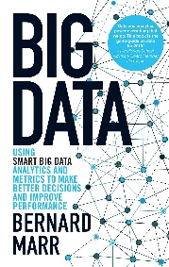
Reality Check
Most businesses are Data Rich and Insight Poor
Small is beautiful in a big data world
Aim to build the smallest, most straightforward database in the world.
Really successful companies today are making decisions based on facts and data-driven insights, not opinions, gut feeling or even experience. Bernard Marr | p. 19, 27, 46
Notes:
We needed to see how data applied to ministry. I like Marr’s reality check: most businesses are data rich and insight poor. This gave us as a religious nonprofit hope! We have lots of data available to us, and we have the potential to tap into greater insights from this data.
Additionally, “small is beautiful.” We don’t need to consider every possible data point we have as an organization. We need to determine the right data points to analyze. For some scenarios, this may mean different or common data points.
The most reassuring advice I found is to “aim to build the smallest, most straightforward database in the world.”
Marr says: “Really successful companies today are making decisions based on facts and data-driven insights, not opinions, gut feeling or even experience.” This sounds just like our thesis!

Slide 12
General Learning Process
Identify Problem / Scenario
Determine Available or Needed Data
Clean Data (Scrub for Personal Info)
Select Learning Model
Analyze Trends
Integrate Results into Decision Making
Participate in Question Storming
Data Analytics involves asking the right questions. The 55 minutes to ask the right question are as important as the 5 minutes to solve it. – Andy LaMora, Topcoder
Notes:
THE LEARNING PROCESS: In addition to taking a software class for visualizing data in Tableau, our team also attended a big data innovation summit in July 2018. We felt like little fish in a big sea! We were completely overwhelmed by all the possibilities and tried to understand how big data could apply to us. The data scientists and analysts in the room were excited to see a church represented there. They were very kind and encouraging!
Many of the presenters shared their company’s learning and discovery process. They all had similar but different qualities. In general, the process looked like this [see graph].
Identify Problem / Scenario
Participate in Question Storming
Determine Available or Needed Data
Clean Data (Scrub for Personal Info)
Select Learning Model
Analyze Trends
Integrate Results into Decision Making
The fascinating part with this learning process was that it was never linear, but rather dynamic, always changing and adapting. Every business had growing and discovery pains. The formulas would often look good on paper, and then fall apart in real life. This gave our team encouragement that we didn’t have to have the perfect process, just a willingness to grow through the process.
Andy LaMora shared an important insight during the summit: The 55 minutes to ask the right question are as important as the 5 minutes to solve it. Another expert talked about taking four minutes to “question storm” and write down every possible data question to ask.

Slide 13
Small Win #1: Education Survey
Campbell Rinker fielding data results – January 2, 2019
COMPLETES | WASHINGTON | POTOMAC | TOTAL
Parents | 460 | 716 | 1,176
Members | 267 | 463 | 730
Prospects | In Progress | In Progress | In Progress
TOTAL | 727 | 1,179 | 1,906
Response Rate | 10.3% | 12.5%
Contact List | 7,044 | 9,456
Overall Open Rate | 35% | N/A
Notes:
SMALL WINS 1-3: A breakthrough moment happened at the data summit when a presenter talked about looking for “small wins.” We came back and started working in earnest on a variety of ministry data projects to start building our collection of “small wins.”
A conference-wide education perceptions survey is our biggest undertaking, and the results from this survey are currently being processed by our research partners at Campbell Rinker. In full transparency, this survey was funded by the NAD, and Potomac Conference was a fellow survey participant.
Building up our contact list and tapping into the RenWeb parent contact data allowed us to contact just over 7,000 people. We had a 10 percent response rate from parents and members, and 35 percent of recipients opened at least one of four survey related emails from us. This is a win in progress! We hope to learn from our audience’s perceptions and potentially open a new school, too, based on data analysis.

Slide 14
Small Win #2: Evangelism Social Ads
Social Ads for 10 Geo-Targeted Cities Reached Nearly 40,000!
Image Campaign
$75 Investment
5,512 Reach
Message Campaign
$150 Investment
13,486 Reach
Video Campaign
$500 Investment
17,360 Reach
Retargeting Campaign x2
$100 Investment
412 Reach (Engage)
Totals:
$875 Investment*
39,759 Reach
399 Reach (Traffic)
Holiday Wildcard
$50 Investment
2,590 Reach
Phase 5
Phase 4
Phase 3
Phase 2
Phase 1
Audience’s Top 3 Image Preferences
Email heidi.baumgartner@wc.npuc.org to request this case study!
Notes:
Our evangelism department agreed to partner with us for a social media campaign to test out a concept for SabbathQuestions.com. We used a five-phase advertising campaign to test images, messages, and two video spots. We also retargeted website traffic visitors and hosted a “wildcard” Thanksgiving-related campaign. For just under $900, we reach nearly 40,000 people in 10 geo-targeted areas of our conference territory! We have a full case study available if you would like to request this by email.

Slide 15
Social Ad Lessons Learned
Our audience has specific preferences that are different from our expectations
Our current ads appeal to an older female audience
We need to value data results over gut reactions, and test new concepts and variables. → Then BLITZ!
Social ad results should inform larger ad buys for effective investment
Our two commercial spots performed well—just with different genders!
Data collection needs common ground so you don’t lose information
Notes:
We learned six key lessons (and smaller ones, too) from this campaign:
Our audience has specific preferences that are different from our expectations
Our current ads appeal to an older female audience
We need to value data results over gut reactions, and test new concepts and variables. → Then BLITZ!
Social ad results should inform larger ad buys for effective investment
Our two commercial spots performed well—just with different genders!
Data collection needs common ground so you don’t lose information

Slide 16
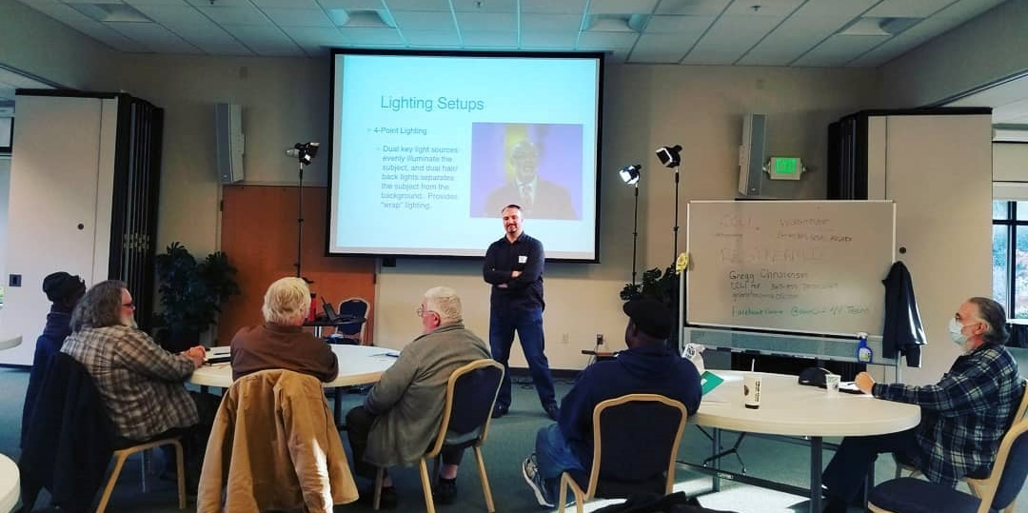
Small Win #3: Event Promotion
16 Survey Responses
30 Attended Event
40 Now on Interest List
Content Based on Audience Needs
Notes:
I also wanted to test data-driven decision making with event planning and promotion. We had a church media production trainer who was available on one of two dates in November. I sent an interest survey to a targeted email list, and received 16 responses just three weeks before the potential training date.
The participants chose the date and prioritized the suggested topics based on their interest and need. We had 30 people show up and another 10 who were interested, but unable to attend. The trainer integrated the pre-submitted audience questions into his presentation and tailored the curriculum to the audience’s needs. The whole day was interactive, and the audience was fully engaged.

Slide 17
The Future
Notes:
THE FUTURE: These experiences are becoming our “case studies.” I frequently share progress reports with my colleagues. They love seeing the on-going results especially for social media advertisements! Many of our departments are now adding a line-item to their budget for social media ads in addition to my department’s advertising budget!
Our team just concluded The Altar Project social campaign where we invited families to have worship together. Right now, we have a 40-day Marriage Revival Challenge underway. In February, we’ll have a prayer initiative associated with the book of Acts.
Our education department is developing plans for building up to a system-wide advertising campaign for registration day in 2020.
Our annual calendar now has a variety of social media campaign concepts in various stages of development so we can learn, grow, and make better ministry decisions.

Slide 18
The Mindset
Long-Term Commitment
New Way of Thinking
Improving Ministry Effectiveness
Learning Process
Cultural Shift
Questions? Email heidi.baumgartner@wc.npuc.org
Notes:
THE MINDSET: We appreciate the North American Division team coaching us in this learning process because we understand this is a long-term commitment. It represents a new way of thinking and a cultural shift to help us overall improve ministry effectiveness. Yes, we’ve had our hiccups. We are finding great value in learning how to take our social media and big data to the next level. My workflow, that I was so worried about, is much more purposeful and manageable now.
When my administrators and colleagues are sitting in meetings now and hearing ministry plans, they are often asking, “Where’s the data?” The lightbulb moments are amazing to witness!
Whether the survey is simple or complex, whether the social media campaign lasts for a week or multiple weeks, whether we are spending 5 dollars, 50 dollars or 500 dollars in advertising, we are learning how to make smart data-driven decisions based on our audience’s interests. This is helping us improve the effectiveness of our reach, our ministries, and our mission.
Our growth doesn’t stop here! And you and your ministry can grow, too, as you learn to apply data to your organization. It is worth the time, effort, and commitment to make data part of your ministry strategy as we seek to grow God’s kingdom and prepare for His soon return.

